Slide 1
ECE 340 Lectures 12-15 Optical Absorption; Recombination; Quasi-Fermi levels
Today we turn the light ON semiconductors
Before we do, recall that with the lights OFF, the number of “free” carriers in a sample are just given by:
1) Thermal generation:
2) Charge neutrality:
[two equations with two unknowns;
a little nicer when N_{D} >> N_{A} or N_{A} >> N_{D}]
When we turn light on, we can generate electron-hole pairs (EHPs), depending on the light frequency (energy)

Slide 2
What is the condition for light absorption?
Plot intensity of transmitted light vs. incident photon energy:
Assume ħω > E_{G} and sample of thickness L
The intensity of transmitted photons is:
Where α =

Slide 3
Plot the absorption coefficient vs. photon energy:
Keep in mind some of the material band gaps:
Once again, semiconductors absorb photons much more efficiently at energies greater than the band gap (ħω > E_{G})

Slide 4
Light absorbed created excess EHPs
(excess with respect to what?)
How long do excess EHPs “live” before they recombine?
Direct EHP recombination occurs spontaneously, emitting a photon of energy _____________
Excess carrier notation:
δn(t) = δp(t) instantaneous excess EHPs at time t
Δn = δn(t=0) initial excess EHPs at time t = 0, right after initial excitation (e.g. light flash)

Slide 5
How do excess EHPs decay?
Assume n-type sample (n₀ >> p₀) so holes are in minority
Will majority carriers (electrons) be disturbed much?
What about minority carriers (holes)?
Excess minority carriers will recombine with already existing majority electrons:
Solution is a simple exponential:
Where the recombination lifetime for excess EHPs is τ
Typical EHP recombination in Si are τ_{Si} ~
Direct recombination → δn decay at same rate as δp

Slide 6
Ex: p-doped GaAs sample with 10¹⁵ cm⁻³ acceptors. Flash light (on/off) to initially produce Δn = Δp = 10¹⁴ EHPs/cm³ at t=0. Recombination lifetime τ = 10 ns. How do p(t) and n(t) evolve with time?

Slide 7
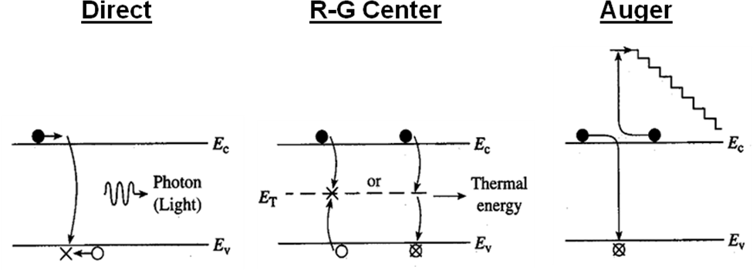
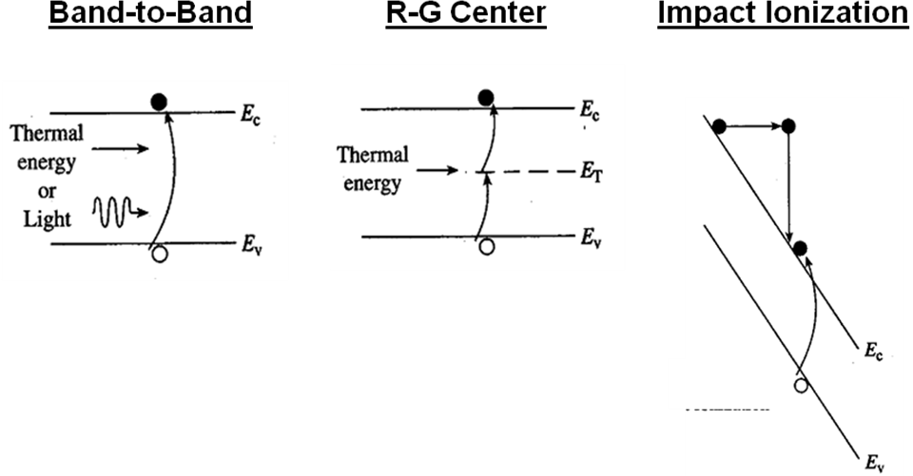
Recombination processes (more generally):
Generation processes:

Slide 8
Revisit some definitions:
Thermal equilibrium: generation = recombination
Steady-state: all time derivatives (∂/∂t) = 0
Ex: A sample of Si doped with N_{A} = 10¹⁶ cm⁻³, with recombination lifetime τ = 1 μs. It is exposed continuously to light, such that electron-hole pairs are generated throughout the sample at the rate of 10²⁰ per cm³ per second, i.e. the generation rate g_{op} = 10²⁰/cm³/s.
a) What are equilibrium n₀ and p₀ (before light is on)?
b) How many extra δn and δp are there with light on?

Slide 9
c) What are total carrier concentrations with light on?
d) What is the n∙p product?

Slide 10
Note: so far, Fermi level (E_{F}) has only been defined in thermal equilibrium, giving us n and p like:
Q: What does Fermi level look like when we have excess carriers (from light) and hence non-equilibrium?
A:
But we like similar (easy) equations so we define quasi-Fermi levels F_{n} and F_{p}:

Slide 11
Ex: Calculate and draw quasi-Fermi levels from the previous example.

Slide 12
Last but not least. We have all these excess carriers with the lights ON. Does the conductivity (resistivity) change?
Remember: σ = q(μ_{n}n₀ + μ_{p}p₀)
Often before, with lights off, we could neglect the minority carriers if the sample was doped n- or p-type
But with lights ON, we have extra carriers δn and δp such that n and p are affected:
Photoconductivity = change in conductivity due to excess carriers (EHPs) from lights being turned on:

