Slide 1
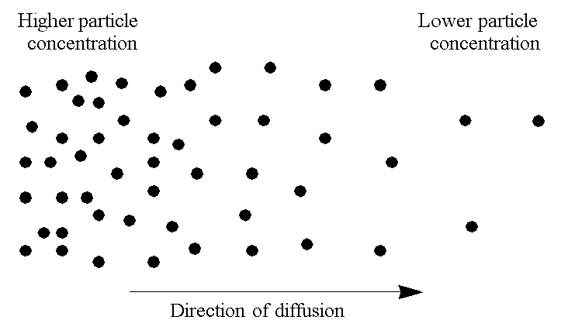
ECE 340 Lectures 16-18 Diffusion of carriers
Remember Brownian motion of electrons & holes!
When E-field = 0, but T > 0, thermal velocity v_{T} = ______
But net drift velocity v_{d} = __________
So net current J_{d} = _________ = __________
What if there is
a concentration or
thermal velocity
gradient?

Slide 2
Is there a net flux of particles? Is there a net current?
Examples of diffusion:
___________
___________
___________
One-dimensional diffusion example:

Slide 3
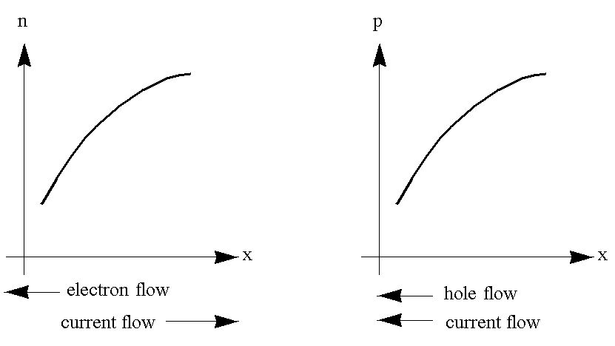
How would you set up diffusion in a semiconductor? You need something to drive it out of equilibrium.
What drives the
net diffusion current?
The concentration
gradients! (no n or p
gradient, no net current)

Slide 4
Mathematically:
J_{N,diff} =
J_{P,diff} =
Where D_{N} and D_{P} are the diffusion coefficients or diffusivity
Now, we can FINALLY write down the TOTAL currents…
For electrons:
For holes:
And TOTAL current:

Slide 5
Interesting point: minority carriers contribute little to drift current (usually, too few of them!), BUT if their gradient is high enough…
Under equilibrium, open-circuit conditions, the total current must always be =
I.e. J_{drift} = - J_{diffusion}
More mathematically, for electrons:
So any disturbance (e.g. light, doping gradient, thermal gradient) which may set up a carrier concentration gradient, will also internally set up a built-in __________________

Slide 6
What is the relationship between mobility and diffusivity?
Consider this band diagram:
Going back to drift + diffusion = 0 in equilibrium:

Slide 7
Leads us to the Einstein Relationship:
This is very, very important because it connects diffusivity with mobility, which we already know how to look up. Plus, it rhymes in many languages so it’s easy to remember.
The Einstein Relationship (almost) always holds true.

Slide 8
Ex: The hole density in an n-type silicon wafer (N_{D} = 10¹⁷ cm⁻³) decreases linearly from 10¹⁴ cm⁻³ to 10¹³ cm⁻³ between x = 0 and x = 1 μm (why?). Calculate the hole diffusion current.

Slide 9
Let’s recap the simple diffusion lessons so far:
Diffusion without recombination (driven by dn/dx)
Einstein relationship (D/μ = kT/q)
kT/q at room temperature ~ 0.026 V (this is worth memorizing, but be careful at temperatures different from 300 K)
Mobility μ look up in tables, then get diffusivity (be careful with total background doping concentration, N_{A}+N_{D})
Next we examine:
Diffusion with recombination
The diffusion length (distance until they recombine)

Slide 10
Assume holes (p) are minority carriers
Consider simple volume element where we have both generation, recombination, and holes passing through due to a concentration gradient (dp/dx)
Simple “bean counting”
in the little volume
Rate of “bean” or “bubble” population increase = (current IN – current OUT) – bean recombination

Slide 11
Note, this technique is very powerful (and often used) in any Finite Element (FE) computational or mathematical model.
So let’s count “beans” (“bubbles”):
Recombination rate = # excess bubbles (δp) / recombination time (τ)
Current (#bubbles) IN – Current (#bubbles) OUT = J_{IN} – J_{OUT} / dx
Note units (VERY important check):
Bubble current is bubbles/cm²/s, but bubble rate of change (G&R) is bubbles/cm³/s
So, must account for width (dx ~ cm) of volume slice
Why does the first equality hold? (simple, boring math…)

Slide 12
Why is there a (diffusion) current derivative divided by q?
Of course, e.g. for holes:
so,
So the diffusion equation (which is just a special case of the continuity equation above) becomes:
This allows us to solve for the minority carrier concentrations in space and time (here, holes)

Slide 13
Note, this is applicable only to minority carriers, whose net motion is entirely dominated by diffusion (gradients)
What does this mean in steady-state?
The diffusion equation in steady-state:
Interesting: this is what a lot of other diffusion problems look like in steady-state. Other examples?
The diffusion length L_{p} = _________ is a figure of merit.

Slide 14
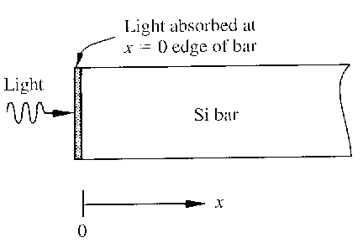
Consider an example under steady-state illumination:
Solve diffusion equation: δp(x) = Δp e^{-x/Lp}

Slide 15
Plot:
Physically, the diffusion lengths (L_{p} and L_{n}) are the average distance that minority carriers can diffuse into a sea of majority carriers before being annihilated (recombining).
What devices is this useful in?! (peek ahead)

Slide 16
Ex: A) Calculate minority carrier diffusion length in silicon with N_{D} = 10¹⁶ cm⁻³ and τ_{p} = 1 μs. B) Assuming 10¹⁵ cm⁻³ excess holes photogenerated at the surface, what is the diffusion current at 1 μm depth?

