Slide 1
ECE 340 Lectures 19-20 P-N diode in equilibrium
So far we studied:
Energy bands, doping, Fermi levels
Drift (~n*v), diffusion (~dn/dx)
Einstein relationship (D/μ = kT/q)
“Boring” semiconductor resistors (either n- or p-type)
Majority/minority carriers with illumination
Today we start our first “useful” device:
The p-n junction diode in equilibrium (external V=0, lights off)
Remember, in equilibrium Fermi levels must be flat

Slide 2
How is the p-n junction fabricated?
1) Start with, say, n-type Si wafer
2) Then dope by p-type ion (e.g. B⁻) implantation:
3) Result:

Slide 3
For more details please:
Read Streetman book section 5.1
Other books and Wikipedia
Take ECE 444!!!
Back to p-n junction.
What happens if I bring a p-type and n-type piece of semiconductor together? We already have the tools to analyze this together. Draw isolated band diagrams.

Slide 4
What happens to the (huge!) electron and hole concentrations on either side of the junction, immediately after they are brought together?
What is required of the Fermi level in equilibrium (why?)
So draw the p-n band diagram in equilibrium:

Slide 5
Q: what do electrons and holes leave behind at the junction, after they recombine and equilibrium is reached?
A:
(this is called “space charge”)

Slide 6
What is required of the currents at equilibrium?
What is the built-in potential V₀?
Can you measure the built-in potential with a voltmeter?
Easy to calculate V₀ for an abrupt p-n junction:
1) First calculate E_{F} – E_{i} on each side of the junction:
2) Notice qV₀ = (E_{Fn} – E_{i}) + (E_{i} – E_{Fp})

Slide 7
Recognize that, say, on the p-side majority carrier: p_{p} = N_{A}
(n_{n} = N_{D} far into the n-side of the junction)
Using np = n_{i}² on p-side, minority carriers there n_{p} =
From the built-in voltage:
This relates the majority/minority carrier concentration on either side of the junction. Which becomes more useful next lecture(s) when we apply an external voltage.

Slide 8
Ex: (p⁺)-n junction with N_{A} = 10²⁰ cm⁻³ and N_{D} = 10¹⁵ cm⁻³. Calculate Fermi levels and built-in potential at equilibrium.

Slide 9
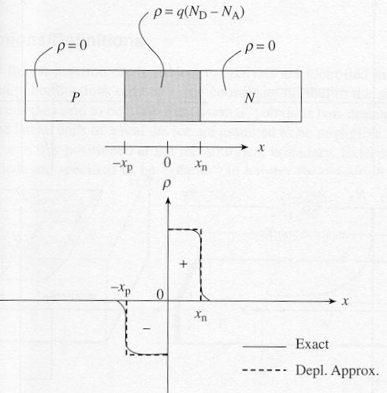
ECE 340 Lectures 21-22 Space charge in a p-n diode
So far we talked about p-n junction built-in voltage V₀.
Today, more about
electrostatics.
In the middle, where
there are huge concentration
gradients, what happens?

Slide 10
What is left in the middle after the electrons & holes there recombine and are gone?
Note: we will keep making the depletion approximation which means an ___________________ between the space charge (N_{D} – N_{A}) region and the two quasi-neutral (n and p) regions
What is the depletion region?
What is the space charge region (SCR)?
What are the quasi-neutral regions (QNR)?
If the SCR width is W = x_{p} + x_{n}, do the two (x_{p}, x_{n}) sides have to be equal? Why or why not?

Slide 11
What is the total charge on
either side of the junction:
On the p-side:
On the n-side:
OK, let’s calculate the depletion
widths x_{n} and x_{p} now

Slide 12
This isn’t too hard with the Poisson equation (Gauss’ law)
Recall:
In one dimension, in the depletion region, this is just:
On the p-side:
On the n-side:
Integrate over the space charge density on either side, and obtain the maximum field at the junction:
The field distribution is “triangular” because the charge distribution is “rectangular” (depletion approximation)

Slide 13
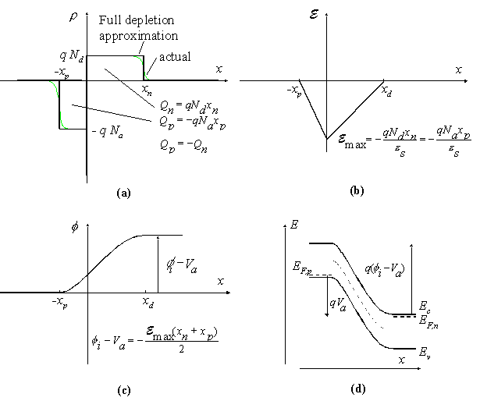
Now, the built-in potential is easy to calculate.
The voltage across the junction is just (minus) the integral over the E-field
So the built-in voltage V₀ is the area under the E-field “triangle”

Slide 14
Be careful (a bit):
Potential Energy = –q * Voltage Potential
Although if we use “eV” units for energy (so q = 1 electron) then the two are equivalent numerically (with a minus sign)
If we use “Joule” units for energy (so q = 1.6 x 10⁻¹⁹ C) then of course you need to be careful multiplying by q to convert from Volts and Joules.
Back to the built-in voltage, we
now have from electrostatics:
But earlier we obtained from
Fermi level misalignment:

Slide 15
Now we can calculate all kinds of things, like the depletion width (W), and the individual depletion regions (x_{p} and x_{n}).
What if I vary the externally applied voltage?
Remember, a positive outside voltage “grabs” the Fermi level on the side it’s applied on and drags it down. (negative pulls it up).
How do we remember this? Think of the simple resistor band diagram, which way the electric field points (external + to -) and which way the electrons “slide down” or holes “bubble up.”
A forward bias is + applied to the p-side, which lowers the built-in voltage barrier (V₀ – V_{fwd}) where V_{fwd} > 0.
A reverse bias is – applied to the p-side, which increases the built-in voltage barrier (V₀ – V_{rev}) where V_{rev} < 0.
Now draw the band diagrams (hint: Fig. 5-13 in the book)

Slide 16
Ex: An abrupt silicon p-n junction has p-side N_{A} = 10¹⁶ cm⁻³, and n-side N_{D} = 5x10¹⁶ cm⁻³. A) What is the built-in voltage. B) How wide is the depletion region with applied V = 0, 0.5 and -2.5 V. C) What is the maximum electric field, and D) the potential across the n-side for these external V’s.

