Slide 1
ECE 340: Semiconductor Electronics
Spring 2013 • Section X: MWF 12pm • Everitt 165 • Prof. Eric Pop
Three lecture/discussion meetings per week
Four sections in parallel: same syllabus, homeworks, exams
Grade = 10% HW, 15% Quiz (3x5%), 40% Midterm (2x20%), 35% Final
Midterms:
    Tuesday, Feb 26, 7-8pm (location TBA)
    Tuesday, Apr 9, 7-8pm (location TBA)
Quizzes: 3x, 10 min., unannounced, must be taken in assigned section
Homeworks, solutions, other resources on web sites:
    http://courses.ece.illinois.edu/ece340 (main)
    http://poplab.ece.illinois.edu/teaching.html (E. Pop)
Prof. Eric Pop, OH Mondays 4-5pm, MNTL 2258
Please take advantage of all instructor and TA office hours
Please read Syllabus handout

Slide 2


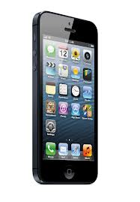

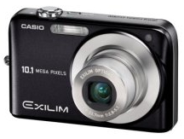
ECE 340 Lecture 1
Introduction, Some Historical Context
Questions, questions…
  1) Why “semiconductors”?
  2) Why “electronics”?
  3) Why are we here?

Slide 3

What’s at the heart of it all?
What can we get out of it?

Slide 4
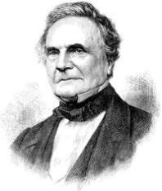
The abacus, ancient digital memory
  Information represented in digital form
  Each rod is a decimal digit (units, tens, etc.)
  A bead is a memory device, not a logic gate
An early mechanical computer
  The Babbage difference engine, 1832
  25,000 parts
Charles Babbage (Wikipedia)

Slide 5
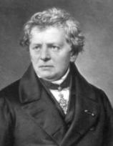
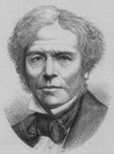
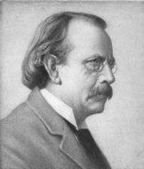
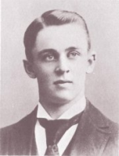
Ohm’s law: V = I x R
  Georg Ohm, 1827
Semiconductors are not metals
  Semiconductor resistance decreases with temperature
  Michael Faraday, 1834
Discovery of the electron
  J.J. Thomson, measured only charge/mass ratio, 1897
  “To the electron, may it never be of any use to anybody.” – J.J. Thomson’s favorite toast.
Measuring the electron charge: 1.6 x 10⁻¹⁹ C
  Robert Millikan, oil drops, 1909
Sources: Wikipedia, http://www.pbs.org/transistor

Slide 6
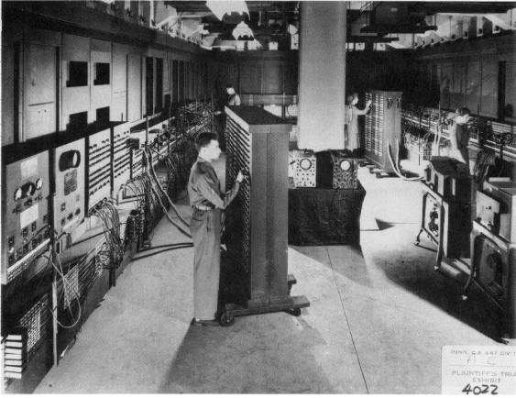

ENIAC: The first electronic computer (1946)
  30 tons, including ~20,000 vacuum tubes, relays
  Punch card inputs, ~5 kHz speed
  It failed ~every five days
Modern age begins in 1947:
  The first semiconductor transistor
  AT&T Bell Labs, Dec 1947
  J. Bardeen, W. Brattain, W. Shockley
  Germanium base, gold foil contacts
Note: ILLIAC @ UIUC
5 tons, 2800 vacuum tubes
64k memory (1952)
Note: ILLIAC II @ UIUC
Built with discrete transistors (1962)
Sources: Wikipedia, http://www.pbs.org/transistor

Slide 7
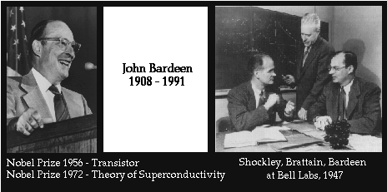
AT&T Bell Labs 1945-1951
Univ. Illinois ECE & Physics 1951-1991
The way I provided the name, was to think of what the device did. And at that time, it was supposed to be the dual of the vacuum tube. The vacuum tube had transconductance, so the transistor would have “transresistance.” And the name should fit in with the names of other devices, such as varistor and thermistor. And… I suggested the name “transistor.”
– John R. Pierce AT&T Bell Labs, 1948

Slide 8
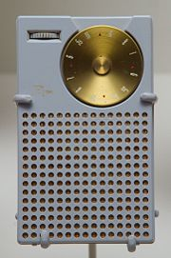
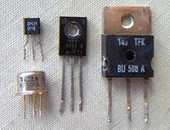
First transistor radio, the Regency TR-1 (1954)
Built with four discrete transistors
Integrated circuits fabricate all transistors and metal interconnects on the same piece of silicon substrate
  Jack Kilby UIUC BS’47, patent TI’1959
  → Nobel prize 2000
  Robert Noyce, 1961
  → co-founder of Fairchild, then Intel

Slide 9
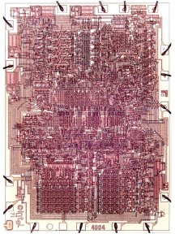
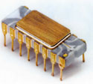
The first microprocessor, Intel 4004 (1971)
2250 transistors, 740 kHz operation
F.F. = Federico Faggin (designer)
Comparable computational power with ENIAC
Built on 2” and then 3” wafers (vs. 12” today)
10 μm line widths (vs. 28-45 nm today), 4-bit bus width
Used in… the Busicom Calculator:
See http://www.intel4004.com
Followed by 8008 (8-bit), 8080, 8086
Then 80286, 80386, 80486 = i486 (1989, 0.8 μm lines)
Pentium, II, III, Itanium, IV, Celeron, Core 2 Duo, Atom…

Slide 10
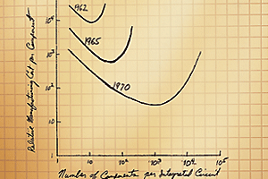
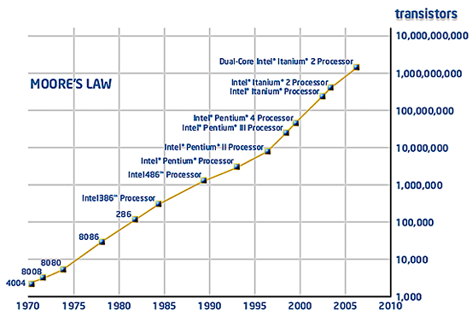
Gordon Moore’s “Law”
~ doubling circuit density every 1.5-2 years
1965
Source: http://www.intel.com

Slide 11
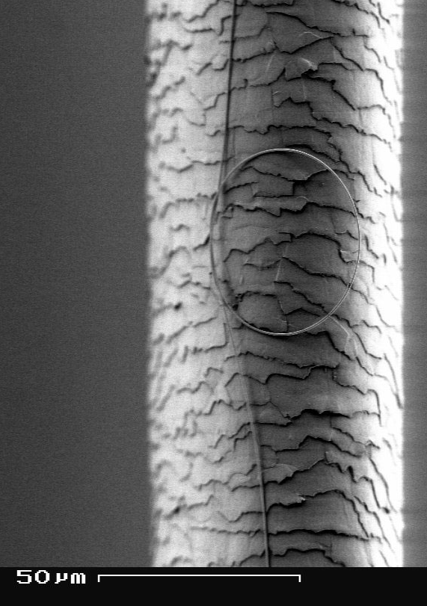
Transistor size scaling:
Sources: NSF, Intel
“65 nm” technology
Influenza virus

Slide 12
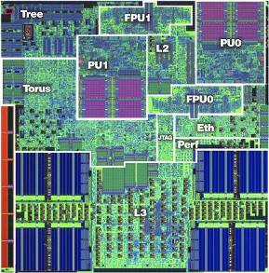
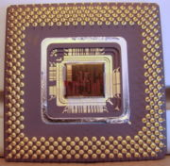
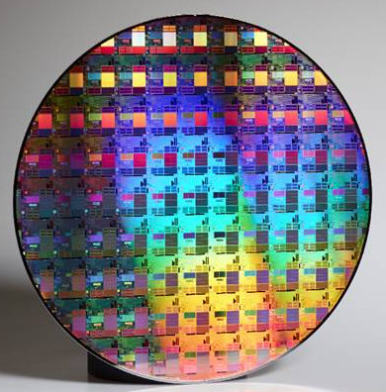
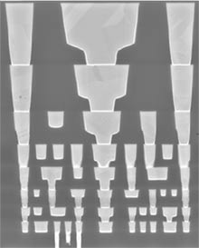
Take the cover off a microprocessor.
Packaged die
Cross-section
Single transistor
Full wafer (100s of dies)
modern wafers: 200-300 mm diameter (8-12 inches)

Slide 13
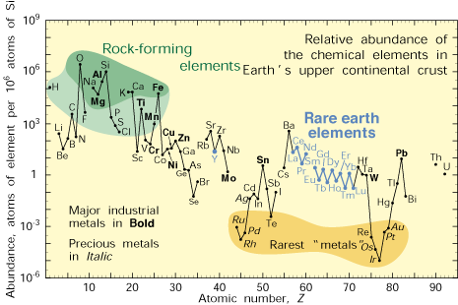
Why semiconductors?
  vs. conductors or insulators
  Elemental vs. compound
Why (usually) crystalline?
Why silicon?

Slide 14
Why the (CMOS) transistor?
  Transistor = switch
  Technology is very scalable (Moore’s Law)
  CMOS = complementary metal-oxide-semiconductor
  Fabrication is reproducible on extremely large scales
  Circuit engineering
  Design abstractions

Slide 15
What do we learn in ECE 340? (and later in ECE 441)
Physics
Processing
  Zone refining
  Epitaxial growth
Photolithography
Resist (positive/negative)
Encapsulation (CVD, sputtering)
Ion etching
Ion implantation and diffusion
Materials
  Fundamental properties
  Crystal structure
Charge carriers
Energy bands
Optical absorption (direct/indirect)
Electrical properties (drift/diffusion)
Mobility and diffusion
Devices
  P-N diode
  Schottky barrier
Bipolar junction transistor
Metal-oxide-semiconductor field-effect transistor (MOSFET)
Solar cells
Photodiodes
(ECE 444)
ECE 340 ECE 441
One shouldn’t work on semiconductors, that is a filthy mess; who knows if they really exist!
Wolfgang Pauli, 1931 (Nobel Prize, Physics, 1945)
Circuits (ECE 442)

