Slide 1
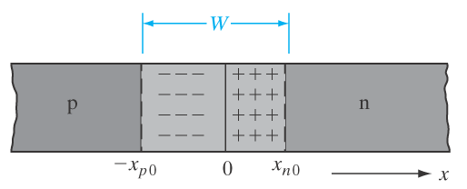
ECE 340 Lecture 23
Current Flow in P-N diode
Last time, we talked about unbiased P-N junction.
Today, biased (V_{ext} ≠ 0) P-N junction and current flow.
Draw equilibrium (V = 0) bands:
Recall built-in voltage and depletion width:

Slide 2
Qualitative band diagrams with applied voltage:
Current flow in equilibrium (V = 0):

Slide 3
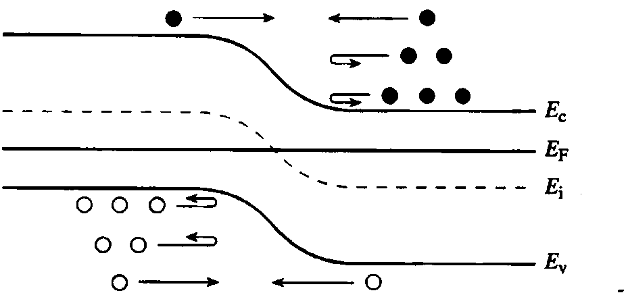
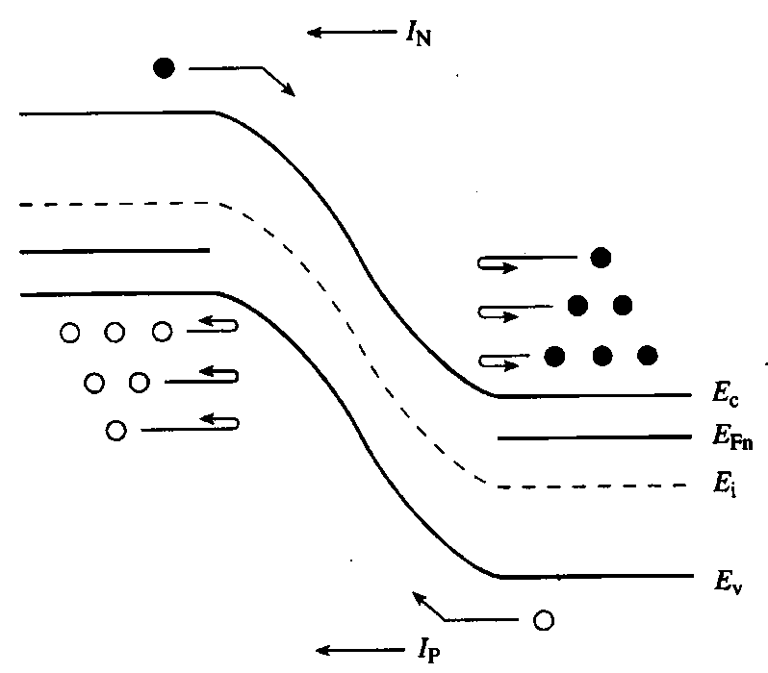
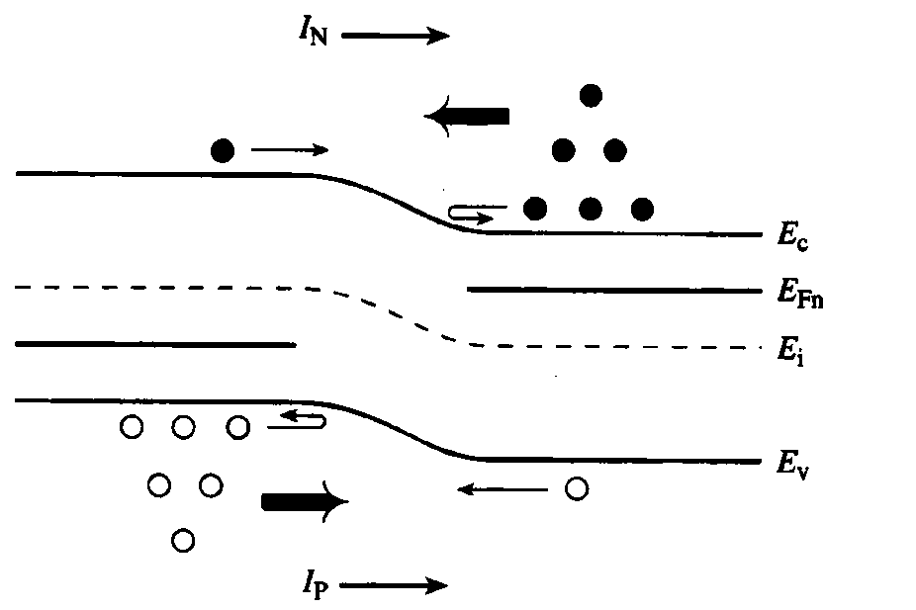
Qualitative current flow:

Slide 4
Qualitatively expect I-V curve to be:
In forward bias, inside space charge region (SCR):
Where V is the applied bias and ___________________

Slide 5
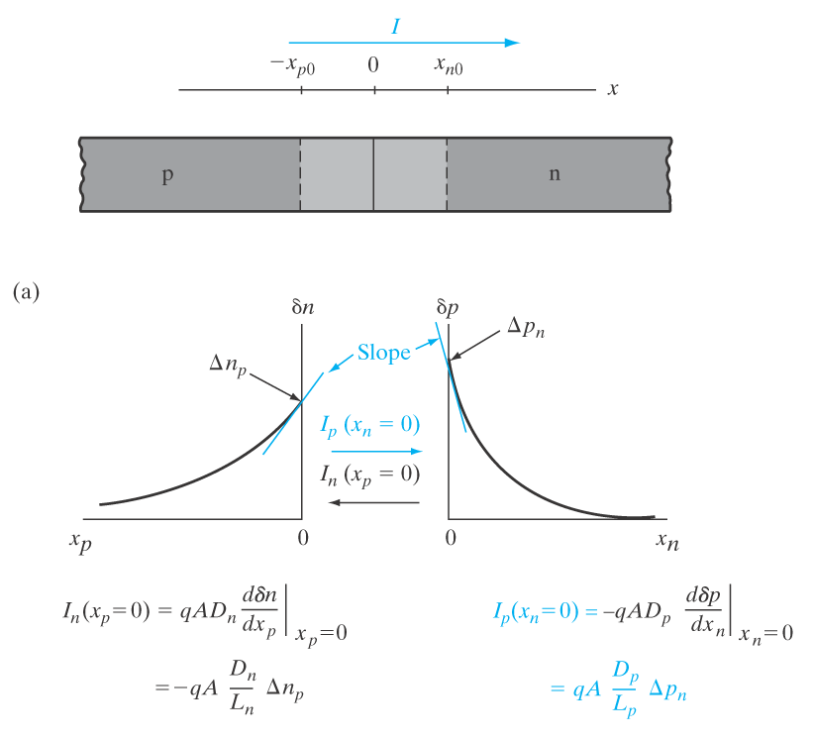
Let’s look at the injected minority carriers:
On the n-side, injected holes.
Just at the edge of n-side depletion region:

Slide 6
Excess injected holes diffuse into the n-side:
(same is true of excess injected electrons on p-side).
Injected hole diffusion current:
Where equilibrium hole concentration p_{n0} =
(and similar for injected electron diffusion on p-side, just replace subscripts p with n)
Hole diffusion current proportional to excess hole concentration at any distance x into the n-type region.
Due to hole current continuity, we can evaluate at x=x_{n0}=0

Slide 7
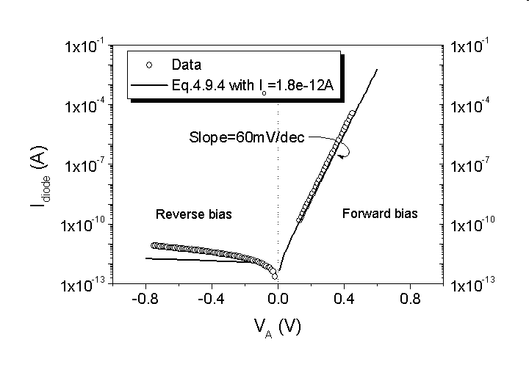
We can also write diffusion current for electrons in p-side:
Now total current

Slide 8
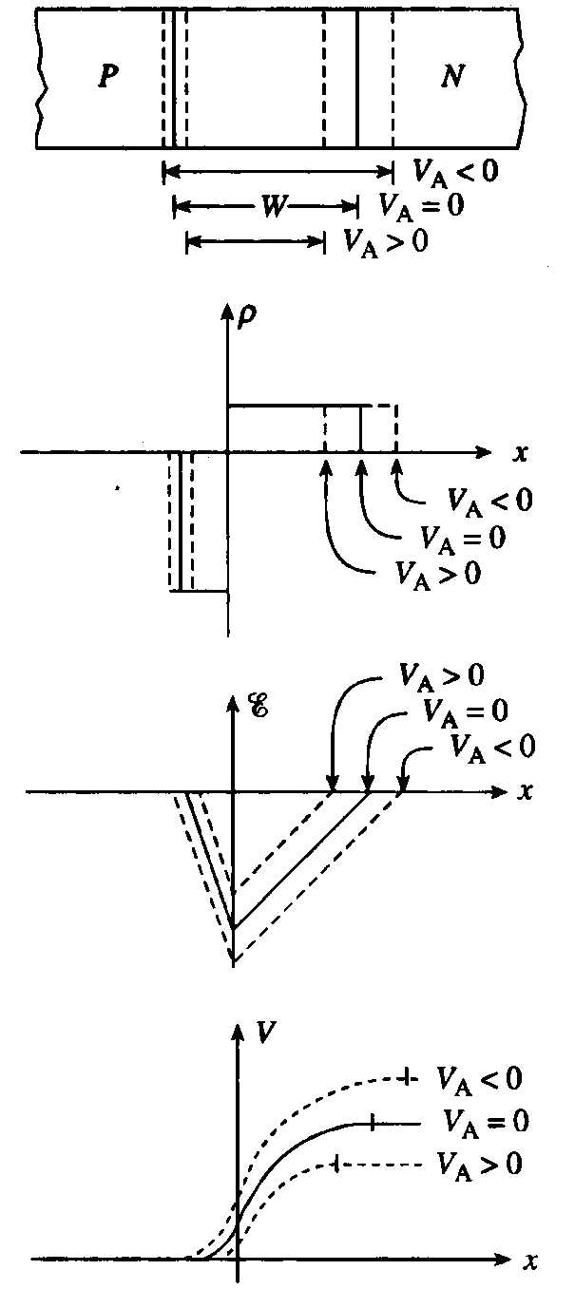
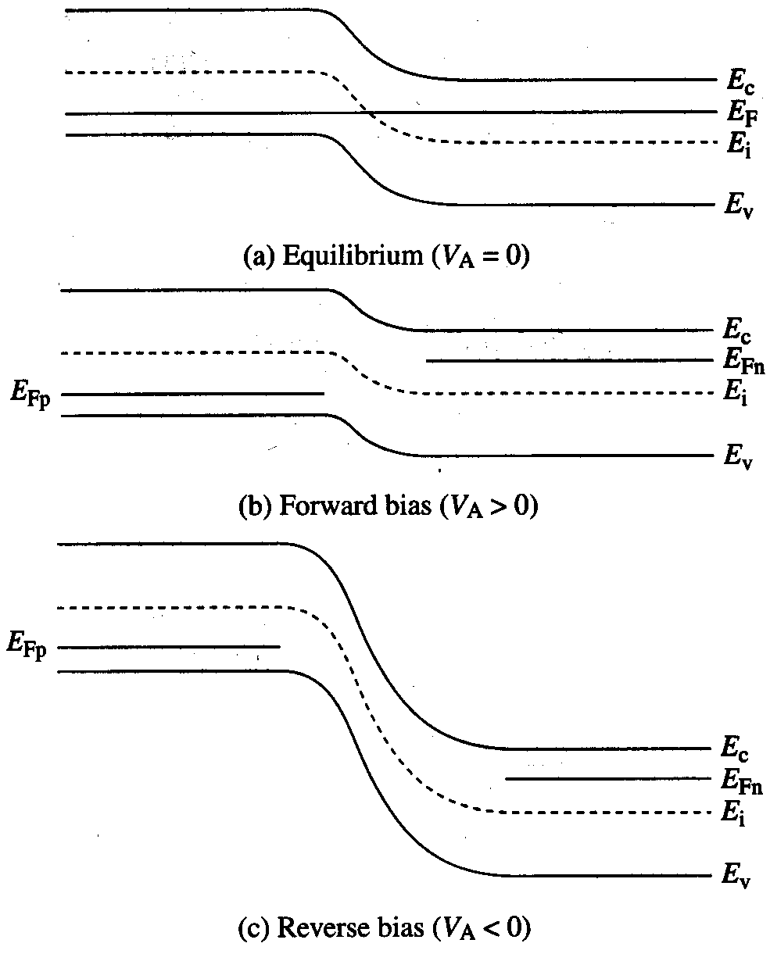
ECE 340 Lectures 24-26
P-N diode carrier injection; reverse bias & breakdown
Recap diode bias diagrams:
equilibrium
forward bias (V > 0)
reverse bias (V < 0)

Slide 9
Recap some of the equations:
  Depletion width
  (decreases at forward bias, increases at reverse bias)
  Maximum electric field
  (decreases at forward bias, increases at reverse bias)
  Built-in voltage
  Charge stored

Slide 10
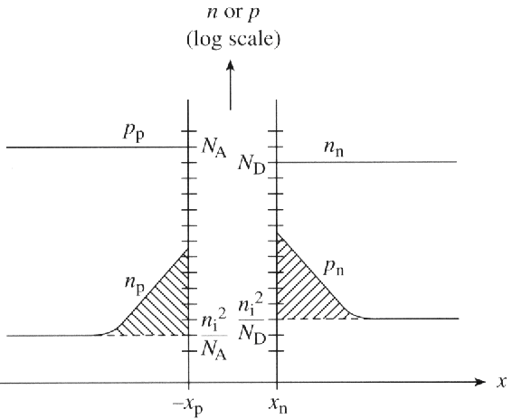
  Current density (current I = J∙A)
  What about an asymmetrically doped junction? Say, p side much more heavily doped (N_{A} >> N_{D}):
Remember, current is due to minority carrier injection
Typically p-n junctions in real life are made by counterdoping. E.g. start with p-type wafer and dope with N_{D} only at the surface to obtain junction. Eqs. so far readily apply if
  N_{A} = net doping on p-side = (N_{A} – N_{D})_{p-side}
  N_{D} = net doping on n-side = (N_{D} – N_{A})_{n-side}

Slide 11
Ex: a p-n junction has N_{A}=10¹⁹ cm⁻³ and N_{D}=10¹⁶ cm⁻³. The applied voltage is 0.6 V. a) What are the minority carrier concentrations at the edges of the depletion region? b) What are the excess minority carrier concentrations? c) Sketch δn(x) on the p-side if recombination lifetime is 2 μs.

Slide 12
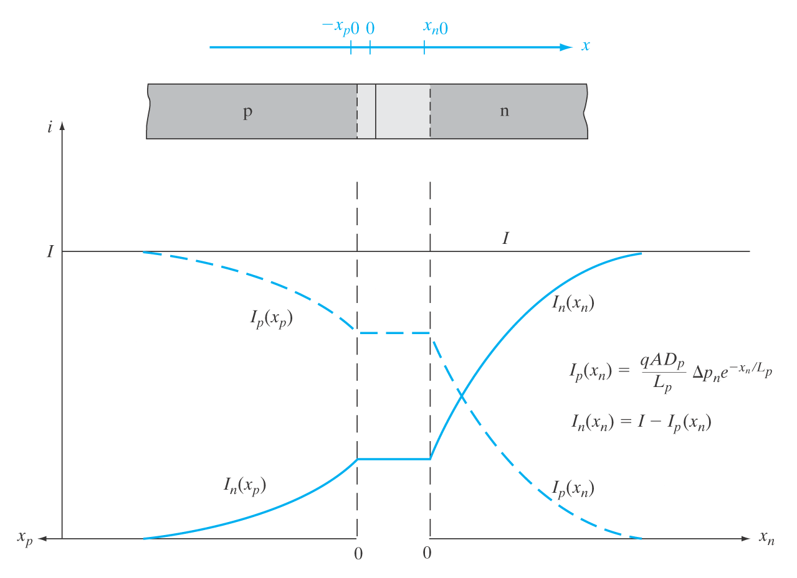
Current continuity along junction length, J_{TOT} = const.
As carriers recombine (deep into n- or p-side) the diffusion current is replaced by _____________
But, we were able to deduce current equation by simple diffusion arguments at the _________________ where the E-field was just barely zero.

Slide 13
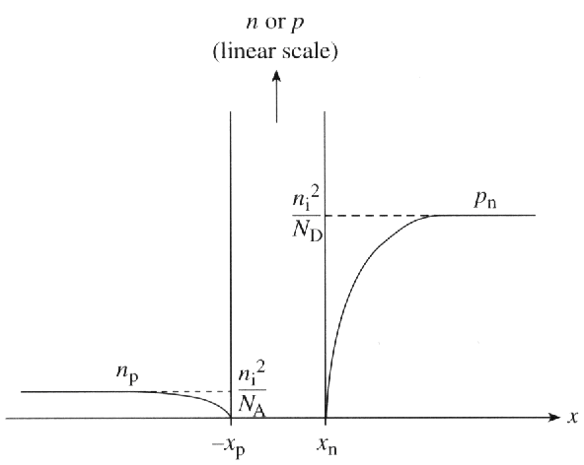
Reverse bias:
  Depletion region widens
  E-field across depletion region _________________
  Current is due only to minority carrier ______________ across the junction
  Current is supplied by EHP generation in the __________________ (what if I change the temperature or turn on the light?)
  Recall, J₀ =

Slide 14
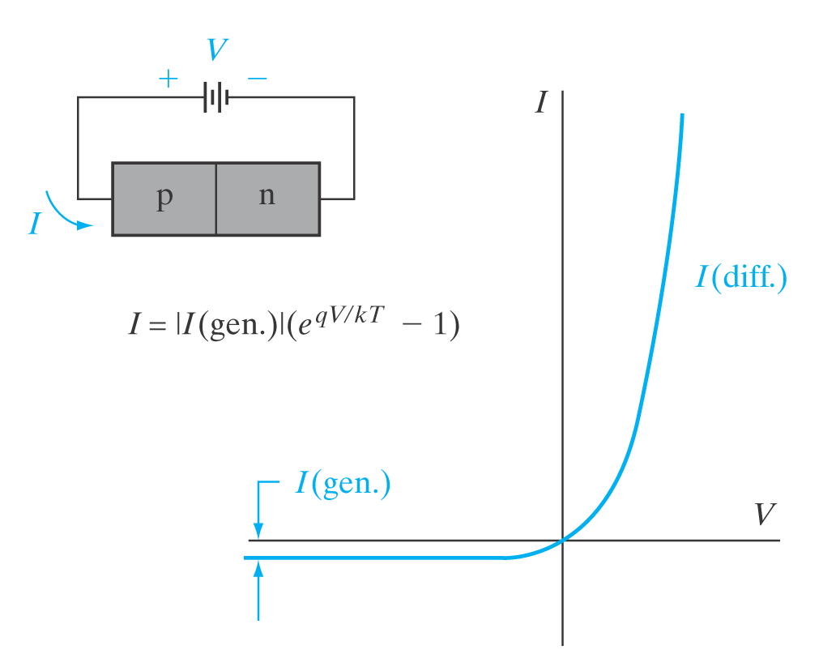
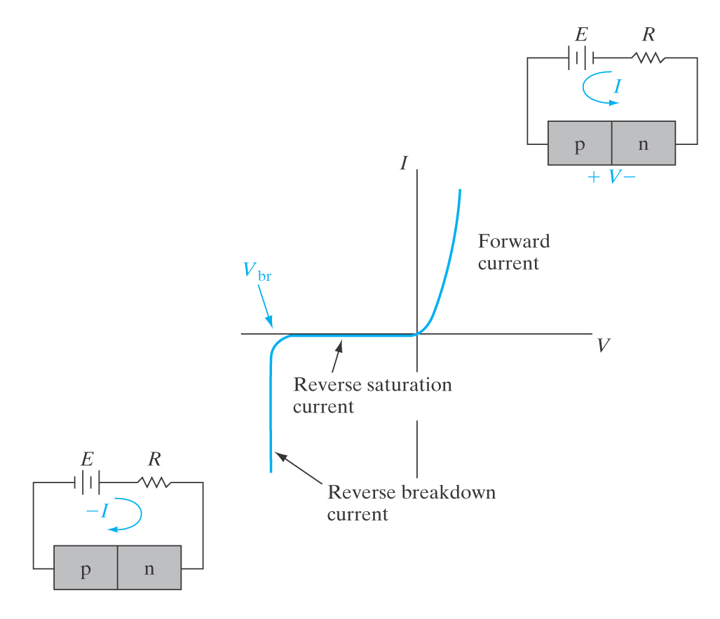
Junction breakdown when E-field exceeds a critical value. If current continues increasing, then diode ______________ .

Slide 15
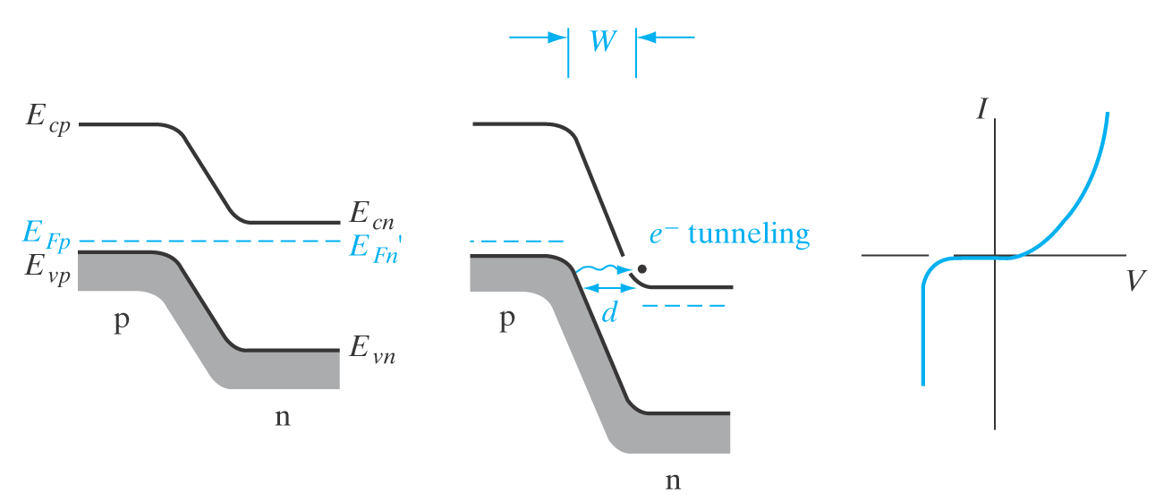
P-N junction breakdown (3 types)
1) Zener breakdown:
  Dominant for heavily doped (>10¹⁸ cm⁻³) p⁺n⁺ diodes
  Breakdown at a few Volts (typically < 5 V)
  Electron tunneling from filled valence states on p-side into (mostly) empty conduction band states on n-side

Slide 16
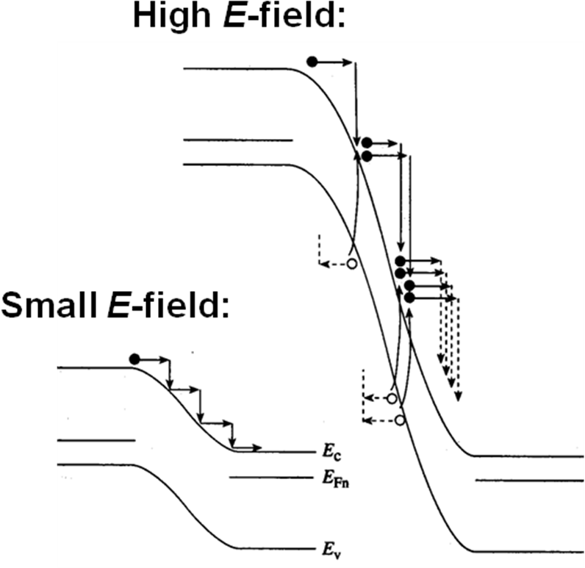
2) Avalanche breakdown
  More lightly doped junctions (<10¹⁷ cm⁻³)
  Wider depletion region, electrons accelerated across it gain enough energy to create additional EHPs
  Impact ionization and carrier multiplication

Slide 17
Empirical observation of V_{BR} with doping and material
  V_{BR} decreases with increasing N (=N_{A} or N_{D})
  V_{BR} decreases with decreasing E_{G}
Breakdown dependence on temperature:
  For tunneling (Zener) breakdown…
  For avalanche breakdown…

Slide 18
3) Punchthrough breakdown:
  Occurs when either depletion region “punches through” the entire length of the diode, e.g. x_{n}(V) = L_{n}
L_{n}

