Slide 1
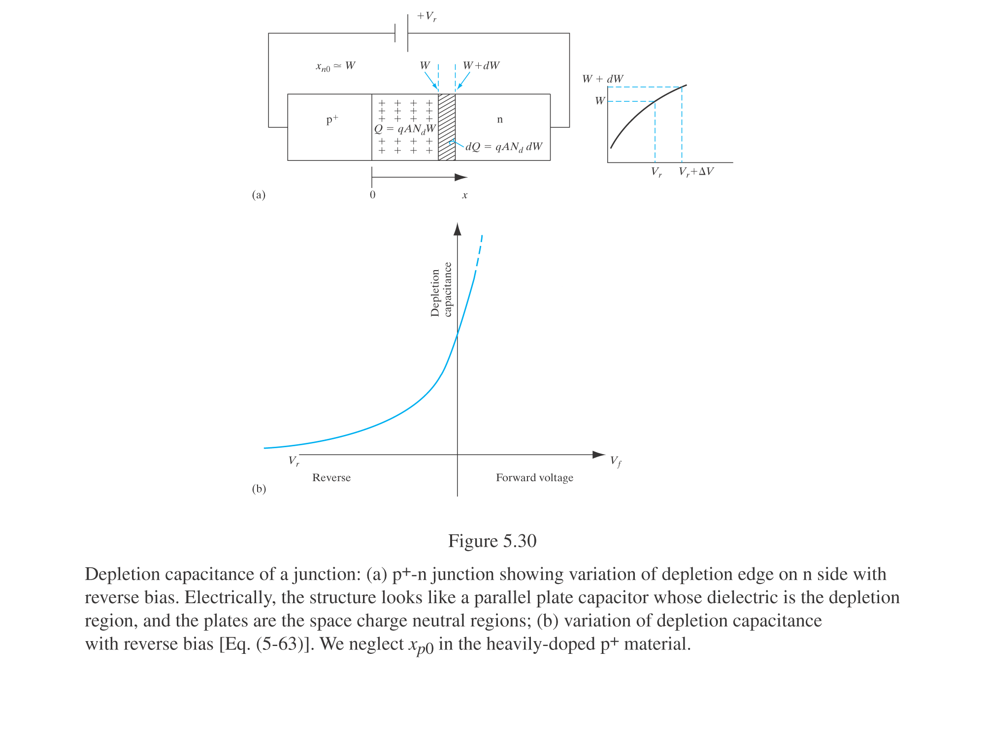
ECE 340 Lecture 27
P-N diode capacitance
In reverse bias (V<0) fixed charge is stored in the junction, as the depletion width widens with more negative V.
Why? How does W change with voltage?

Slide 2
If we measure and plot 1/C_{J}² vs. V, I can get __________

Slide 3
Ex: Diode with area 100x100 μm², slope of (1/C_{J})² vs. V is -2x10²³ F⁻²V⁻¹, and intercept is 0.84 V. If N_{A} >> N_{D}, find the two sides’ doping.

Slide 4
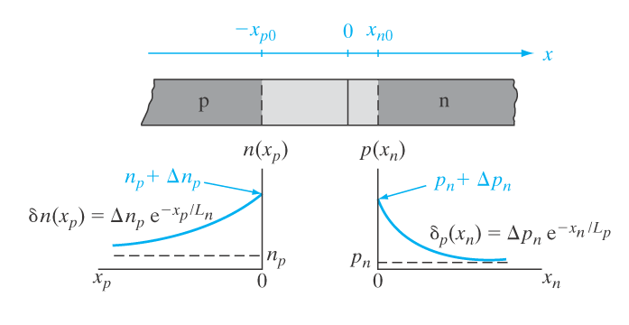
In forward bias (V>0) excess minority carriers are stored in the quasi-neutral regions of the p-n diode.
In n-side (note zero of x-axis redefined to x_{n0} = 0):
Where Δp_{n}(x_{n}) =
and L_{p} =
In p-side (note zero of x-axis redefined to x_{p0} = 0):

Slide 5
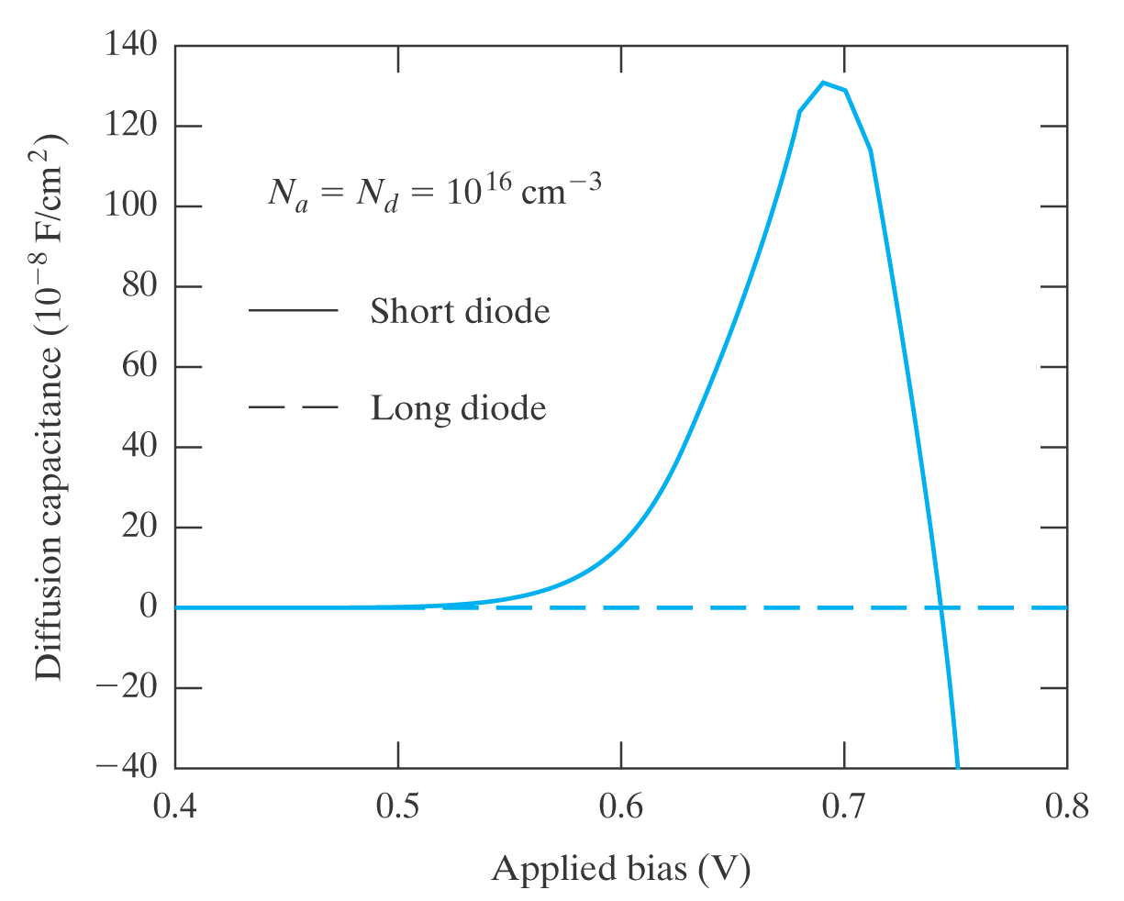
Diffusion capacitance for holes in n-side:
Where ℓ_{n} = ________________
And p_{n} = _________________
Keep in mind that in general C_{J}(V) = C_{depl} + C_{diff}
  “Long” diode = _______________________
  “Short” diode = _______________________

Slide 6
We’ve (nearly) exhausted the p-n junction. Now we know:
  1) Why and how it conducts current (forward, reverse)
  2) How to calculate depletion width, field, built-in voltage
  3) How diodes break down
  4) How diodes store charge as capacitors
  5) How to make an LED or photodiode

Slide 7
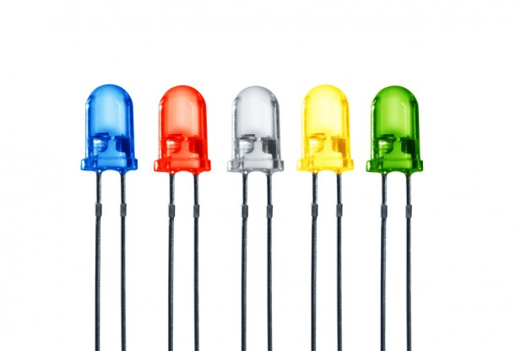
Two diode applications in optoelectronics:
Photodiode
or solar cell
2) Light-emitting diode (LED)

Slide 8
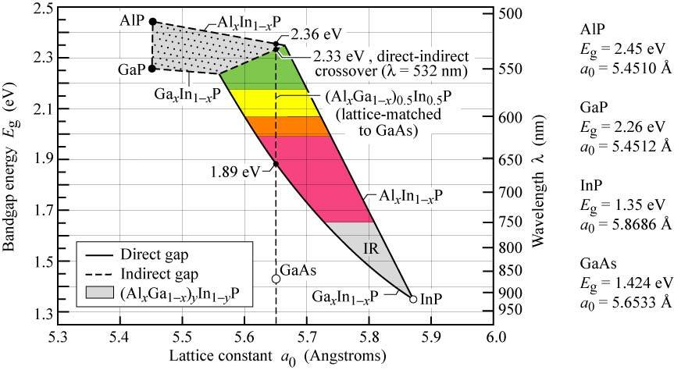
ECE 340 Lecture 28-29
P-N optoelectronics; photodetectors, solar cells, LEDs
Recall: Si is great (cheap, good SiO₂ insulator) for high complexity digital & cheap analog circuits
What if we want: High-speed (10s GHz – 1 THz) analog amplifiers; Optical receivers, emitters (LEDs, lasers)
Look at other semiconductors with BETTER mobility and light emission / absorption properties (“custom” E_{G}).

Slide 9
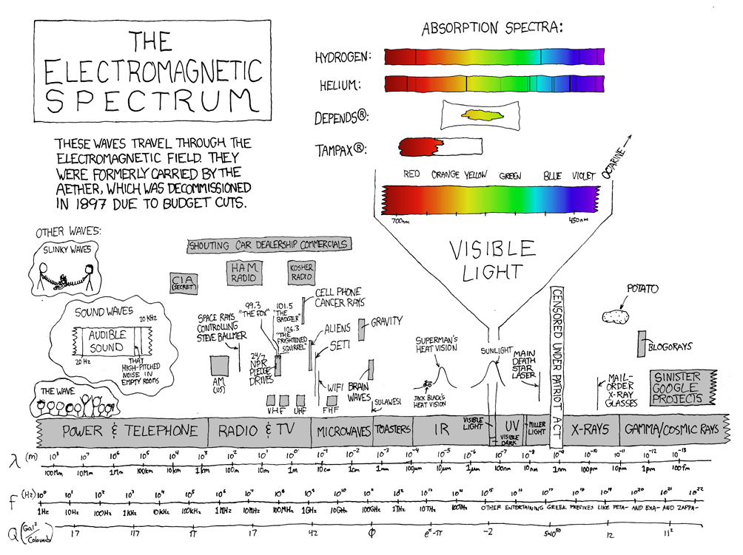
http://xkcd.com/273/

Slide 10
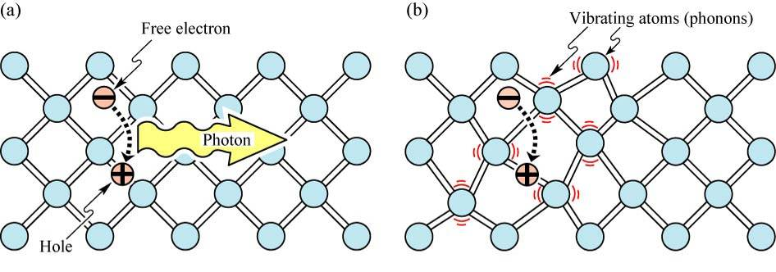
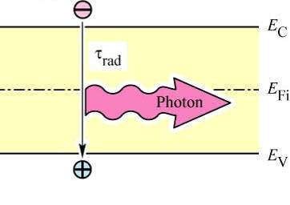
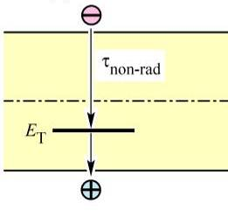
Another thing to keep in mind:
  Direct band gap (E_{G}) →
  Indirect band gap (E_{G}) →
Ball-and-stick
lattice picture:
Band diagram picture:
Remember: E_{G} = hf = hc/λ; numerically E_{G}(eV) = 1.24/λ(μm)

Slide 11
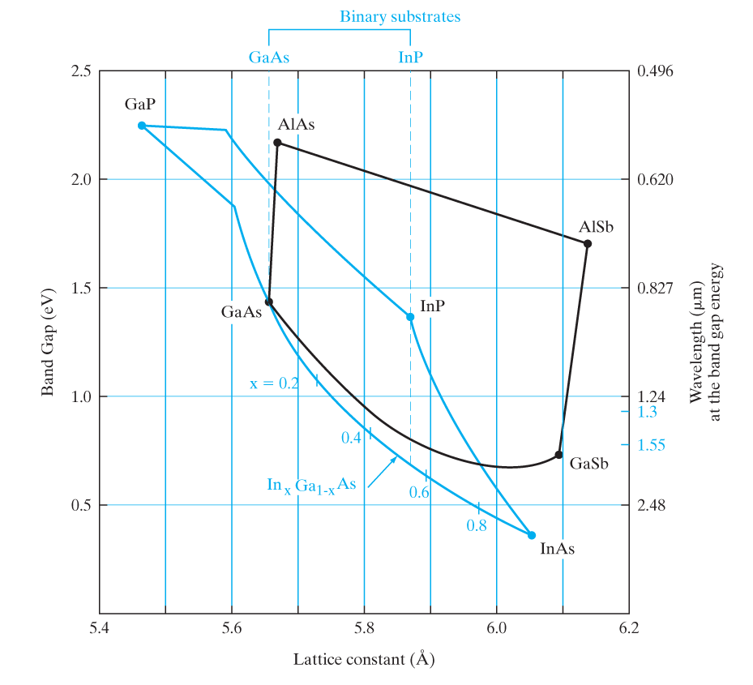
We now focus mostly on direct band gap semiconductors like GaAs, InP and their alloys:
Note, we can vary alloy
composition (e.g. In_{x}Ga_{1-x}As)
and get different _________
and _____________
Getting same lattice constant
as the substrate (GaAs or InP)
is important to minimize lattice
defects in a device.
Generally, assume lattice constant (a) and band gap (E_{G}) vary linearly with alloy fraction (x)

Slide 12
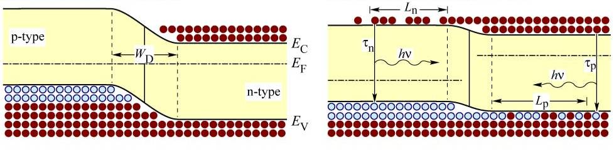
We know p-n junction can be used to:
  Emit light (EHP recombination at ___________ bias)
  Absorb light (EHP generation at ___________ bias)
Minority & majority carriers recombine and emit light
  In the ________________ region (W_{D})
  Within a _______________ length (L_{n}, L_{p}) in n- and p-sides

Slide 13
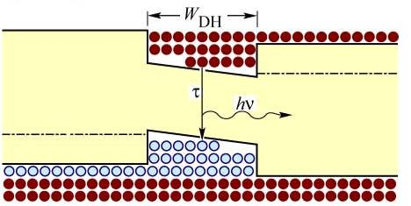
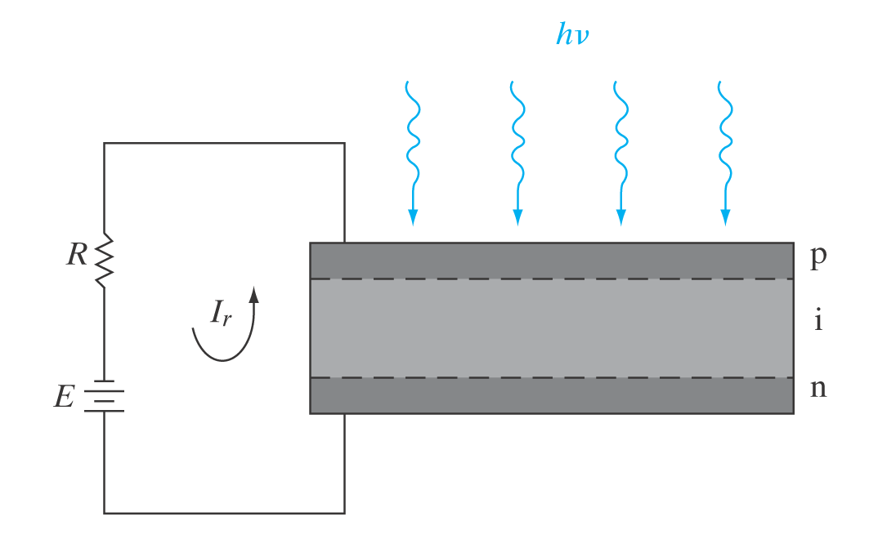
Can we control & improve p-n light emission / absorption?
Use p-n heterojunction, i.e. make
depletion region in a material with
_____________ E_{G}
Use p-i-n diode by making
depletion region intrinsic (“i”)
to enlarge depletion region W

Slide 14
What are the current & voltage in an illuminated junction?
  1) Note: need illumination photon energy hf > E_{G}
  2) Assume quantum efficiency Q.E. = 1 = one EHP created for every incoming photon
For example, if EHP generation is g_{op} = 10¹⁷ EHPs/cm³/s
What is the optically generated current in a diode?

Slide 15
How does the photogenerated current add (or subtract) to the current already induced by the diode voltage?
Short-circuit current: external V = 0 → I_{sc} = ____
Open-circuit voltage: external I = 0 → V_{oc} = ____
This is a photovoltaic effect.

Slide 16
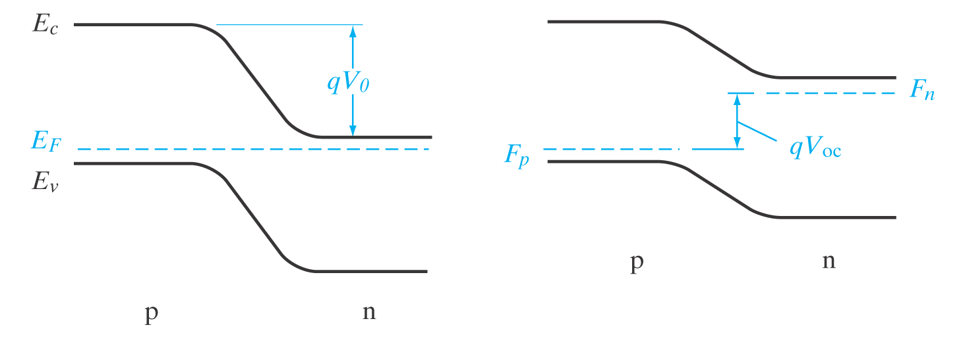
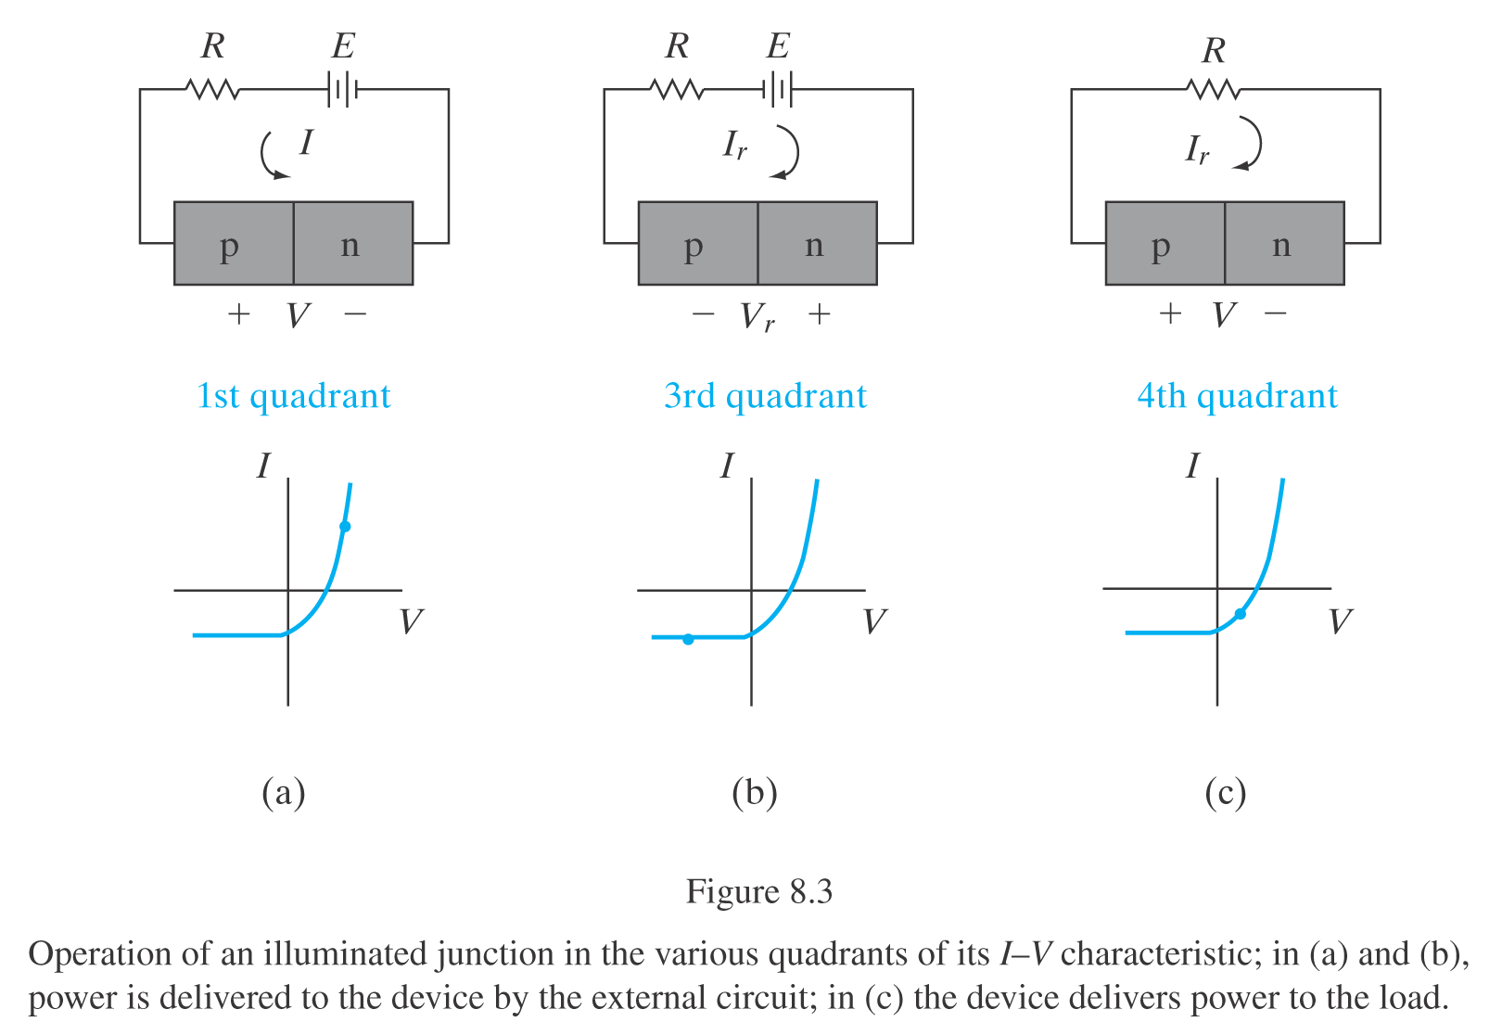
How fast is the photodiode speed (response frequency)?
f_{max} = …

Slide 17
Ex: Photodiode Design. Consider a p-i-n photodiode (see Fig. 8-7), with “i” region made of In_{x}Ga_{1-x}As (see Fig. 1-13). Design stoichiometry “x” and thickness of the “i” region (W_{i}) to enable response at 1.3 μm wavelength, up to 20 GHz signals. Assume fields are sufficiently high to reach v_{sat} ≈ 10⁷ cm/s in the “i” region. Name at least one design constraint on the “p” and “n” regions of this photodiode. You may assume the lattice constant and band gap of In_{x}Ga_{1-x}As vary linearly with composition “x”.

Slide 18
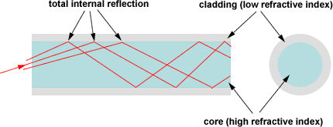
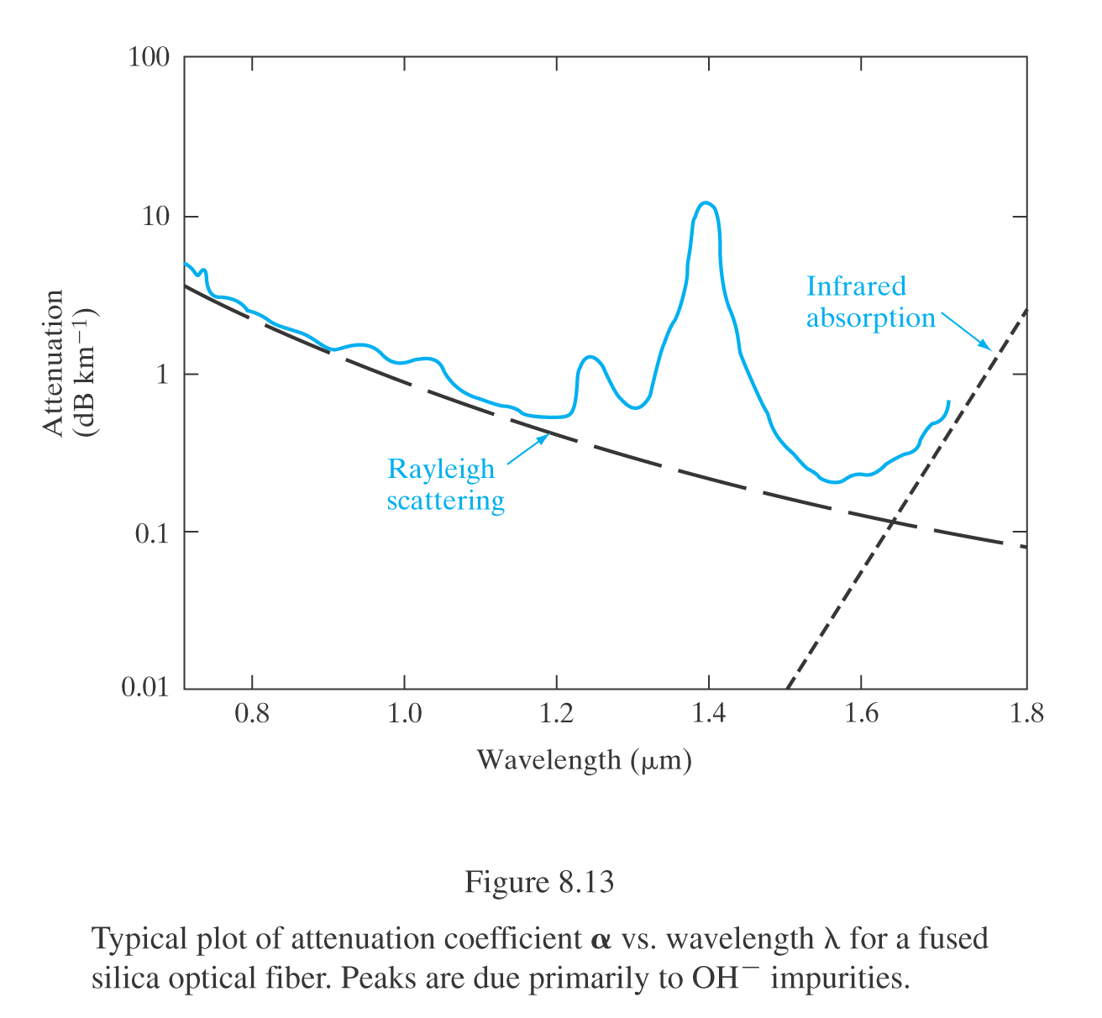
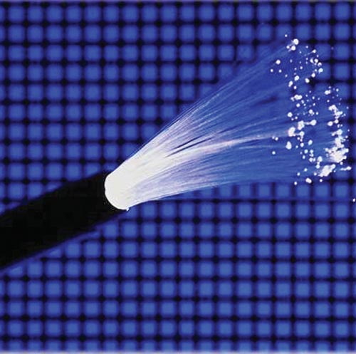
Optical fiber communications → why use wavelengths of 1.3 or 1.55 μm?
  Minimum _____________
  Minimum _____________

Slide 19
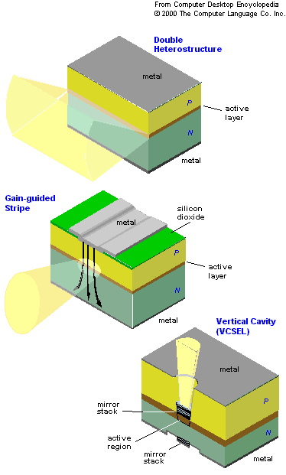
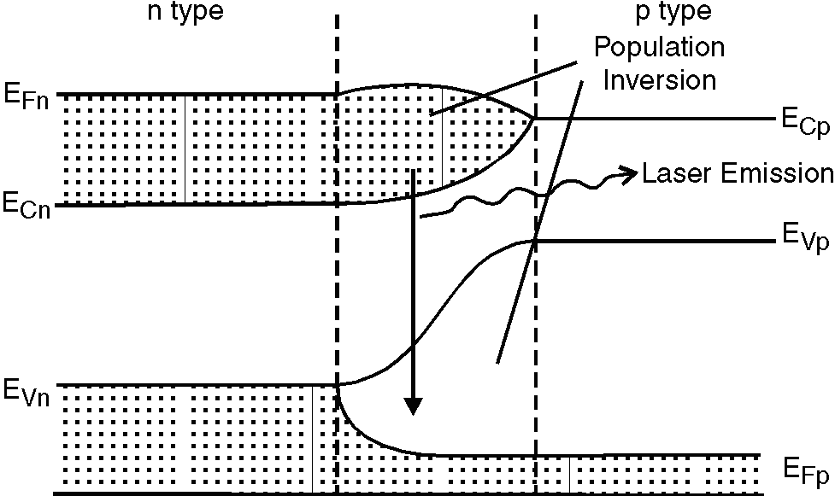
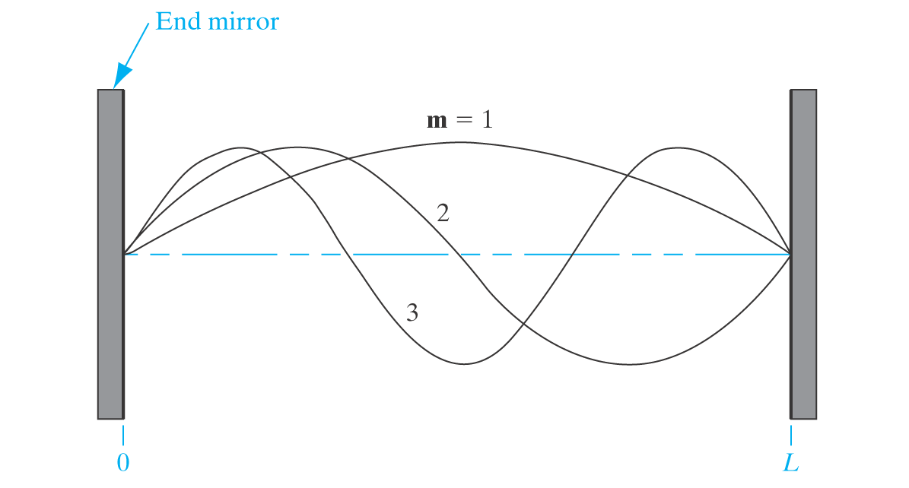
Semiconductor lasers vs. LEDs:
  Strong fwd. bias, population inversion
  Recombination region + resonant cavity
  (length L, between semi-reflective mirrors)
  Stimulated emission at λ = 2L/m
resonant modes
between mirrors
in laser cavity

Slide 20
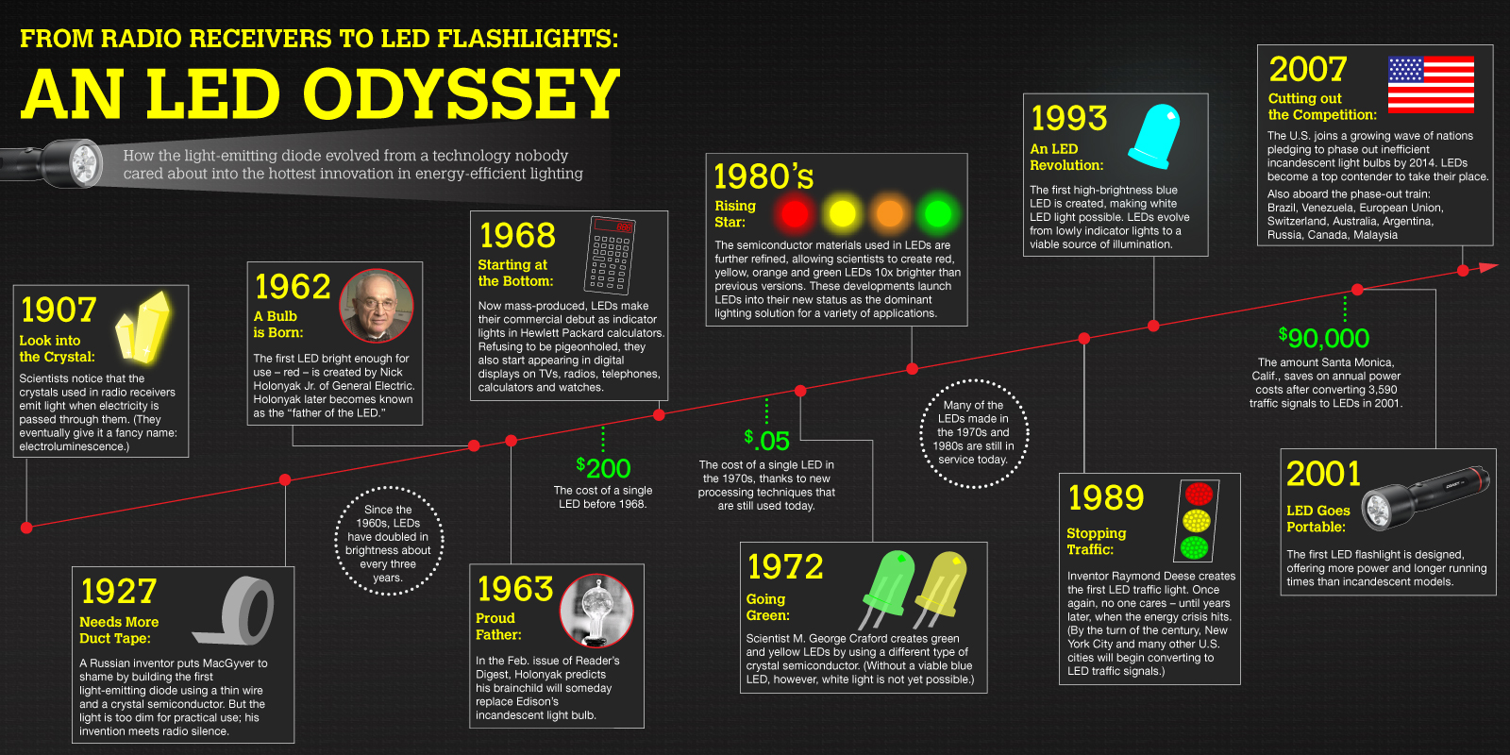
(also see Fig. 8.10 in your textbook)
http://www.infographicsshowcase.com/from-radio-receivers-to-led-flashlights-an-led-odyssey/coast-led-timeline/

