Slide 1
ECE 340 Lecture 30
Metal-Semiconductor Contacts
Real semiconductor devices and ICs always contain metals. Why? _______________________
Metals are actually easier to treat than semiconductors:
  1) No band gap, only Fermi level matters
  2) ~100-1000x more electrons than highly doped silicon (no internal E-fields → flat energy bands in metals!)
Draw metal next to semiconductor,
define work function:

Slide 2
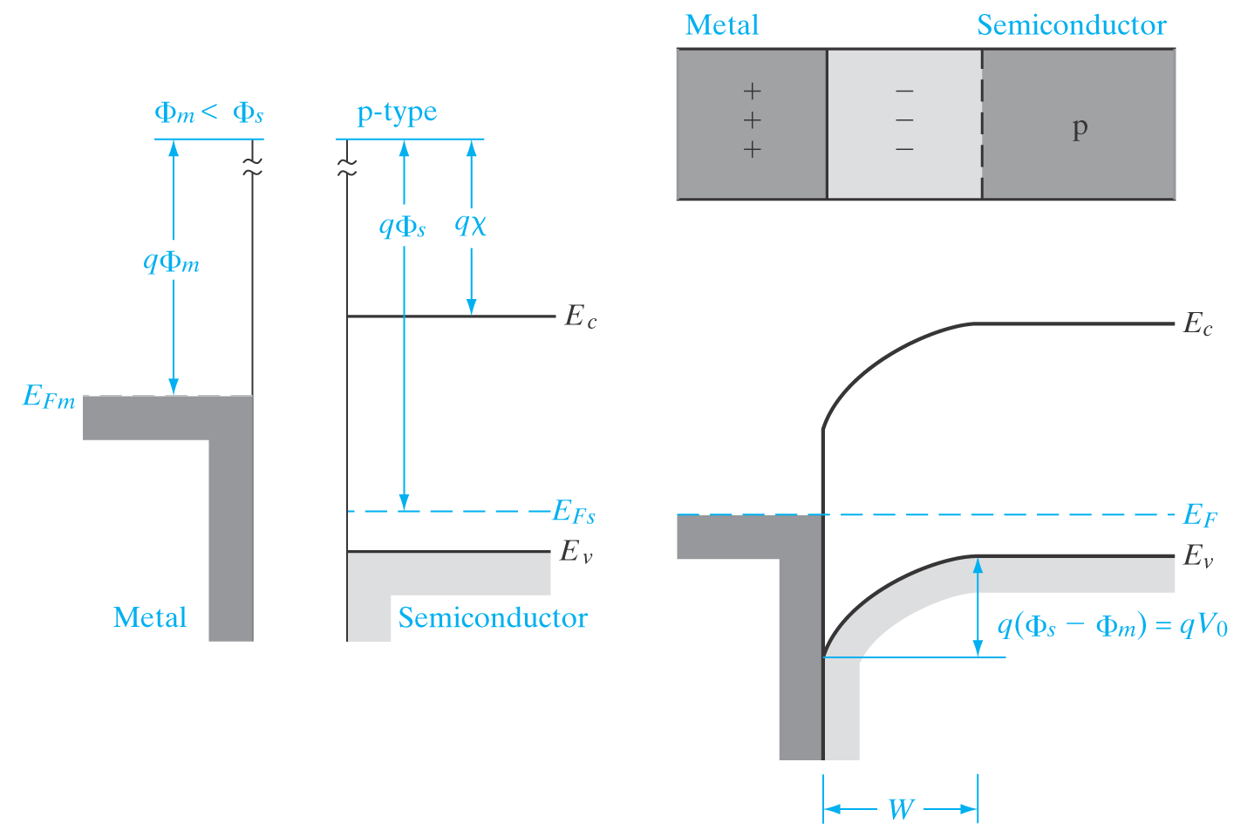
Another scenario, if Φ_{m} < Φ_{s}
Contact potential V₀
Use analogy to p⁺n
junction to evaluate
depletion width W:
Ex: calculate semiconductor work function qΦ_{s} if it is silicon doped p-type with N_{A}=10¹⁷ cm⁻³

Slide 3
Two types of metal-silicon contacts become apparent:
  1) Schottky (rectifying, like a diode)
  2) Ohmic
How do you get one vs. the other?
When would you want one vs. the other?
Silicon work function:
Some typical metal work functions:

Slide 4
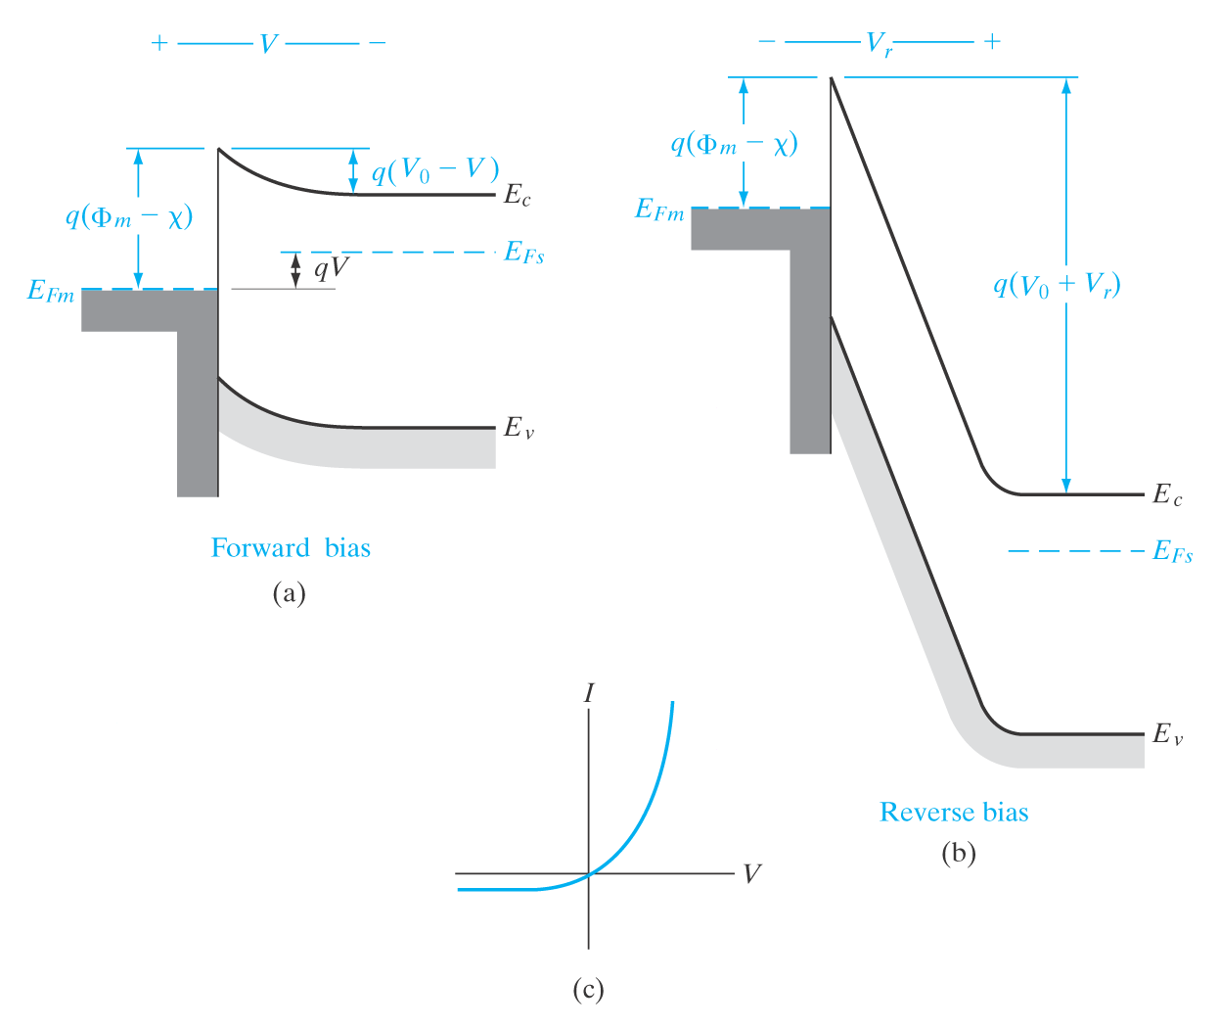
Schottky (rectifying) contact on n-type Si:
Apply V>0 on metal, reduce
built-in energy barrier.
  What happens?
  Can electrons flow from metal to Si?
Apply V<0 on metal, enhance built-in energy barrier.
qΦ_{B} =

Slide 5
Ohmic contacts on silicon, two ways to achieve them:
  1) Choose metal with appropriate work function to “match” the Fermi level of p- or n-type Si
  2) Dope silicon highly, to thin out Schottky barrier, so electrons can tunnel through (almost) regardless of Φ_{m}

Slide 6
ECE 340 Lecture 31-32
Metal-Oxide-Semiconductor (MOS) Capacitor
MOS capacitor, needed for MOSFETs and DRAM (and Flash):
  In nMOS device: n+ gate (or low Φ_{m}), p-substrate
  In pMOS device: p+ gate (or high Φ_{m}), n-substrate
Note gate = metal by Intel at 45nm tech node, since ~2008. Why?
SiO₂ most common gate insulator (E_{G} = 9 eV, ε_{r} = 3.9)
Intel switched to bilayer HfO₂ (E_{G} ≈ 5 eV, ε_{r} ≈ 20) with SiO₂. Why?
d

Slide 7
Metal/high-K MOSFET (we’ll come back to it later):
Draw band diagram of MOS capacitor with n+ gate and p-substrate.
source: intel.com

Slide 8
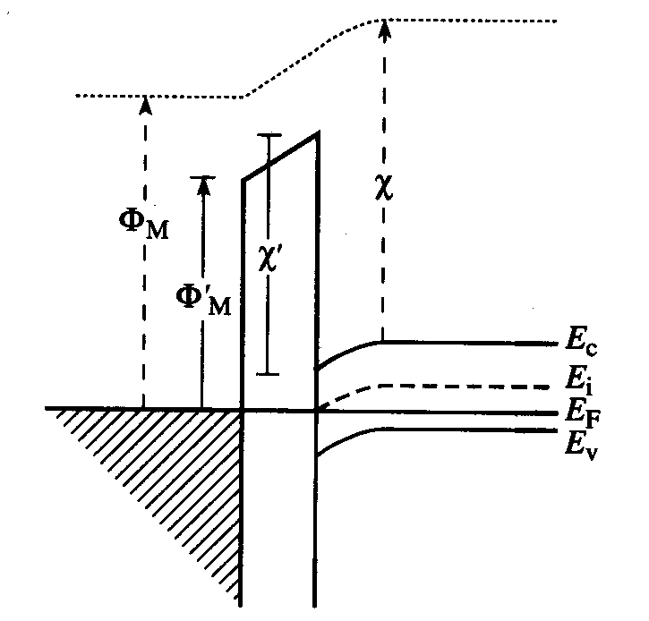
We drew this as n+ gate MOS, but remember that gate can also be metal! Then metal gate work function Φ_{m} matters:
Define the bulk (body) potential:
Define the surface potential:

Slide 9
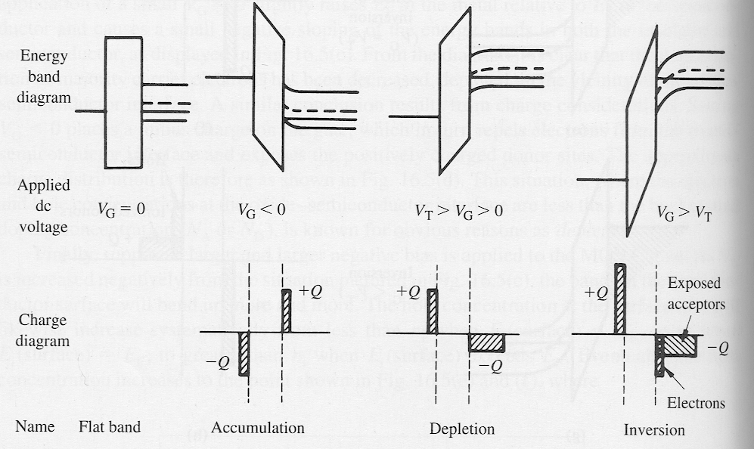
What happens if we apply a gate voltage?
There are two important reference voltages here:
  1) Flat-band voltage, V_{FB} = voltage needed on gate to get E-field = 0 everywhere (flat bands). Note, this can be zero (“ideal” MOS), but generally depends on gate Φ_{m} or doping, qV_{FB} =
  2) Threshold voltage, V_{T} = voltage needed on gate to get electron concentration at Si/SiO₂ surface same as that of (majority) holes in the bulk. I.e. Φ_{s}(inv) = 2Φ_{F} and Si surface is “inverted”.

Slide 10
In general, voltage applied on the gate will be:
  Where V_{i} = E_{i}d = voltage dropped across SiO₂ insulator
  And Φ_{s} = voltage dropped in the Si (surface potential)
Q: what is V_{i} when V = V_{FB}?
Three interesting regions of MOS operation:
  Accumulation (V < V_{FB} for pMOS)
  Depletion (V_{FB} < V < V_{T})
  Inversion (V_{T} < V)
Let’s take them one by one:

Slide 11
Accumulation: V < V_{FB}, holes accumulate at the surface
|qV_{i}|
V_{i}

Slide 12
Depletion: V_{FB} < V < V_{T}, holes pushed back in substrate
  Surface is depleted of mobile carriers
  All surface charge is due to fixed dopant atoms
Again, we apply depletion approximation we used for p-n diode: assume abrupt displaced charge (rectangular). Draw:
qV_{i}

Slide 13
Charge density in depleted region:
Poisson’s equation in depleted region:
Integrate twice (from bulk x = W to surface x = 0 to obtain surface Φ_{s} or depletion depth W:
To find Φ_{s} as a function of gate V we need all voltage drops.
  Across insulator: V_{i} = E_{i}d = Q_{d}/C_{i} where
  Q_{d} is depletion charge in silicon substrate, Q_{d} = -qN_{A}W =
Finally, V_{G} = V_{FB} + Φ_{s} + V_{i} =
We can now solve from the surface potential vs. gate V:

