Slide 1
ECE 340 Lecture 33
MOS capacitor Threshold Voltage
Inversion: at V > V_{T} (for NMOS), many electrons drawn to surface, which is now “inverted” vs. the p-doped substrate. Draw charge distribution:
Draw energy bands at inversion:

Slide 2
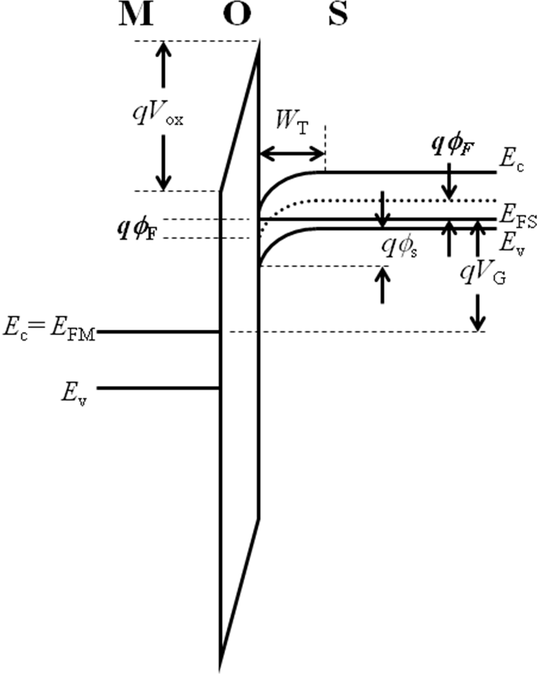
Note:
  Mobile charge anywhere is given by difference between E_{C} or E_{V} and Fermi level as, e.g. n = N_{C}exp(E_{C} – E_{F})
  If E_{F} is close to E_{C} then lots of __________________
  If E_{F} is close to E_{V} then lots of __________________
At high gate V (> V_{T}) which band is closer to E_{F}?
The condition for this onset is ϕ_{S} = 2ϕ_{F} (see plot)
qV_{i}

Slide 3
At inversion (on p-type sub.) the mobile surface charges are ______________, such that numerically n_{surf.} = N_{A,sub.}
Now we can calculate the threshold voltage, V_{T}:
  For NMOS (electron inversion on p-type substrate):
  For PMOS (hole inversion on n-type substrate):
  Net surface charge in inversion layer?

Slide 4
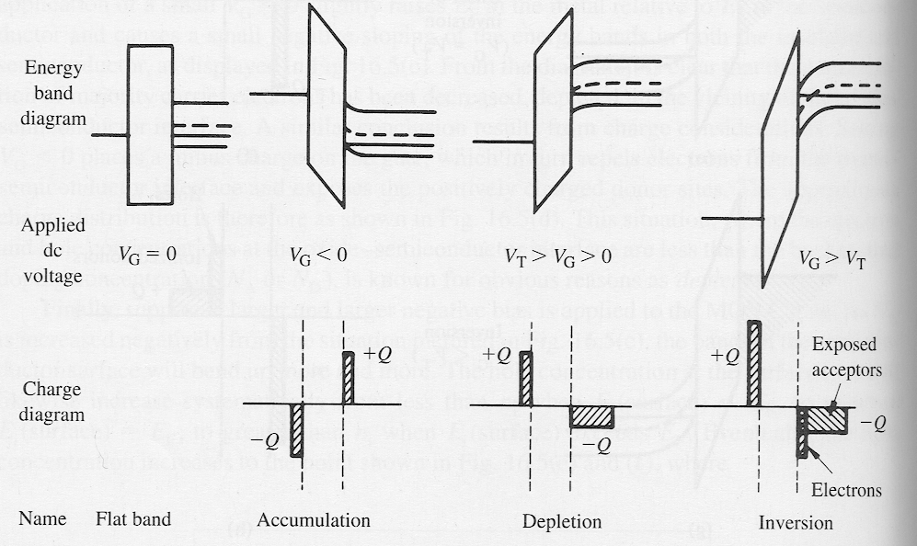
This is a good place to recap MOS capacitor behavior:
Since this is a capacitor, what
does the C-V measurement look like?

Slide 5
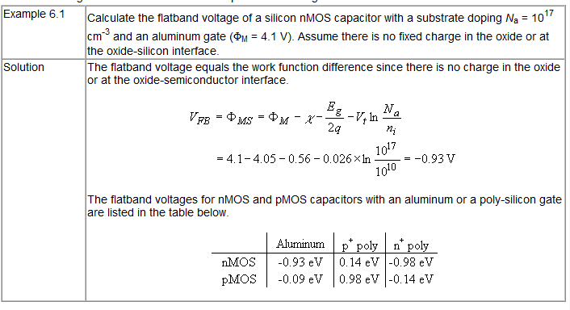
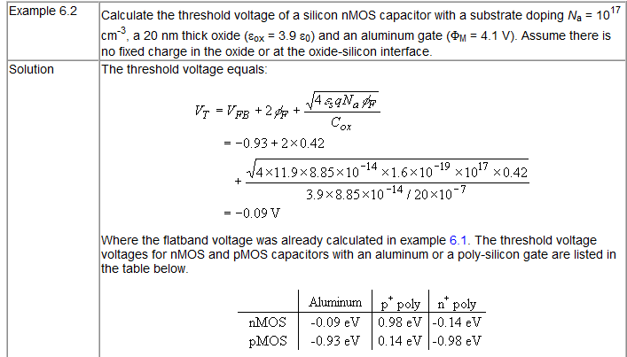

Slide 6
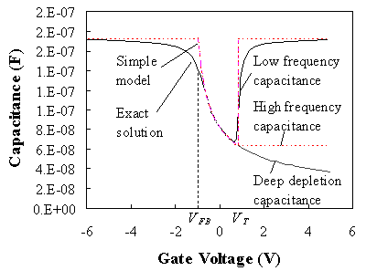
ECE 340 Lecture 34
MOS Capacitance-Voltage (C-V) curve
MOS capacitance measurement:

Slide 7
Why is there a difference in inversion capacitance at:
  Low-frequency (<10 kHz)
  High-frequency (~1 MHz)
Answer:
C_{i}
C_{i}
C_{i}
C_{i}

Slide 8
Inversion case I: inversion-layer (minority carriers!) can be supplied quickly to respond to changes in V_{G}
How do we supply them?
  1) Optical generation (turn lights on)
  2) Providing a nearby source of minority carriers (like in a MOSFET)
Inversion case II: inversion-layer cannot be supplied quickly enough to respond to changes in V_{G}
C_{i}
C_{i}
C_{i}
C_{i}
C_{i}
C_{i}

Slide 9
Ex: plot and label the C-V curve of a PMOS capacitor with P+ gate, substrate doping N_{D}=5x10¹⁷ cm⁻³ and SiO₂ d=2 nm

Slide 10
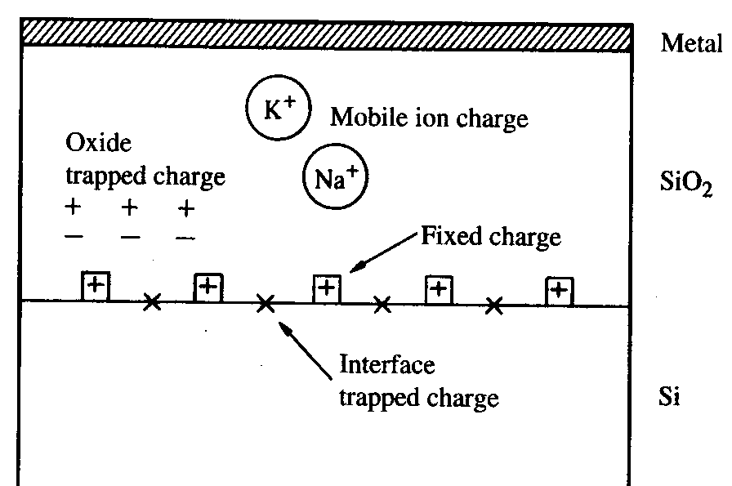
MOS capacitor non-idealities… in reality, neither the SiO₂ nor the Si/SiO₂ interface are perfect:
  Mobile ions (Na+ used to be a major headache)
  Dangling bonds at Si/SiO₂ interface
  Charge traps within SiO₂
We can group these non-idealities together as an equivalent sheet of charge Q_{i} (>0) at the Si/SiO₂ interface
+ charge at the interface pulls down the E-bands there and changes the field across the SiO₂
This shifts the flat-band voltage:

Slide 11
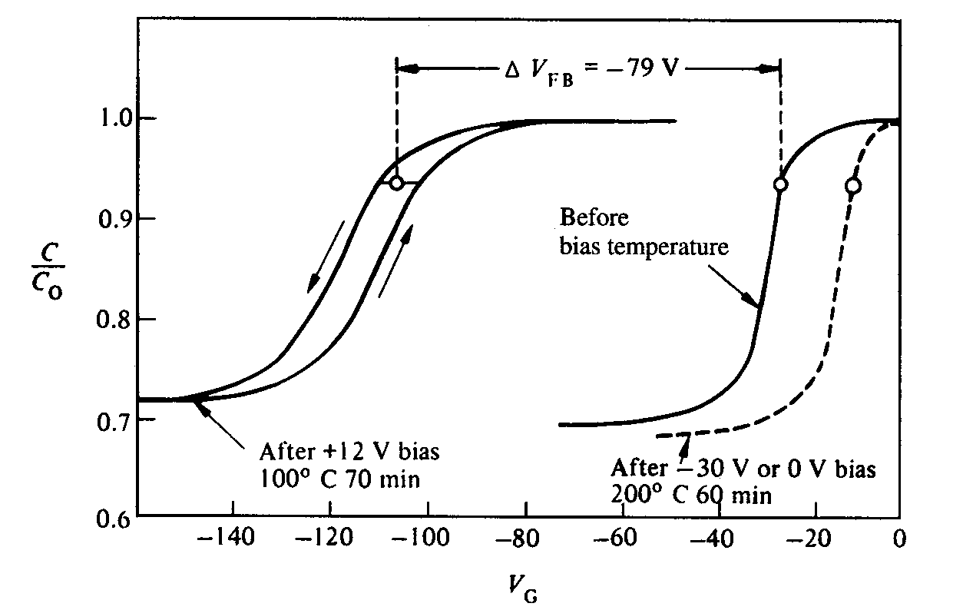
Odd shifts in C-V characteristics were once a mystery:
Source of problem: Mobile ionic charge (e.g. Na+, K+) moving to/away from the interface, ΔV_{FB} = Q_{i} / C_{i}
Solution: cleaner environment, water, chemical supply.
With simple C-V measurements we can learn (and “debug”) a great deal about the properties and quality of MOS capacitors:
  Obtain oxide thickness (d) from → C accumulation
  Obtain substrate doping (N_{A}) from → C_{min} at V_{T} (high-freq)
  Interface charge (Q_{i}) and V_{FB} from → C-V across various d_{ox} thicknesses

Slide 12
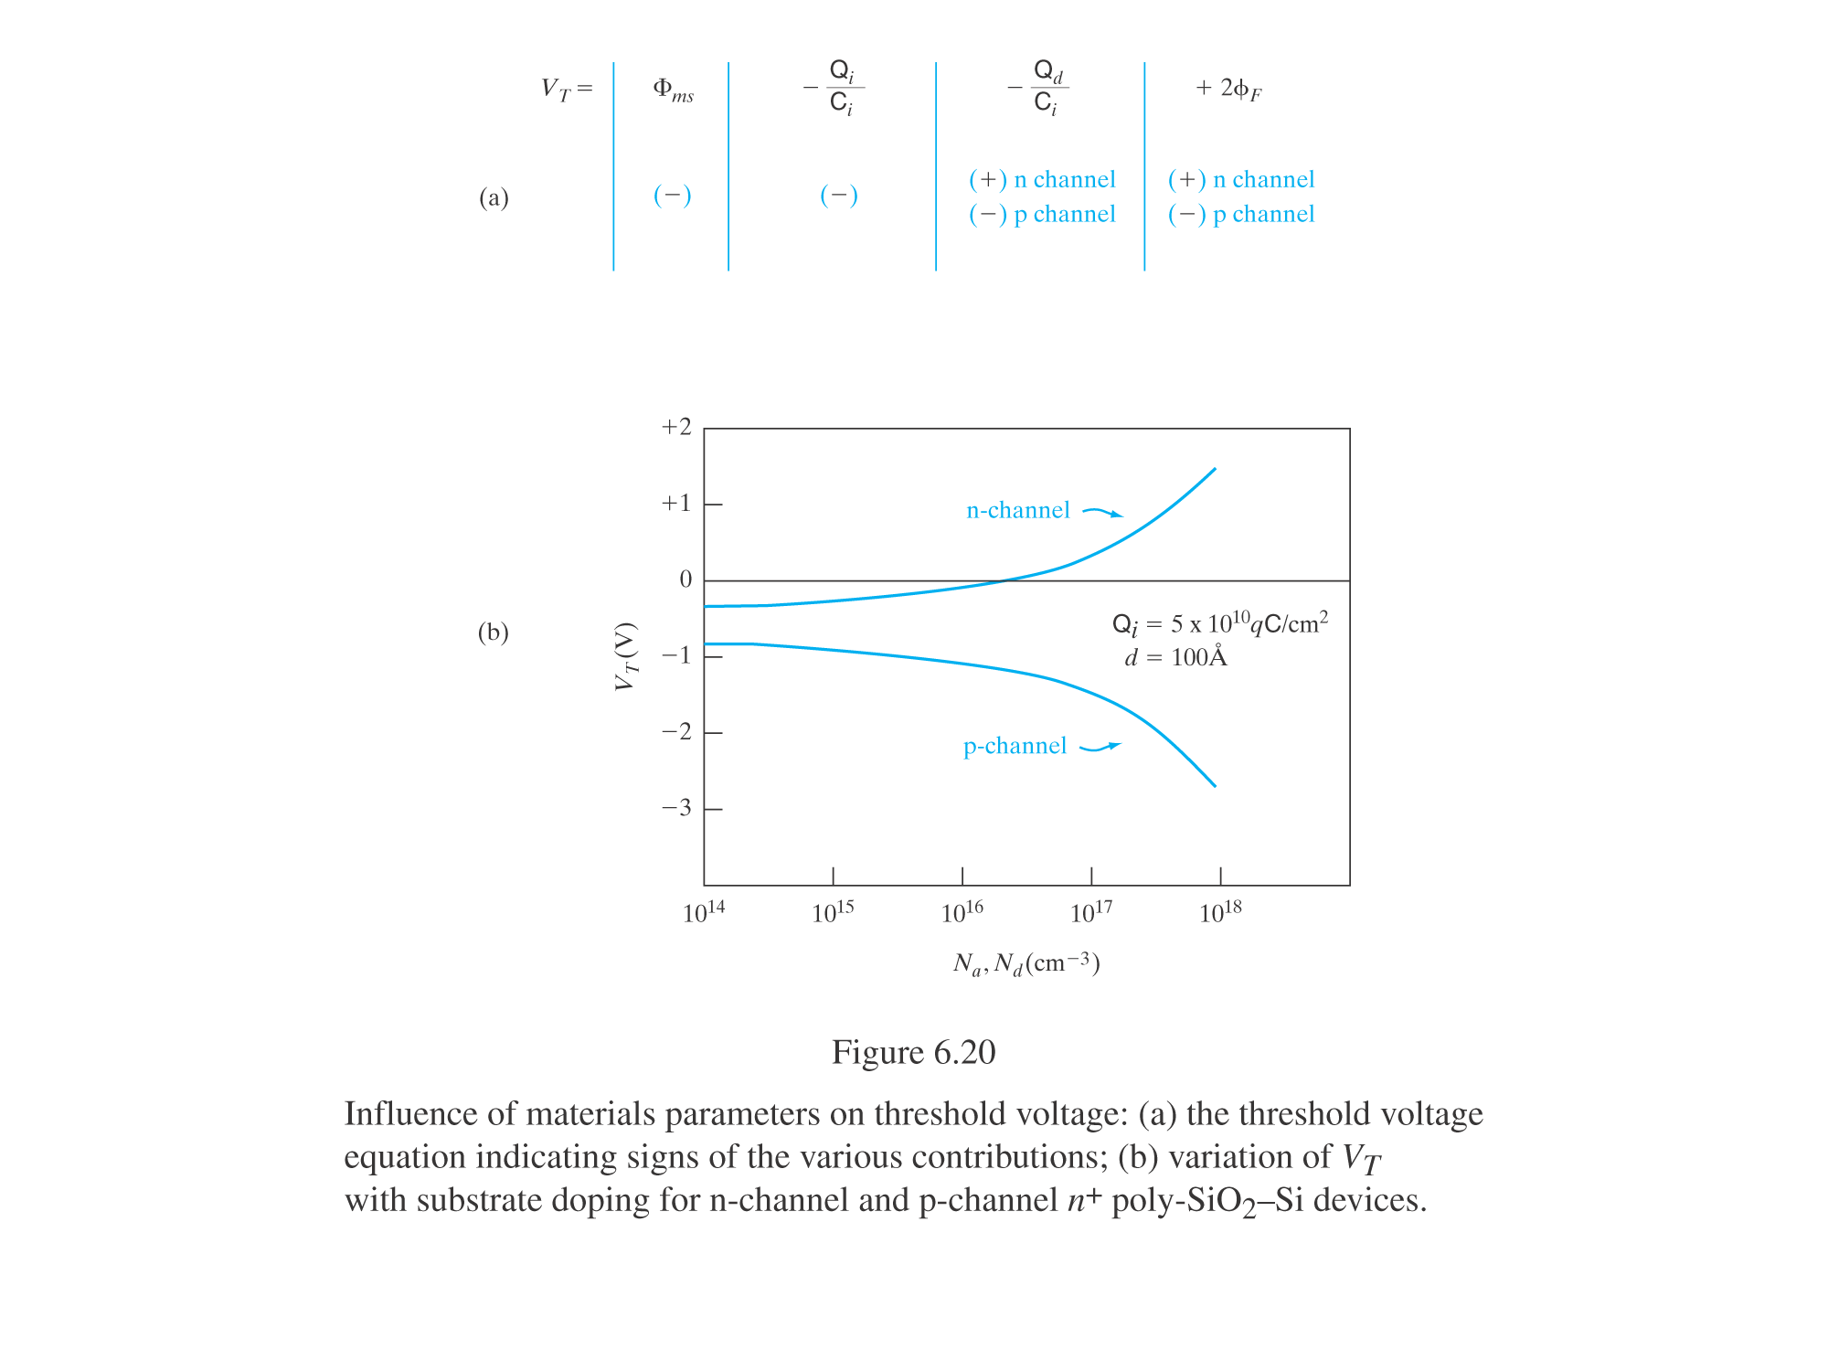
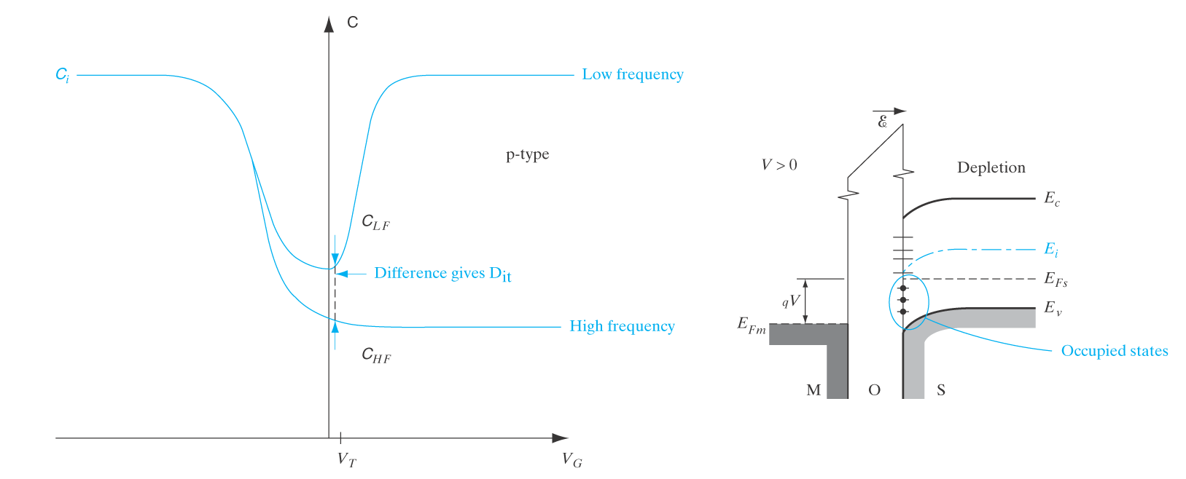
MOS capacitor wrap-up:
Experimental measurement of fast interface states (traps):
C_{i}

Slide 13
A little more on the real measured C-V curve:
Effective oxide capacitance affected by:
  Poly-silicon gate depletion (no problem with metal gate)
  Finite thickness of inversion layer
Both of which are somewhat functions of voltage.
Last but not least:
  Why HfO₂ instead of SiO₂?
  Why metal gate instead of highly-doped poly-Si gate?
C_{i}

