Slide 1
ECE 340 Lecture 35
MOS Field-Effect Transistor (MOSFET)
The MOSFET is an MOS capacitor with Source/Drain terminals
How does it work?
  Gate voltage (V_{GS}) controls
  mobile charge sheet under
  _______________
  Source-drain voltage (V_{DS}) sweeps
  the mobile charge away, creating ____________ (I_{D})
Desired characteristics (remember water faucet analogy):
  “On” current __________________
  “Off” current___________________

Slide 2
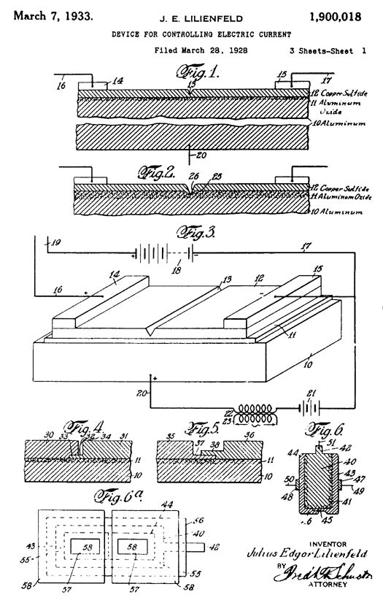
First MOSFET patents: Julius Lilienfeld (early 1930s)
This invalidated most of Bardeen,
Brattain and Shockley’s transistor
patent claims in the late 1940s!
But the MOSFET did not work in
practice until the 1960s. Why?

Slide 3
A modern “n-type” MOSFET (N-MOSFET):
How does it work?
  If V_{G} = 0, any current between source-drain (I_{D})?
  If V_{G} > 0 what happens (assume source grounded, V_{S} = 0)
  If V_{GS} >> 0 and V_{DS} > 0 what happens?

Slide 4
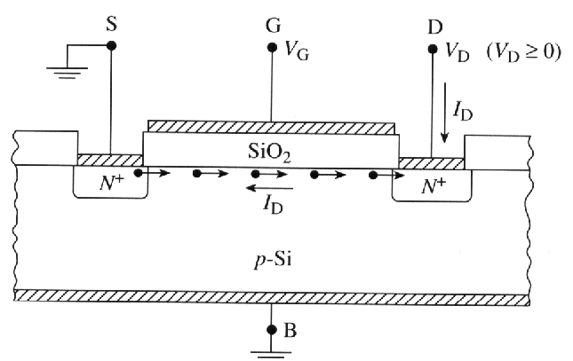
Typical 2-D cross-section view of the N-MOSFET:
Note direction of carrier flow,
and of current flow
Gate voltage (V_{GS}) controls
Source-to-Drain current (I_{D})
“Source” terminal refers to source of _____________
I_{D}
I_{D}
V_{GS}
V_{GS}

Slide 5
Theory of the MOSFET (*here N-MOSFET):
  When V_{GS} < V_{T} the channel
  is _________________
  When V_{GS} > V_{T} the channel
  is _________________
  If small drain voltage (V_{DS} > 0)
  is applied __________
Will charge sheet move by drift or diffusion?
  Current ≈ width X charge sheet X velocity
What is the inversion charge: |Q_{inv}| ≈
What is the drift velocity: v ≈

Slide 6
At low V_{DS}, the inversion layer essentially acts like a resistor!
What about higher drain voltages V_{DS}?
Must take into account variation of potential along channel, 0 < V_{x} < V_{DS}. So inversion layer charge at any point is
|Q_{inv}(x)| = C_{i}(V_{GS} – V_{T} – V_{x})
And the current is:
I_{DS,lin} =
Still linear in V_{GS} voltage! This is the linear region.
When V_{DS} = V_{GS} – V_{T} the channel becomes _____________

Slide 7
When V_{DS} > V_{GS} - V_{T} the un-inverted (drain depletion) region increases, as does the ____________________
Any increase in V_{DS}:
  Reduces the amount of inversion charge, but…
  Increases the lateral field (charge velocity)
The two effects cancel each other out, so at high V_{DS} the drain current is no longer a function of V_{DS}! The current saturates to a value only dependent on V_{GS} (i.e. charge).
Putting in V_{DS} = V_{GS} – V_{T} (the pinch-off, i.e. saturation condition) in the previous equation:

Slide 8
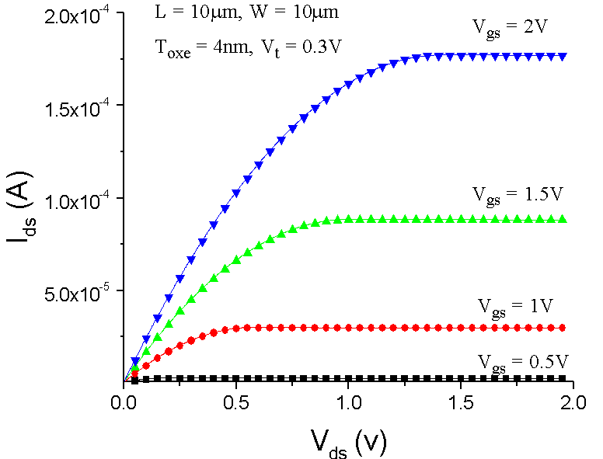
Plot and label an example N-MOSFET:
What about I_{DS} vs. V_{GS}?
Z
d_{ox}
V_{T}

Slide 9
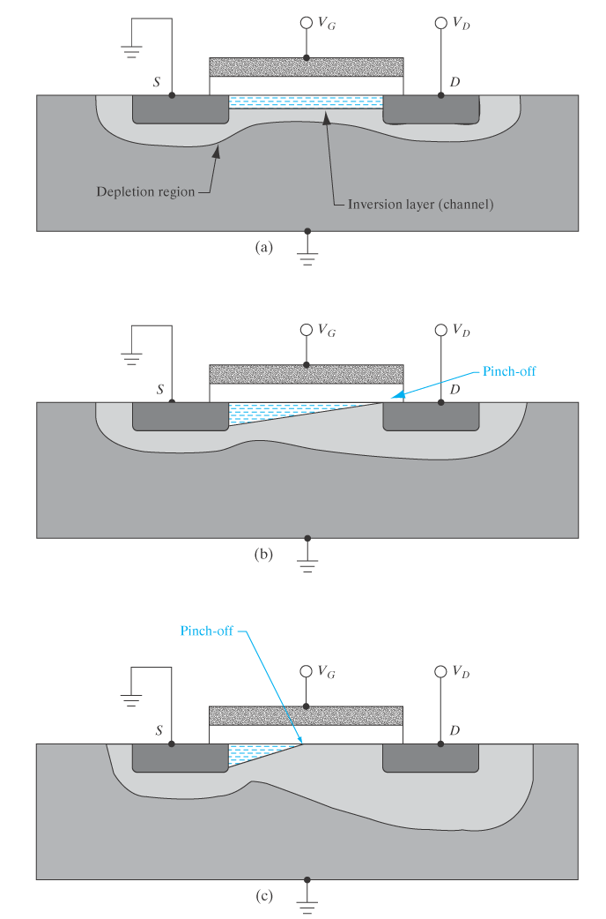
Back to the physical picture, why does I_{D} vs. V_{DS} saturate?
Why is this desirable?
  Voltage gain, dV_{DS}/dI_{D} because small changes in I_{D} cause large swings in V_{DS}

Slide 10
What is the “effective mobility” μ_{eff} in the MOSFET channel?
Can we look it up in the bulk-silicon charts?
Scattering mechanisms
affecting mobility in channel:
  Charged impurity (Coulomb) scattering
  Lattice vibration (phonon) scattering
  Surface roughness scattering

Slide 11
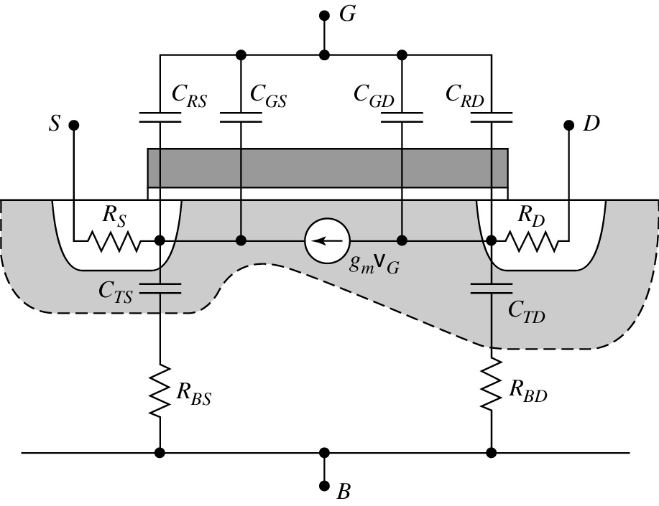
ECE 340 Lecture 36
MOSFET Analog Amplifier and Digital Inverter
Analog applications: Small-Signal MOSFET model
Of all elements in the model… C_{GS} ~ C_{i} and g_{m} (transconductance dI_{D}/dV_{GS}) are essential, the rest are parasitics which must be reduced
Note that a lot of elements are voltage-dependent, e.g. depletion capacitances vary with depletion widths and voltage

Slide 12
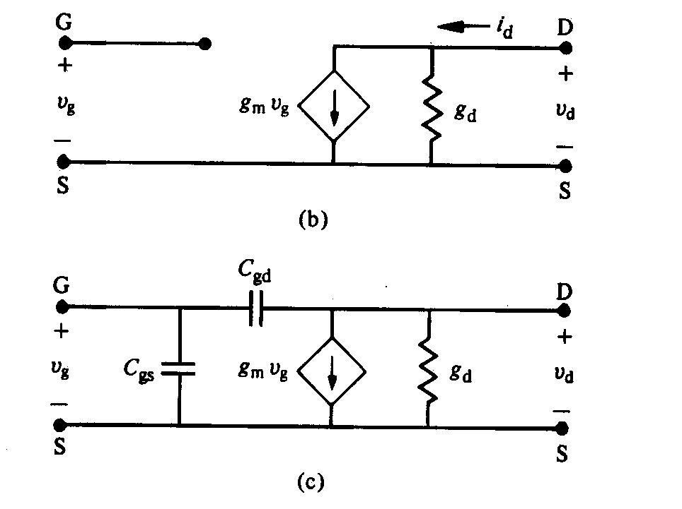
At low frequency
At high frequency
Drain current:
Conductance parameters:
See ECE 342, ECE 441
output conductance
transconductance

Slide 13
Cutoff frequency f_{max} = frequency where MOSFET no longer amplifies input (gate) signal
Obtained by considering high-freq. small-signal model with output shorted, finding freq. where |i_{out}/i_{in}| = 1
Something we already knew qualitatively → higher MOSFET operating frequency
achieved by decreasing channel
length L, increasing mobility μ_{eff}
Smaller = faster for devices
(though parasitics play a big role
in realistic circuits)

Slide 14
Logic applications: CMOS inverter
Key property: signal regeneration – returns logic outputs (0 or 1=V⁺=V_{DD}) even in presence of noise
Complementary MOS (CMOS) inverter

Slide 15
Qualitative operation:
  When V_{in} = 0 → V_{out} =
  NFET is ________ PFET is __________
  When V_{in} = V_{DD} → V_{out} =
  NFET is ________ PFET is __________
Other key property of CMOS inverter: no power consumption while idling in either logic state (only while switching)
Consider PFET as “load” to NFET:
Note “rail-to-rail” logic levels 0 and V_{DD}
Want transition voltage V_{DD}/2, but usually
L_{p} = L_{n} which means choose Z_{p}/Z_{n} ≈ 2
because μ_{n} ≈ 2μ_{p} (for Si)*
*what about other materials?

Slide 16
A quick look at CMOS power dissipation
Energy consumed while charging capacitive load: E_{P} = _______
C_{L} is discharged through NFET → E_{N} = _________
Total energy dissipated per clock cycle: E = C_{L}V_{DD}²
Frequency f cycles per second → active power P = fC_{L}V_{DD}²
This is very important: fundamental trade-off between speed (f) and power dissipation. Reducing voltage and parasitic C’s is a must to keep power low at higher speeds.

Slide 17
In reality, there is also passive power (leakage) dissipated by the FETs supposed to be “off”: P_{off} = I_{leak}V_{DD}
I_{off} ~ I_{on}/1000 in modern technology per transistor
But this can become a headache when you have 100s of millions of “sleeping” transistors (i.e. “passive power” vs. “active power”)!
Ex: see IBM journal of Research & Dev.
http://www.research.ibm.com/journal/rd/504/tocpdf.html

