Slide 1
ECE 340 Lecture 3
Crystals and Lattices
Online reference: http://ece-www.colorado.edu/~bart/book
Crystal Lattices:
  Periodic arrangement of atoms
  Repeated unit cells (solid-state)
  Stuffing atoms into unit cells
  Diamond (Si) and zinc blende (GaAs) crystal structures
  Crystal planes
  Calculating densities

Slide 2
Appendix III in your book (semiconductors):
Where crystalline semiconductors fit in (electrically):

Slide 3
The periodic lattice:
Stuffing atoms into unit cells:
  How many atoms per unit cell?
  Avogadro’s number: N_{A} = # atoms / mole
  Atomic mass: A = grams / mole
  Atom counting in unit cell: atoms / cm³
  How do you calculate density?

Slide 4
The Silicon lattice:
Si atom: 14 electrons occupying lowest 3 energy levels:
  1s, 2s, 2p orbitals filled by 10 electrons
  3s, 3p orbitals filled by 4 electrons
Each Si atom has four neighbors
“Diamond lattice”
How many atoms per unit cell?

Slide 5
Zinc blende lattice (GaAs, AlAs, InP):
  Two intercalated fcc lattices

Slide 6
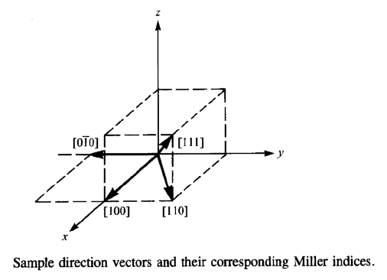
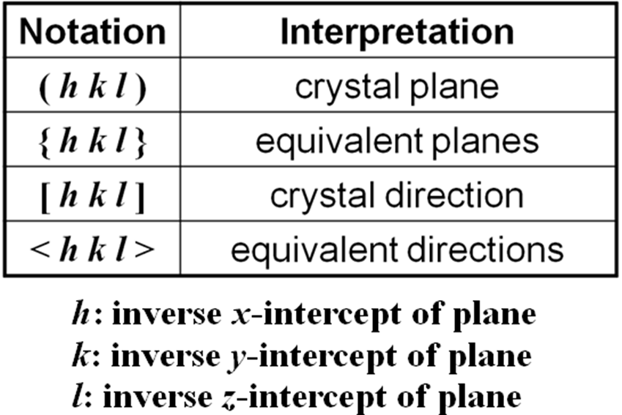
Crystallographic notation

Slide 7
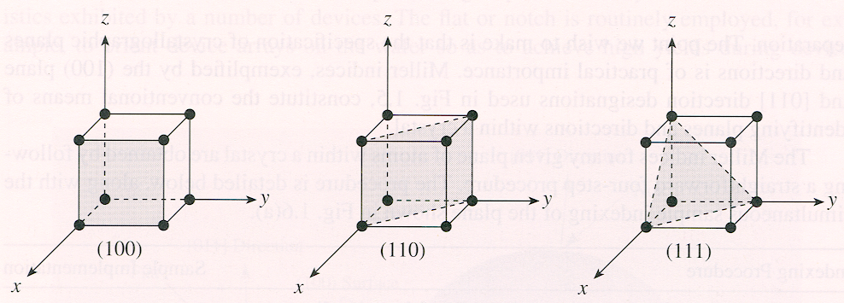
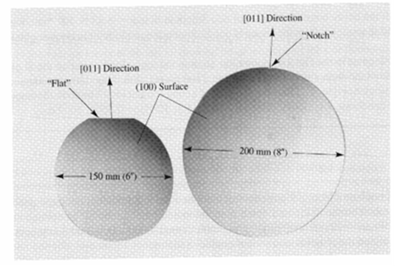
Crystallographic planes and Si wafers
Si wafers usually cut along {100} plane with a notch or flat side to orient the wafer during fabrication

Slide 8
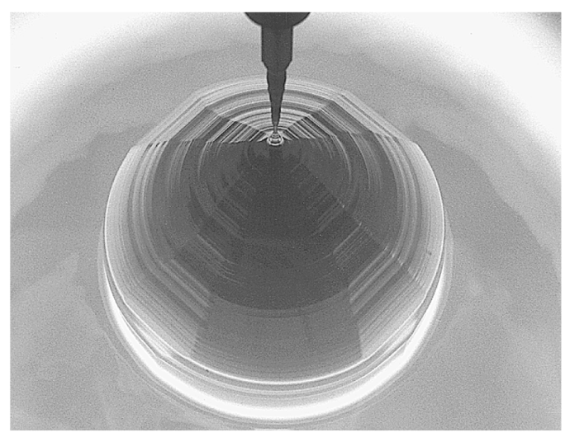
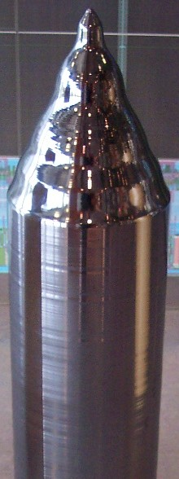
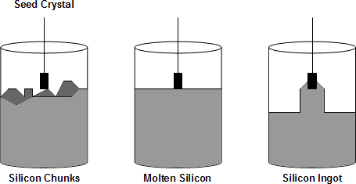
Where do (pure) Si wafers come from?
  Read sections 1.3-1.4 in Streetman book
  Take ECE 444
  Short answer:
Image sources: Wikipedia

Slide 9
ECE 340
Lecture 4
Bonds & Energy Bands

Slide 10
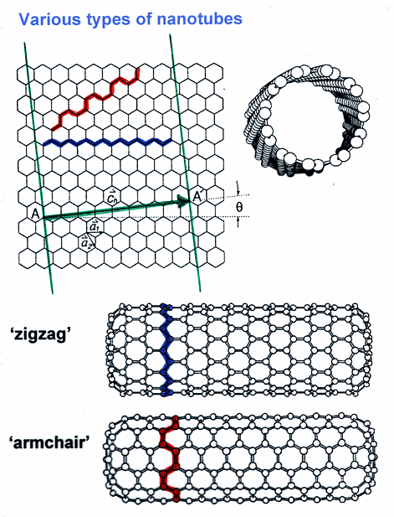
Graphite (~pencil lead) = parallel sheets of graphene
Carbon nanotube = rolled up sheet of graphene

Slide 11

The Bohr model of the (isolated) Si atom (N. Bohr, 1913):
Note: inner shell electrons screen outer shell electrons from the positive charge of the nucleus (outer less tightly bound)
Bohr model:

Slide 12


Quantum theory on two slides:
1) Key result of quantum mechanics (E. Schrödinger, 1926):
  Particle/wave in a single (potential energy) box
  Discrete, separated energy levels

Slide 13
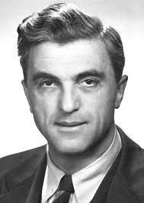
2) Key result of wave mechanics (F. Bloch, 1928):
  Plane wave in a periodic potential
  Wave momentum k only unique up to 2π/a
  Only certain electron energies allowed, but those can propagate unimpeded (theoretically), as long as lattice spacing is “perfectly” maintained‼!
  But, resistance introduced by: __________ and __________

Slide 14
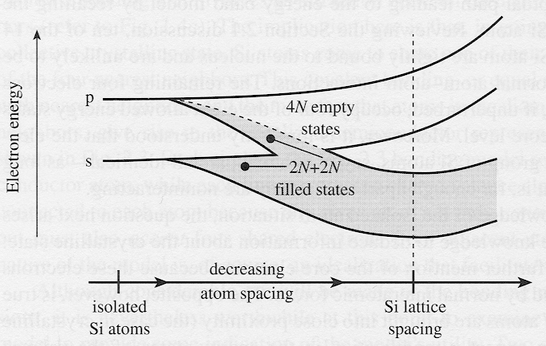
Energy levels when atoms are far apart:
Energy levels when atoms are close together (potentials interact):
Energy levels from discrete atoms to crystal lattice:

Slide 15
Energy states of Si atom expand into energy bands of Si lattice
Lower bands are filled with electrons, higher bands are empty in a semiconductor
The highest filled band = ___________ band
The lowest empty band = ___________ band
Insulators?
Metals?

Slide 16
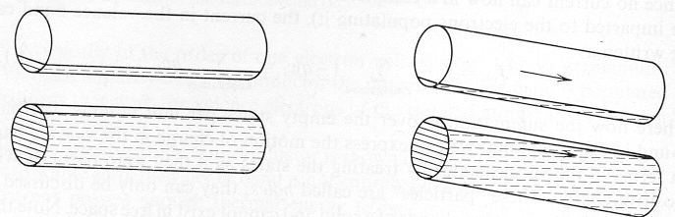
Band structure explains why SiO₂ (diamond, etc) is insulating, silicon is semiconducting, copper is a metal
For electrons to be accelerated in an electric field they must be able to move into new, unoccupied energy states.
Water bottle flow analogy (empty vs. full)
So, what is a hole then?

Slide 17
In devices we usually draw:
Simplified version of energy band model, indicating
  Top edge of valence band (E_{V})
  Bottom edge of conduction band (E_{C})
  Their separation, i.e. band gap energy (E_{G})

Slide 18
ECE 340 Lecture 5
Energy Bands, Temperature, Effective Mass
Typical semiconductor band gaps (E_{G}) between 0-3 eV
  GaAs → E_{G} ≈ 1.42 eV
  Si → E_{G} ≈ 1.12 eV
  Ge → E_{G} ≈ 0.67 eV
… for more, see Appendix III in book
Insulator band gaps > 5 eV → SiO₂ E_{G} = 9 eV
Where are all electrons at T=0 K?
Do either insulators or semiconductors conduct at 0 K?
What about at T=300 K?

Slide 19
bond picture:
(here 2-D)
band
picture:
mechanical
analogy:

Slide 20
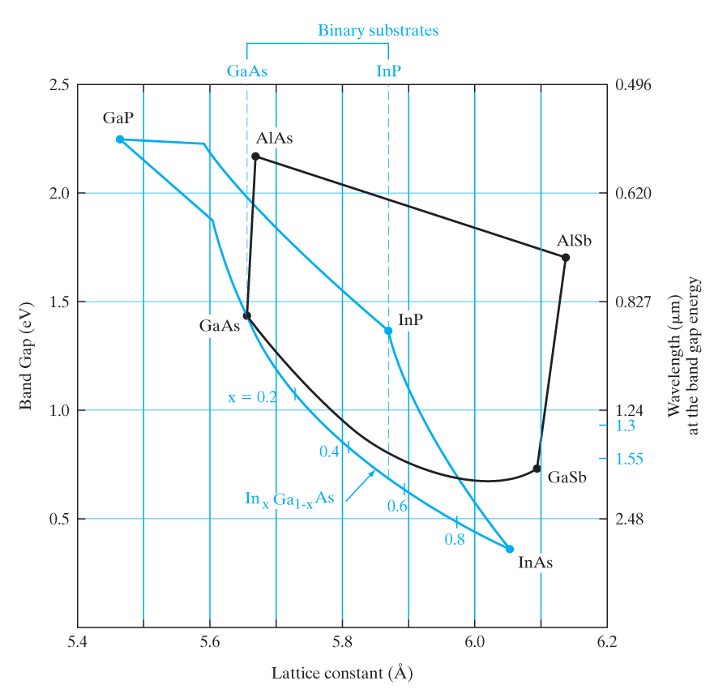
How do band gaps vary with lattice size? (is there a trend?)
How do band gaps
vary with temperature?

Slide 21
Short recap, so we are comfortable switching between:
  Bond picture
  Band picture vs. x
  Band picture vs. k

Slide 22
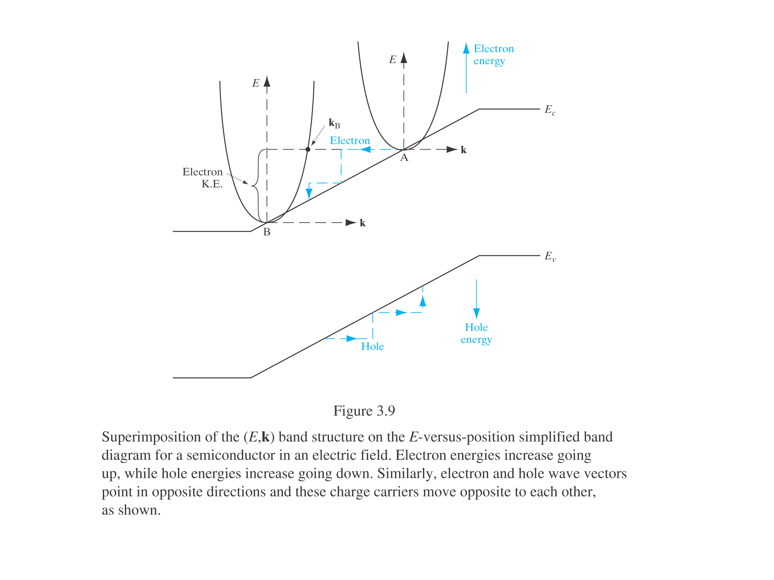
Let’s combine energy bands vs. k and vs. x:
Note what is potential, kinetic, and total energy
Note which way energy of holes increases

Slide 23
Electrons (or holes) as moving particles:
Newton’s law still applies: F = m*a
Where m* = the “effective mass” of the particle,
which includes all the complex influences of the
crystal potential on the motion of the electron (or hole).
Acceleration?
  For electrons: For holes:
Effective mass values? Fractions of m₀. See Appendix III.
  Sometimes depend on direction of motion in the crystal.
  E.g. for electrons in Si: m_{l} = 0.98m₀, m_{t} = 0.19m₀
  Can also depend on particle location in the band (bottom, top, edge, “light” band vs. “heavy” band).
  Values in Appendix III are given at the bottom of C-band for electrons, top of V-band for holes.

Slide 24
Q: What is the meaning of the energy band slope in the E-x band diagram picture?

