Slide 1
ECE 340 Lecture 6
Intrinsic Material, Doping, Carrier Concentrations
Intrinsic semiconductor = pure, without external additives
No free charge carriers at T=0K
What about at T=300K?
How much energy to break a bond?

Slide 2
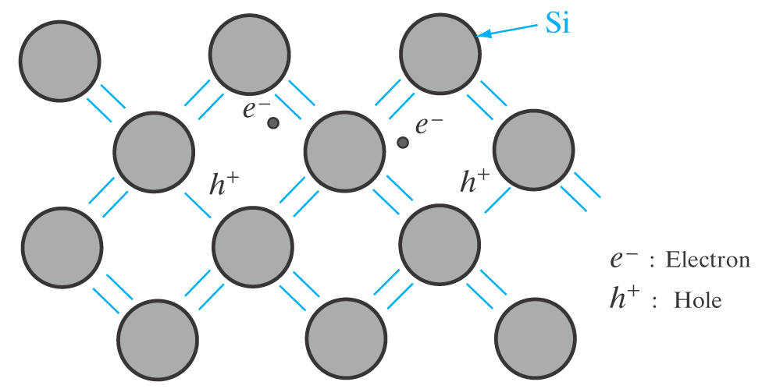
How many electron-hole pairs (EHPs) are created when bonds are broken by thermal agitation?
In thermal equilibrium
  generation = recombination
Simple probability:
  Recombination driven by…
  Generation intrinsically driven only by…
Hence the np product at thermal equilibrium:

Slide 3
At room temperature (T ~ 300 K) intrinsic concentrations:
  n_{i} ~ 2 x 10⁶ electrons and holes per cm³ in GaAs
  ~ 1 x 10¹⁰ cm⁻³ in Si
  ~ 2 x 10¹³ in Ge
What about the band gaps of these materials?
To get a sense of scale, how do these numbers:
  compare with N_{A}?
  compare with number of Si atoms per cm³ (x4 valence electrons per atom)?
What if temperature is increased?

Slide 4
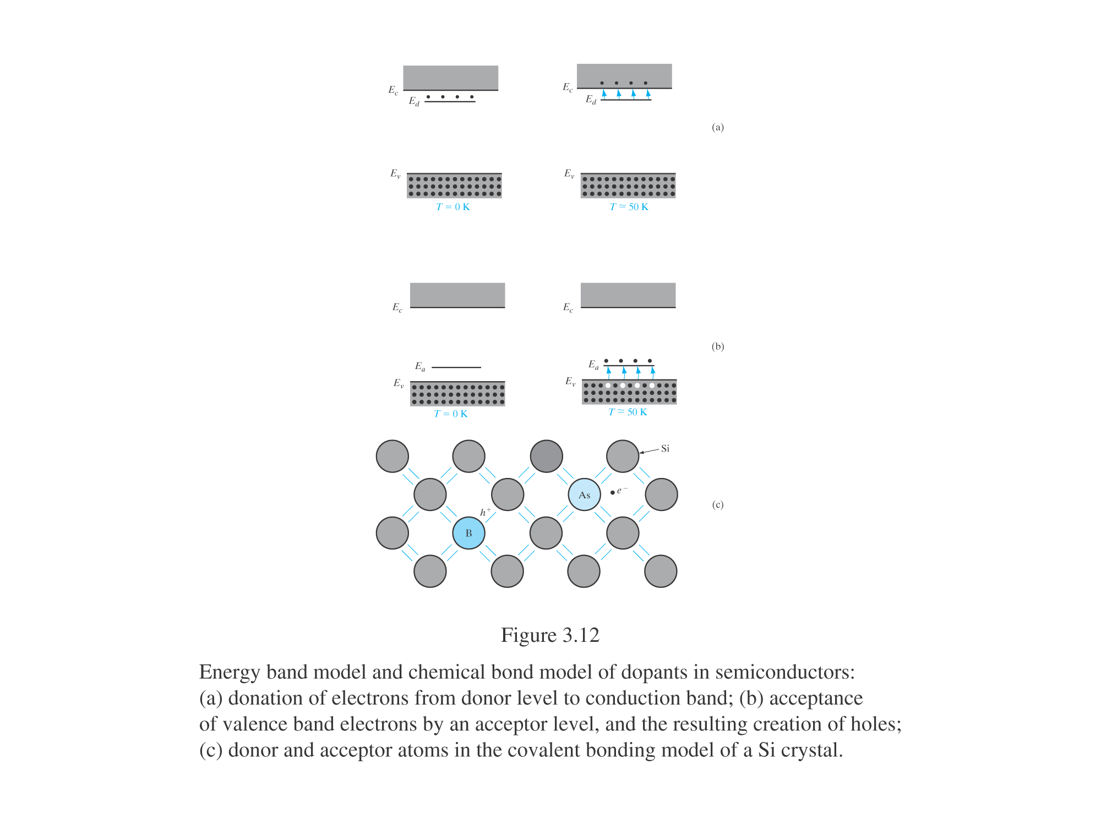
How to manipulate carrier concentrations
Doping = purposely introducing impurities into the crystal
Intrinsic material = pure, undoped. Extrinsic = doped.
Donors and acceptors… of what?
Ex: compare # of valence electrons (e.g. 5 for As) with number of electrons of the atom it replaces (e.g. 4 for Si)

Slide 5
Arsenic (As) dopant in Si: 4 electrons used up for bonding with neighbors. But, how loosely bound is that 5th electron that As brought into the Si lattice?
Approximate binding energy using Niels Bohr’s model:
The real numbers of donors and acceptors in Si:
(note: binding energy = ionization energy)
be careful with choice
of m* and K = 4πϵ_{r}ϵ₀
Donor in Si | P | As | Sb
Binding energy (eV) | 0.045 | 0.054 | 0.039
Acceptor in Si | B | Al | Ga | In
Binding energy (eV) | 0.045 | 0.067 | 0.072 | 0.16

Slide 6
Where are the donor and acceptor levels on the band diagram model?
Recall: thermal agitation
energy ~ 3/2 k_{B}T

Slide 7
Extrinsic (doped) material:
  n-type semiconductor if…
  p-type semiconductor if…
Ex: what are the electron & hole concentrations in a Si wafer doped with 10¹⁵ cm⁻³ As atoms (at room T). Is this n- or p-type Si?
How much has the resistivity changed from intrinsic Si?

Slide 8
Summary:
Band gap energy (E_{G}) is energy required to free an electron from a covalent bond
  E_{G} = 1.1 eV for Si at 300 K
  Insulators have “large” E_{G}, semiconductors have “small” E_{G}
Dopants in Si:
  Substitute pre-existing Si atoms on lattice sites
  Group-V elements are donors, contribute conduction electrons
  Group-III elements are acceptors, contribute holes
  Low ionization energy (~50 meV) → all ionized at room T
  Useful dopant concentrations in Si range from 10¹⁵ to 10²⁰ cm⁻³

Slide 9
ECE 340 Lectures 7-8
Doping, Fermi Level, Density of States
How to calculate electron (and hole) densities for:
  Any temperature
  Any doping concentration
  Any energy level
Recall that in thermal equilibrium: np = n_{i}²
What if I turn the light on? (qualitatively)

Slide 10
We are (typically) dealing with large concentrations, not individual electrons → we need a statistical treatment of these electron (or hole) populations
Two key concepts needed to “count” populations:
  The probability of finding electrons (or holes) in a state
  The number (i.e. density) of states available
Recall that electrons (and holes) obey the Pauli exclusion principle, i.e. electrons are fermions
  So are neutrons, protons (all spin = _____)
But photons and phonons (vibrations) are bosons

Slide 11
1) Fermi-Dirac probability function for electrons & holes
≈ the probability of finding a spectator in a seat as you go up from the bottom row of a stadium
What does this look like?
What is the meaning of the Fermi level, E_{F}?
T=0
f (E)
T=300 K
T=1000 K

Slide 12
2) Density of states in Si conduction & valence band
Counting states (i.e. “stadium seats per row”) in App. IV:
Most important feature is ~E^{1/2} (more states at higher E)
What is E with respect to? Any states in the band gap?
What is m* here?
Bonus question: what about in 1-D and 2-D devices?

Slide 13
So how do we calculate electron & hole concentrations knowing the density of states and probability of occupation?
This is the density of electrons in the C-band. What about holes in the V-band?
This is usually a tough numerical integral, but we can approximate it if E_{F} is well inside the band gap
where

Slide 14
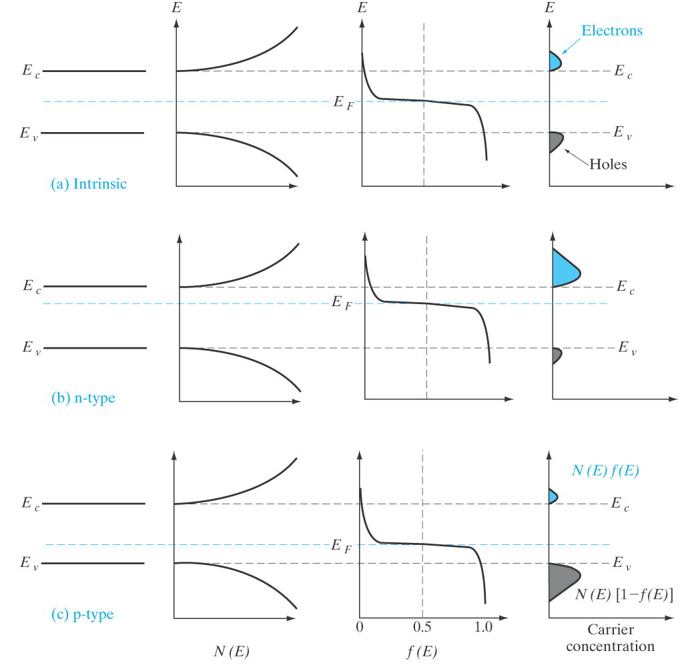
Where is E_{F}
in intrinsic material?
What happens with E_{F} when we start doping the material?

Slide 15
We can write similarly for holes:
And so the product:
Is there an easier way to write these?
Recall if the material is intrinsic, E_{F} = E_{i} = where?
  E_{C} – E_{i} = E_{G}/2
Write n_{i} with N_{C} and N_{V} as above
But we know n_{i} ~ ______ so it’s easier to re-write:
(is the product as
it should be?)

Slide 16
Sample problem: Si doped with 10¹⁶ Boron atoms per cm³. What are the electron & hole concentrations at room T? (assume lights off.) Is this n- or p-type material? Where is the Fermi level E_{F}?

