Slide 1
ECE 340 Lecture 9
Temperature Dependence of Carrier Concentrations
L7 and L8: how to get electron & hole concentrations at:
  Any temperature
  Any doping level
  Any energy level
Previously we also derived:
Where
And

Slide 2
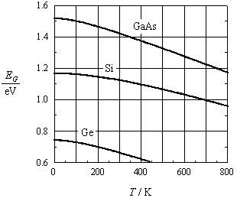
So the intrinsic carrier concentration at any T is:
What does this tell us?
Note that m_{n}*=1.1m₀ and m_{p}*=0.56m₀
These are ________________________ effective masses in Si, not to be confused with _______________________
Does the band gap E_{G} change with T?

Slide 3
Plot log₁₀ of n_{i} vs. T
What do we expect?
Note your book plots this vs. 1000/T in Fig. 3-17; why?
What is this (simple) plot neglecting?

Slide 4
Recall n_{i} is very temperature-sensitive! Ex: in Silicon:
  While T = 300 → 330 K (10% increase)
  n_{i} = ~10¹⁰ → ~10¹¹ cm⁻³ (10x increase)
Also note:
  Now we can calculate the equilibrium electron (n₀) and hole (p₀) concentrations at any temperature
  Now we can calculate the Fermi level (E_{F}) position at any temperature
Ex: Calculate and show position of Fermi level in doped Ge (10¹⁶ cm⁻³ n-type) at -15 ºC, using previous plot

Slide 5
Assume Si sample doped with N_{D} = 10¹⁵ cm⁻³ (n-type)
How does n change with T? (your book plots this vs. 1000/T in Fig. 3-18)
Recall the band diagram, including the donor level.
Note three distinct regions:
  Low, medium, and high-temperature

Slide 6
So far, we assumed material is either just n- or p-doped and life was simple. At most moderate temperatures:
  n₀ ≈
  p₀ ≈
What if a piece of Si contains BOTH dopant types? This is called compensation.
Group V elements are _______
and introduce ________
Group III elements are _______
and introduce ________

Slide 7
Case I, assume we dope with N_{D} > N_{A}
  Additional electrons and holes will _____________ until you have n₀ ≈ N_{D} - N_{A} and p₀ ≈ _________
Case II, what if we introduce N_{D} = N_{A} dopants?
  The material once again becomes ____________ and n₀ ≈ p₀ ≈ ______
Case III and more generally, we must have charge neutrality in the material, i.e. positive charge = negative charge, so p₀ + N_{D} = __________

Slide 8
So most generally, what are the carrier concentrations in thermal equilibrium, if we have both donor and acceptor doping?
And how do these simplify if we have N_{D} >> N_{A} (n-type doping dominates)?
When is “>>” approximation OK?

Slide 9
ECE 340 Lectures 10-11
Carrier drift, Mobility, Resistance
Let’s recap 5-6 major concepts so far:
Memorize a few things, but recognize many.
  Why? Semiconductors require lots of approximations!
Why all the fuss about the abstract concept of E_{F}?
  Consider (for example) joining an n-doped piece of Si with a p-doped piece of Ge. How does the band diagram look?

Slide 10
So far, we’ve learned effects of temperature and doping on carrier concentrations
But no electric field = not useful = boring materials
The secret life of C-band electrons (or V-band holes): they are essentially free to move around, how?
Instantaneous velocity given by thermal energy:
Scattering time (with what?) is of the order ~ 0.1 ps
So average distance (mean free path) travelled between scattering events L ~ _______

Slide 11
But with no electric field (E=0) total distance travelled is: ___
So turn ON an electric field:
F = ± qE
F = m*a → a =
Between collisions, carriers accelerate along E field:
  v_{n}(t) = a_{n}t = ______________ for electrons
  v_{p}(t) = a_{p}t = ______________ for holes
Recall how to draw this in the energy band picture

Slide 12
On average, velocity
is randomized again
every τ_{C} (collision time)
So average velocity in E-field is: v = _____________
We call the proportionality constant the carrier mobility
This is a very important result!!! (what are the units?)
What are the roles of m_{n,p} and τ_{C}?

Slide 13
Then for electrons: v_{n} = -μ_{n}E
And for holes: v_{p} = μ_{p}E
Mobility is a measure of ease of carrier drift in E-field
  If m↓ “lighter” particle means μ…
  If τ_{C}↑ means longer time between collisions, so μ…
Mobilities of some undoped (intrinsic) semiconductors at room temperature:

Slide 14
What does mobility (through τ_{C}) depend on?
  Lattice scattering (host lattice, e.g. Si or Ge vibrations)
  Ionized impurity (dopant atom) scattering
  Electron-electron or electron-hole scattering
  Interface scattering
Which ones depend on temperature?
Qualitative, how?
Strongest scattering, i.e. lowest mobility dominates.

Slide 15
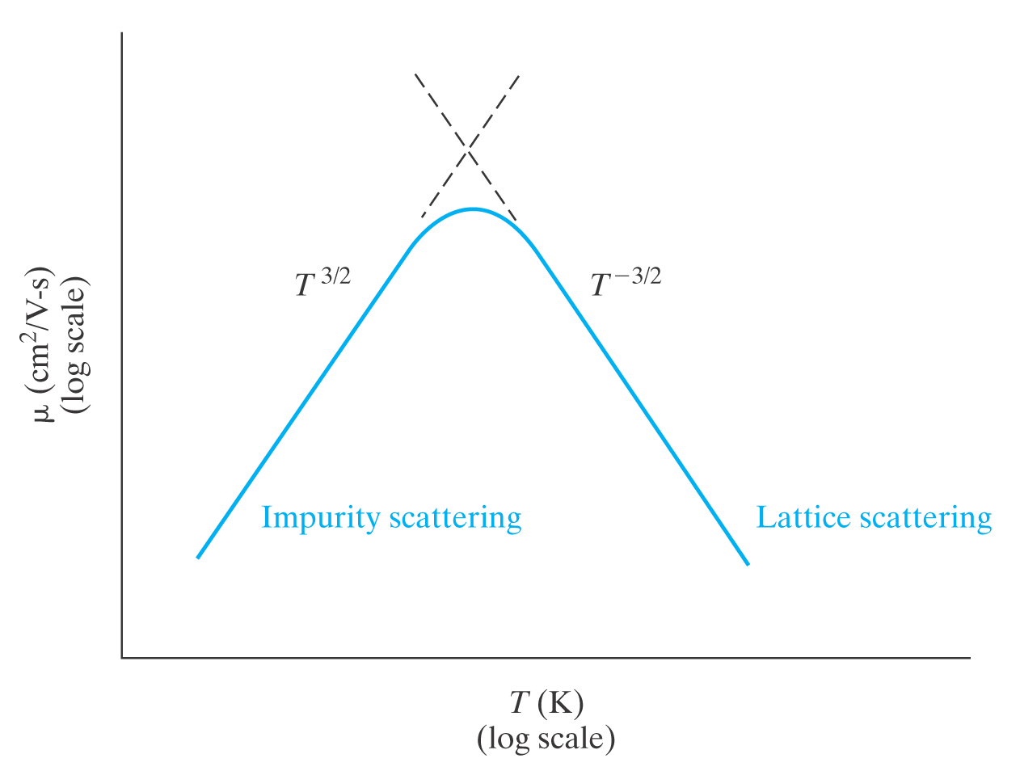
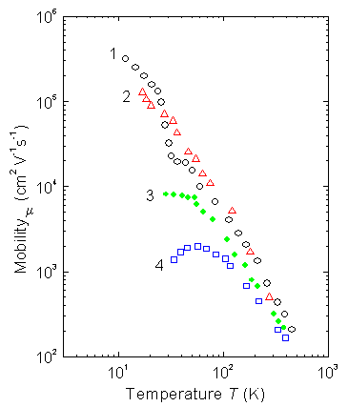
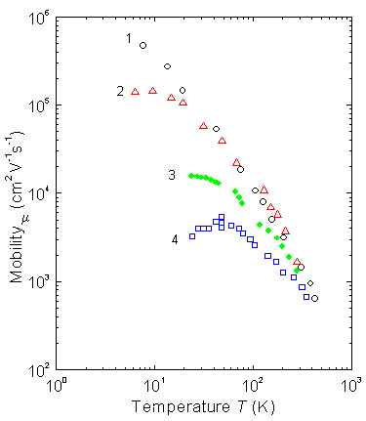
Qualitatively
Quantitatively we rely on experimental measurements (calculations are difficult and not usually accurate):
http://www.ioffe.rssi.ru/SVA/NSM/Semicond/Si/electric.html

Slide 16
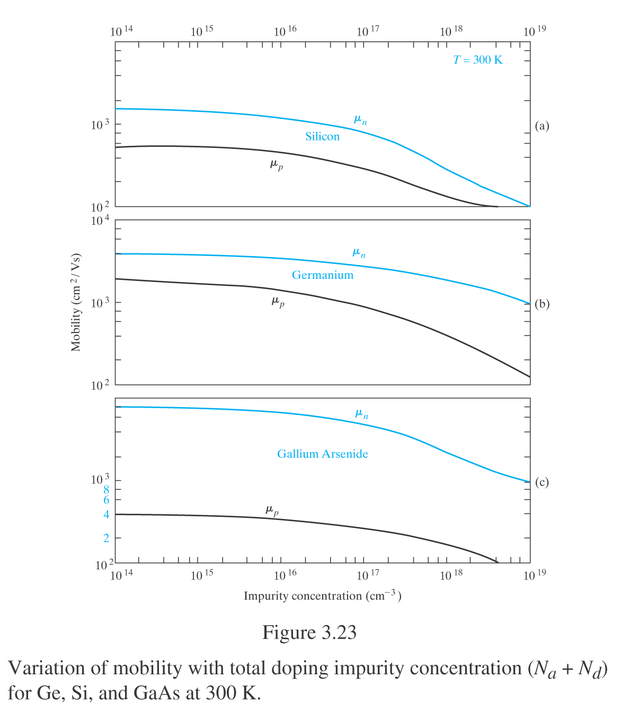
Once again, qualitatively we expect the mobility to decrease with total impurities (N_{D}+N_{A})
Why total impurities and not just N_{D} or N_{A}? (for electrons and holes?)

Slide 17
In linear scale, from the ECE 340 course web site:

Slide 18
Ex: What is the hole drift velocity at room temperature in silicon, in a field E = 1000 V/cm? What is the average time and distance between collisions?

Slide 19
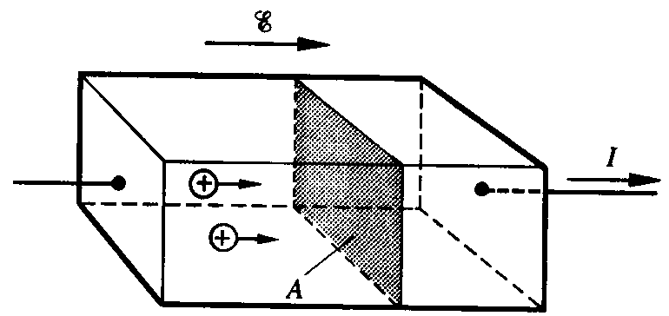
Now we can calculate current flow in realistic devices!
Net velocity of charge particles → electric current
Drift current density ∝ net carrier drift velocity
∝ carrier concentration
∝ carrier charge
First “=“ sign always applies. Second “=“ applies typically at low-fields (<10⁴ V/cm in Si)
(charge crossing plane of area A in time t)

Slide 20
Check units and signs:
Total drift current:
Has the form of Ohm’s Law!
Current density:
Current:
This is very neat. We derived Ohm’s Law from basic considerations (electrons, holes) in a semiconductor.

Slide 21
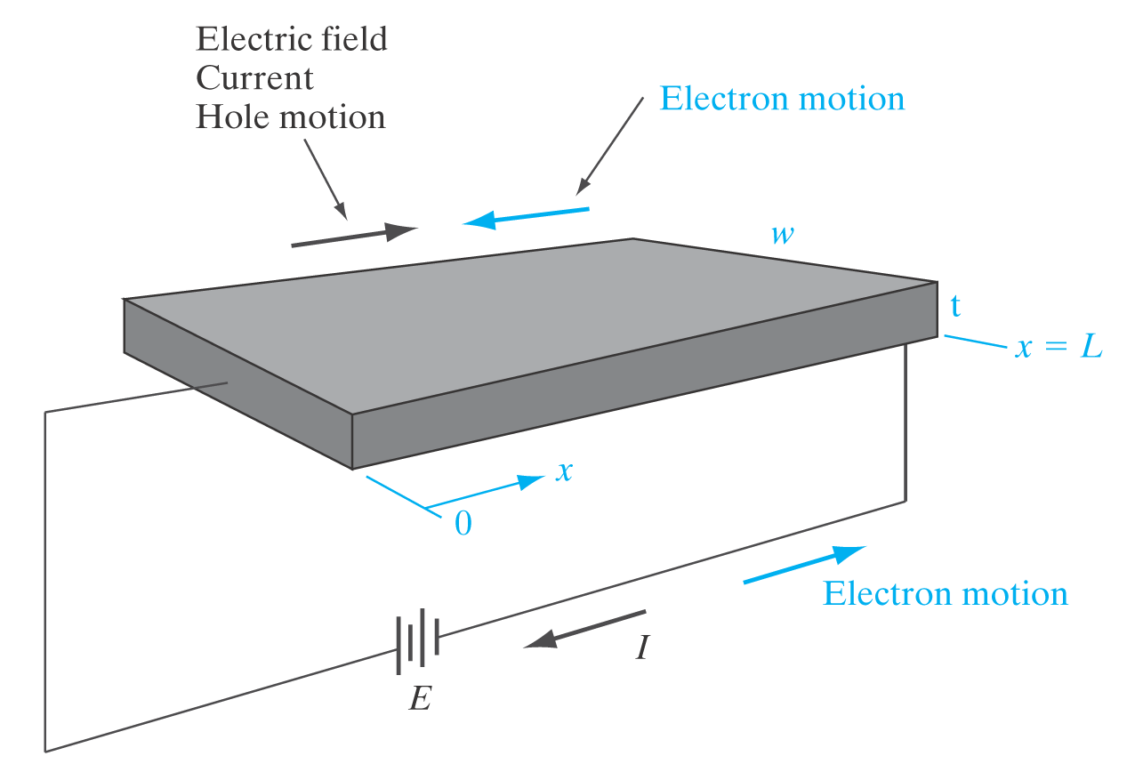
Resistivity of a semiconductor:
What about when n >> p? (n-type doped sample)
What about when n << p? (p-type doped sample)
Drift and resistance:

Slide 22
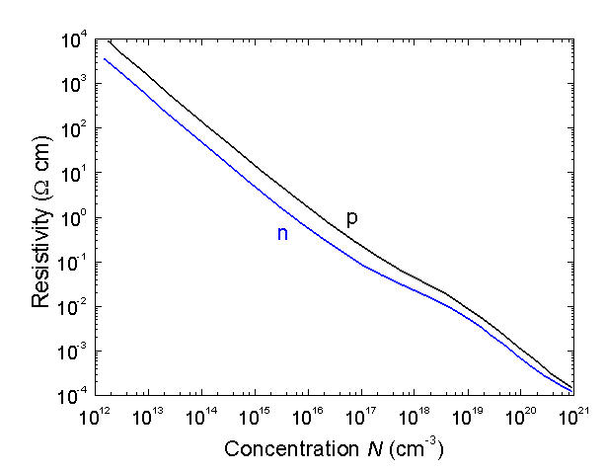
Experimentally, for Si at room T:
This is absolutely essential to show our control over resistivity via doping!
Notes:
  This plot does not apply to compensated material (with comparable amounts of both n- and p-type doping)
  This plot applies most accurately at low-field (<10⁴ V/cm)

