Slide 1
Conductance Quantization
One-dimensional ballistic/coherent transport
Landauer theory
The role of contacts
Quantum of electrical and thermal conductance
One-dimensional Wiedemann-Franz law

Slide 2
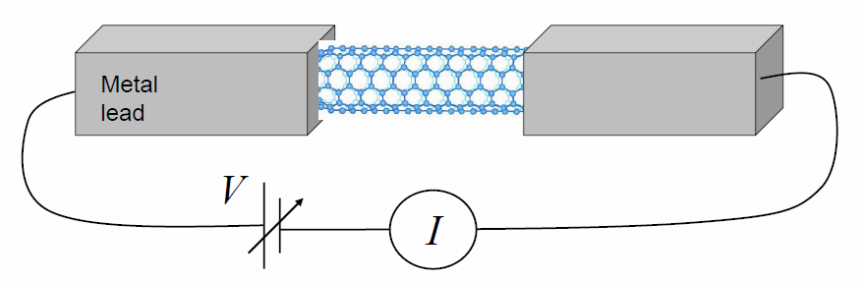
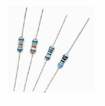
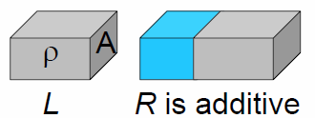
“Ideal” Electrical Resistance in 1-D
Ohm’s Law: R = V/I [Ω]
Bulk materials, resistivity ρ: R = ρL/A
Nanoscale systems (coherent transport)
  R (G = 1/R) is a global quantity
  R cannot be decomposed into subparts, or added up from pieces

Slide 3
Charge & Energy Current Flow in 1-D
Remember (net) current J_{x} ≈ x×n×v where x = q or E
Let’s focus on charge current flow, for now
Convert to integral over energy, use Fermi distribution
Net contribution

Slide 4
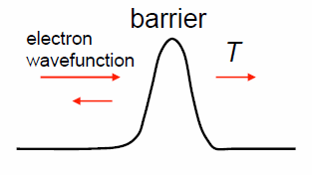
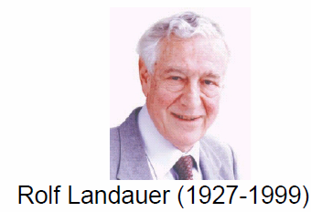
Conductance as Transmission
S
µ₁
D
µ₂
Two terminals (S and D) with Fermi levels µ₁ and µ₂
S and D are big, ideal electron reservoirs, MANY k-modes
Transmission channel has only ONE mode, M = 1

Slide 5
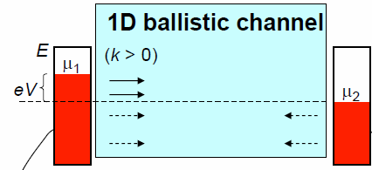
Conductance of 1-D Quantum Wire
qV
x
I
V
g_{k+} = 1/2π
x2 spin
1D
k-space
0
k
quantum of
electrical conductance
(per spin per mode)
Voltage applied is Fermi level separation: qV = µ₁ - µ₂
Channel = 1D, ballistic, coherent, no scattering (T=1)

Slide 6
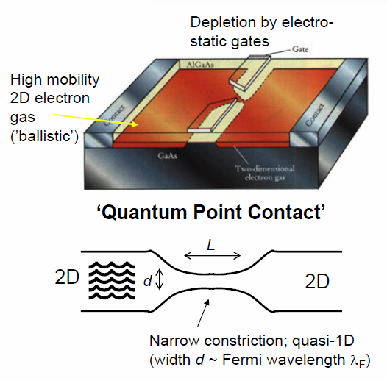
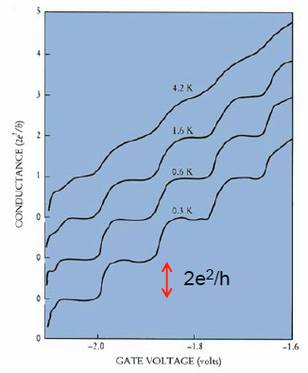
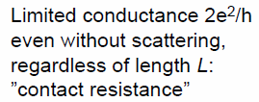
Quasi-1D Channel in 2D Structure
van Wees, Phys. Rev. Lett. (1988)
spin

Slide 7
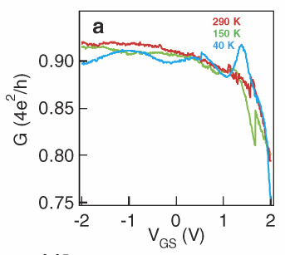

Quantum Conductance in Nanotubes
2x sub-bands in nanotubes, and 2x from spin
“Best” conductance of 4q²/h, or lowest R = 6,453 Ω
In practice we measure higher resistance, due to scattering, defects, imperfect contacts (Schottky barriers)
CNT
S (Pd)
D (Pd)
L = 60 nm
V_{DS} = 1 mV
SiO₂
G (Si)
Javey et al., Phys. Rev. Lett. (2004)

Slide 8
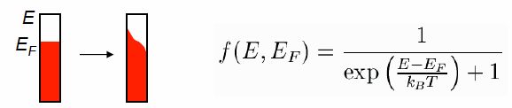

Finite Temperatures
Electrons in leads according to Fermi-Dirac distribution
Conductance with n channels, at finite temperature T:
At even higher T: “usual” incoherent transport (dephasing due to inelastic scattering, phonons, etc.)

Slide 9
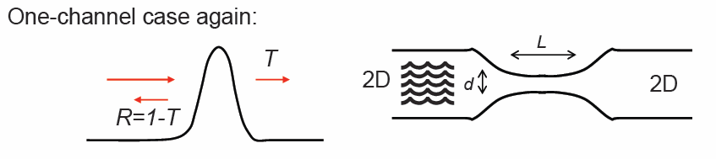
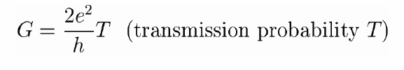

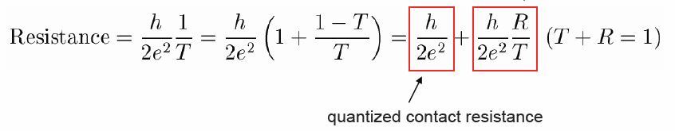
Where Is the Resistance?
S. Datta, “Electronic Transport in Mesoscopic Systems” (1995)

Slide 10
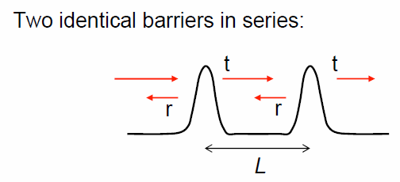
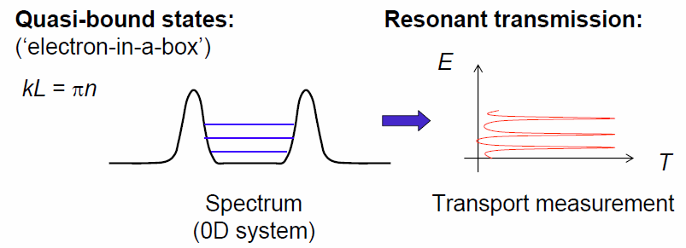
Multiple Barriers, Coherent Transport
Coherent, resonant transport
L < L_{Φ} (phase-breaking length); electron is truly a wave
Perfect transmission through resonant, quasi-bound states:

Slide 11
Multiple Barriers, Incoherent Transport
L > L_{Φ} (phase-breaking length); electron phase gets randomized at, or between scattering sites
Total transmission (no interference term):
Resistance (scatterers in series):
Ohmic addition of resistances from independent scatterers
average mean
free path; remember
Matthiessen’s rule!

Slide 12
Where Is the Power (I²R) Dissipated?
Consider, e.g., a single nanotube
Case I: L << Λ
R ~ h/4e² ~ 6.5 kΩ
Power I²R → ?
Case II: L >> Λ
R ~ h/4e²(1 + L/Λ)
Power I²R → ?
Remember

Slide 13


1D Wiedemann-Franz Law (WFL)
Does the WFL hold in 1D? → YES
1D ballistic electrons carry energy too, what is their equivalent thermal conductance?
(x2 if electron spin included)
nW/K at 300 K
Greiner, Phys. Rev. Lett. (1997)

Slide 14
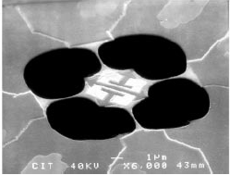
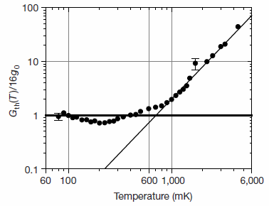
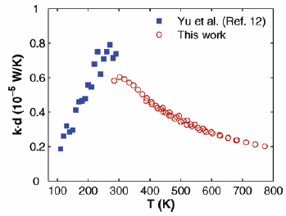
Phonon Quantum Thermal Conductance
Same thermal conductance quantum, irrespective of the carrier statistics (Fermi-Dirac vs. Bose-Einstein)
Phonon G_{th} measurement in
GaAs bridge at T < 1 K
Schwab, Nature (2000)
nW/K at 300 K
Single nanotube G_{th}=2.4 nW/K at T=300K
Pop, Nano Lett. (2006)
Matlab tip:
>> syms x;
>> int(x^2*exp(x)/(exp(x)+1)^2,0,Inf)
ans =
1/6*pi^2

Slide 15
Electrical vs. Thermal Conductance G₀
Electrical experiments → steps in the conductance (not observed in thermal experiments)
In electrical experiments the chemical potential (Fermi level) and temperature can be independently varied
  Consequently, at low-T the sharp edge of the Fermi-Dirac function can be swept through 1-D modes
  Electrical (electron) conductance quantum: G₀ = (dI_{e}/dV)|_{low dV}
In thermal (phonon) experiments only the temperature can be swept
  The broader Bose-Einstein distribution smears out all features except the lowest lying modes at low temperatures
  Thermal (phonon) conductance quantum: G₀ = (dQ_{th}/dT) |_{low dT}

Slide 16
Back to the Quantum-Coherent Regime
Single energy barrier – how do you get across?
Double barrier: transmission through quasi-bound (QB) states
Generally, need λ ~ L ≤ L_{Φ} (phase-breaking length)
E
f_{FD}(E)
thermionic emission
tunneling or reflection
E_{QB}
E_{QB}

Slide 17
Wentzel-Kramers-Brillouin (WKB)
E_{x}
E||
f_{FD}(E_{x})
A
B
tunneling only
0
L
Assume smoothly varying potential barrier, no reflections
k(x) depends on
energy dispersion
E.g. in 3D, the net current is:
Fancier version of
Landauer formula!

Slide 18
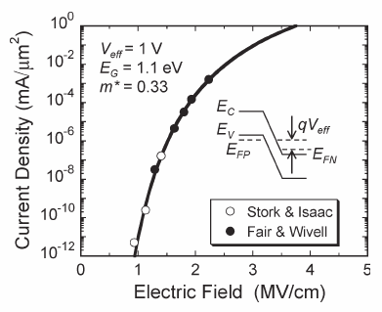
Band-to-Band Tunneling
Assuming parabolic energy dispersion E(k) = ħ²k²/2m*
E.g. band-to-band (Zener) tunneling
in silicon diode
F = electric field
See, e.g. Kane, J. Appl. Phys. 32, 83 (1961)

