Slide 1
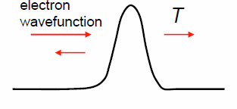
Summary of Boundary Resistance
g(E)
E
thermionic emission
f_{FD}(E)
tunneling or reflection
ω
µ₁
ω_{D,2}
µ₁-µ₂ = ?
g(ω)
ω
ω_{D,1}
µ₂
f_{BE}(ω)
g(ω)
Electrical: Work function (Φ) mismatch
Thermal: Debye (v,Θ) mismatch
++ ??
++ ??

Slide 2
Acoustic vs. Diffuse Mismatch Model
Specular
Diffuse
Acoustic Impedance
Mismatch (AIM)
= (ρv)₁/(ρv)₂
Diffuse Mismatch
= (Cv)₁/(Cv)₂
Acoustic Mismatch Model (AMM)
Khalatnikov (1952)
Diffuse Mismatch Model (DMM)
Swartz and Pohl (1989)
Snell’s law
with Z = ρv
(normal incidence)

Slide 3
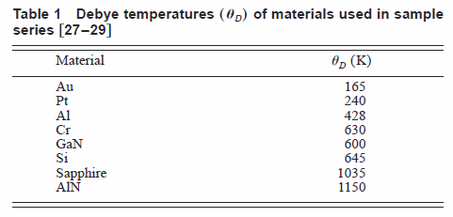
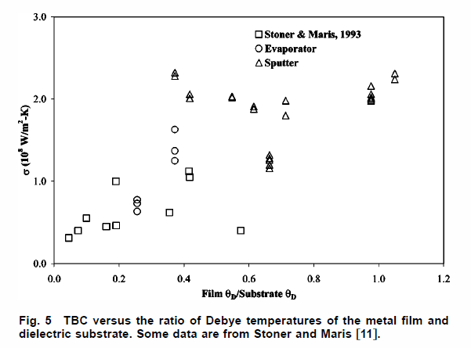
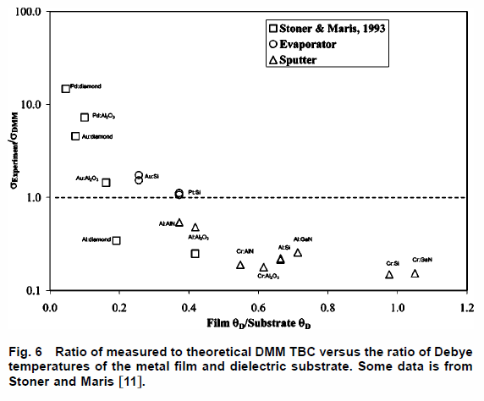
Debye Temperature Mismatch
DMM
Stevens, J. Heat Transf. 127, 315 (2005)
Stoner & Maris, Phys. Rev. B 48, 16373(1993)

Slide 4
General Approach to Boundary Resistance
(conductance)
E_{x}
E||
f_{FD}(E_{x})
A
B
transmission
0
L
Flux J = #incident particles x velocity x transmission prob.
More generally:
fancier version of
Landauer formula!
ex: electron tunneling

Slide 5
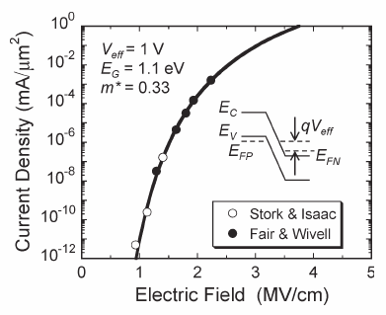
Band-to-Band Tunneling Conduction
Assuming parabolic energy dispersion E(k) = ħ²k²/2m*
E.g. band-to-band (Zener) tunneling
in silicon diode
F = electric field
See, e.g. Kane, J. Appl. Phys. 32, 83 (1961)

Slide 6
Thermionic and Field Emission (3D)
thermionic emission
Φ
tunneling (field emission)
µ₁
F
µ₁-µ₂ = qV
µ₂
field emission a.k.a. Fowler-Nordheim tunneling
see, e.g. Lenzlinger, J. Appl. Phys. 40, 278 (1969)
S. Sze, Physics of Semiconductor Devices, 3rd ed. (2007)

Slide 7
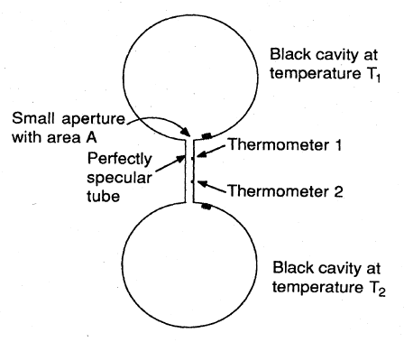



The Photon Radiation Limit
Phonons behave like photons at low-T
in the absence of scattering (why?)
Acoustic analog of
Stefan-Boltzmann constant
c_{i} = sound velocities (2 TA, 1 LA)
Heat flux:
what’s the temperature profile?
Swartz & Pohl, Rev. Mod. Phys. 61, 605 (1989)

Slide 8
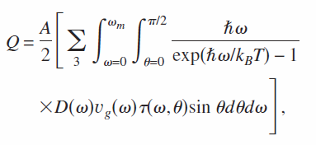
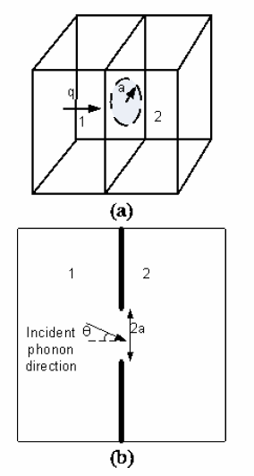
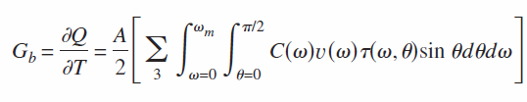


Phonon Conductance of Nanoconstrictions
1) a >> λ → τ = cos(θ)
λ = dominant phonon wavelength
Prasher, Appl. Phys. Lett. 91, 143119 (2007)

Slide 9
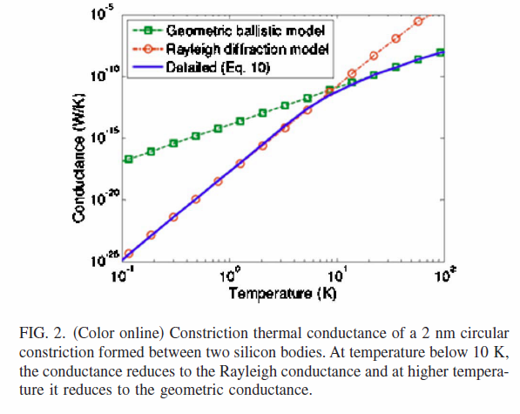
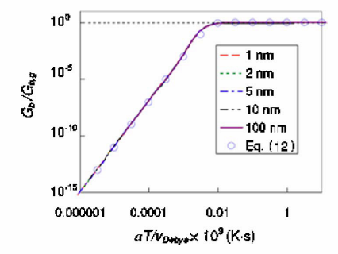


Phonon Conductance of Nanoconstrictions
2) a << λ
λ = dominant phonon wavelength
Prasher, Appl. Phys. Lett. 91, 143119 (2007)

Slide 10
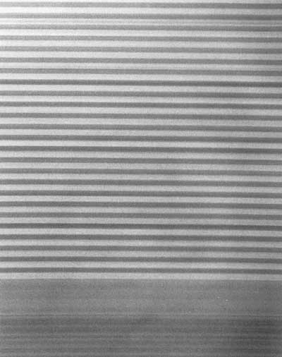
Why Do Thermal Boundaries Matter?
TEM of superlattice
source: A. Majumdar
Because surface area to volume ratio is greater for nanowires, nanoparticles, nanoconstrictions
Because we can engineer metamaterials with much lower “effective” thermal conductivity than Mother Nature

Slide 11
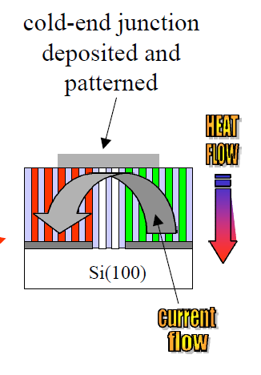
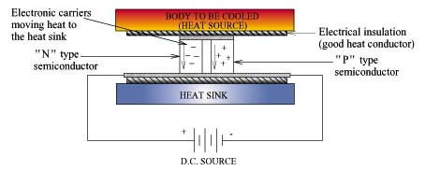
Because of Thermoelectric Applications
No moving parts: quiet and reliable
No Freon: clean
Courtesy: L. Shi, M. Dresselhaus

Slide 12
Thermoelectric Figure of Merit (ZT)
Coefficient of Performance
where ZT is…
T_{H} = 300 K
T_{C} = 250 K
Seebeck coefficient
Freon (CFCs)
Electrical conductivity
Bi₂Te₃
Temperature
Thermal conductivity
Courtesy: L. Shi

Slide 13
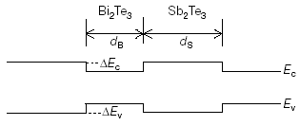
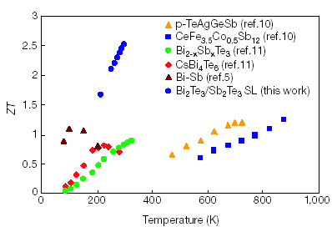
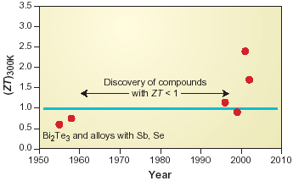
ZT State of the Art
Venkatasubramanian et al. Nature 413, 597
2.5-25nm
Bi₂Te₃/Sb₂Te₃ Superlattices
Harman et al., Science 297, 2229
Quantum dot superlattices
5
Goal: decrease k (keeping σ same) with superlattices, nanowires or other nanostructures
Nanoscale thermal engineering!
Courtesy: A. Majumdar, L. Shi

Slide 15
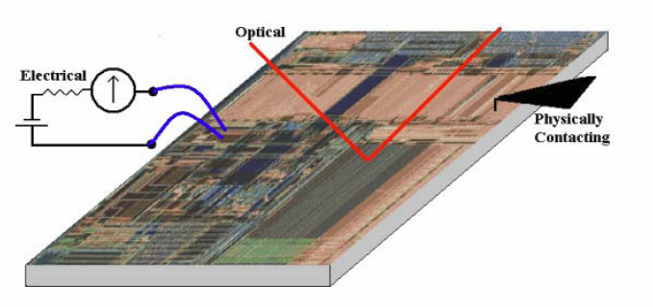
Nanoscale Thermometry
Reviews: Blackburn, Semi-Therm 2004 (IEEE)
Cahill, Goodson & Majumdar, J. Heat Transfer (2002)

Slide 16
Typical Measurement Approach
For nanoscale electrical we can still measure I/ΔV = AJ_{q}/ΔV
For nanoscale thermal we need J_{th}/ΔT, but there is NO good, reliable nanoscale thermometer
Typically we either:
  a) Measure optical reflectivity change with ΔT
  b) Measure electrical resistivity change with ΔT
  (after making sure they are both calibrated)
Must know the thermal flux J_{th}

Slide 17

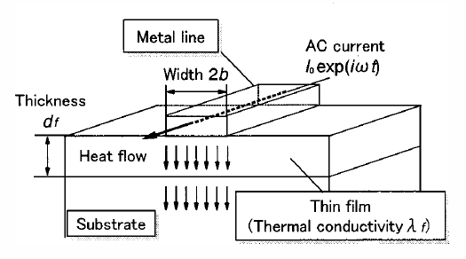
The 3ω Method (thin film cross-plane)
Metal line
I ~ 1ω
T ~ I² ~ 2ω
R ~ T ~ 2ω
V_{3ω} ~ IR ~ 3ω
L
2b
V
Thin film
I₀ sin(ωt)
Substrate
where α is metal line TCR
D. Cahill, Rev. Sci. Instrum. 61, 802 (1990)
T. Yamane, J. Appl. Phys. 91, 9772 (2002)

Slide 18
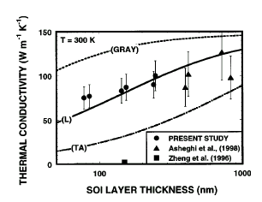
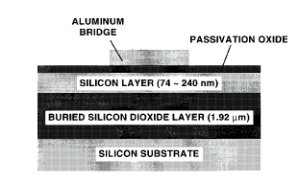
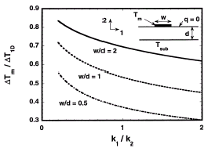
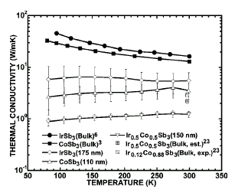
3ω Method Applications…
Thin crystalline Si films
Ju and Goodson, Appl. Phys. Lett. 74, 3005 (1999)
Compare temperature rise of
metal line for different line
widths, deduce anisotropic
polymer thermal conductivity
Superlattices
Song, Appl. Phys. Lett. 77, 3154 (2000)
Ju, Kurabayashi, Goodson, Thin Solid Films 339, 160 (1999)

Slide 19
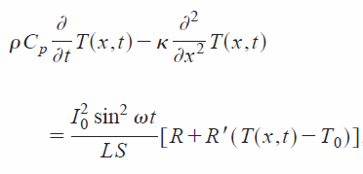
The 3ω Method (longitudinal)
Lu, Yi, Zhang, Rev. Sci. Instrum. 72, 2996 (2001)
V
I₀ sin(ωt)
Low frequency: V(3ω) ~ 1/k
High frequency: V(3ω) ~ 1/C
Tested for a 20 μm diameter Pt wire
Results for a bundle of MW nanotubes:
C ~ linear T dependence, low k ~ 100 W/mK
Wire
Substrate
3w mechanism: ΔT~ V²/k and R ~ R_{o} + αΔT

Slide 20
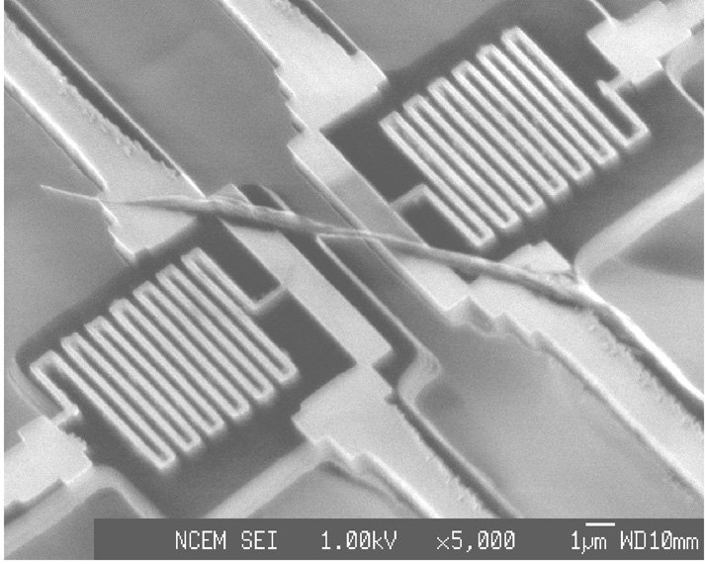
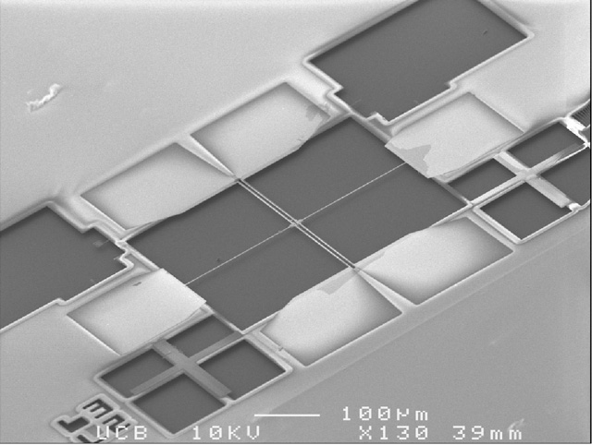
Another Suspended Bridge Approach
Pt heater line
Multiwall nanotube
SiN_{x} beam
Pt heater line
Suspended island
Source: L. Shi

Slide 21
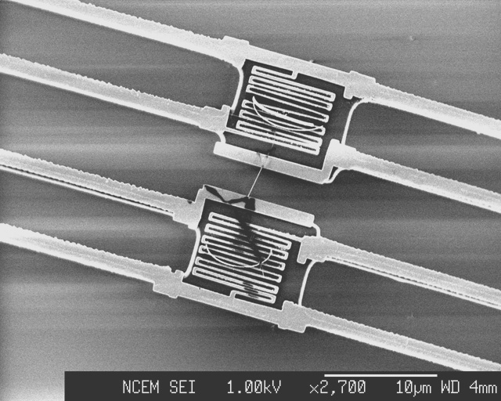
Measurement Scheme
G_{t} = kA/L
Thermal Conductance:
T
h
T
s
T
s
Q_{H} = IR_{H}
R
t
R
h
s
Tube
Q_{L} = IR_{L}
I
Environment
10 nm multiwall tube
T
0
V_{TE}
Beam
Thermopower:
Q = V_{TE}/(T_{h}-T_{s})
Island
Pt heater line

Slide 22
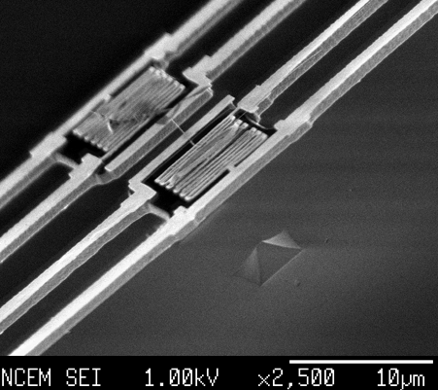
Multiwall Nanotube Measurement
L. Shi, J. Heat Transfer, 125, 881 (2003)
14 nm multiwall tube
Measurement result
Cryostat: T : 4-350 K
P ~ 10⁻⁶ torr

Slide 23
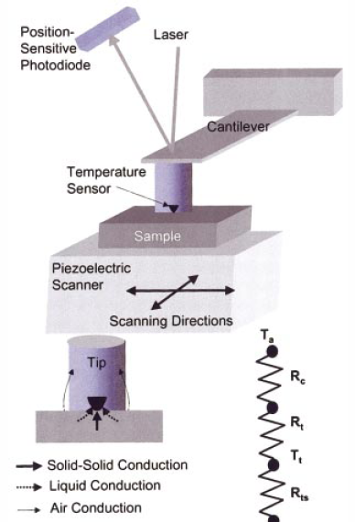
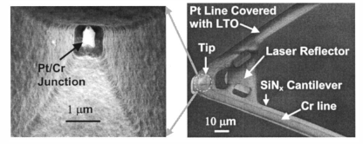

Scanning Thermal Microscopy (SThM)
T_{A}
Sharp temperature-sensing tip mounted on cantilever
Scan in lateral direction, monitor cantilever deflection
Thermal transport at tip is key (air, liquid, and solid conduction)
T_{T}
T_{S}
Source: L. Shi, Appl. Phys. Lett. 77, 4296 (2000)

Slide 24
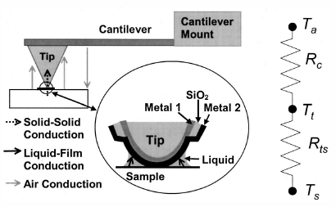
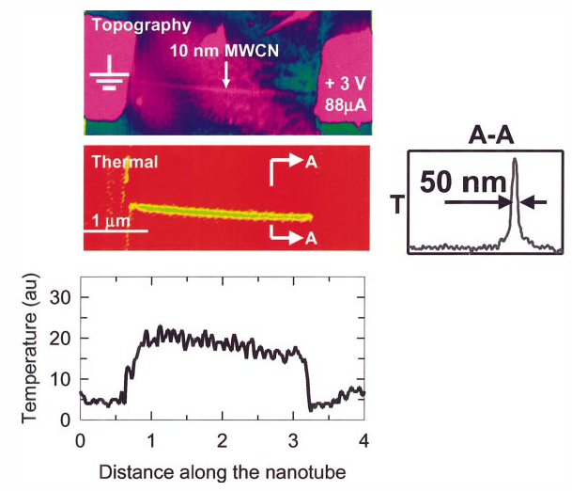
SThM Applied to Multi-Wall Nanotube
Must understand sample-tip heat transfer
Note arbitrary temperature units here (calibration was not possible)
Note R_{tip} ~ 50 nm vs. d ~ 10 nm
Source: L. Shi, D. Cahill

Slide 25
Scanning Joule Expansion Microscopy
AFM cantilever follows the thermo-mechanical expansion of periodically heated (ω) substrate
Ex: SJEM thermometry images of metal interconnects
Resolution ~10 nm and ~degree C
Source: W. P. King

Slide 26
Thermal Effects on Devices
At high temperature (T↑)
  Threshold voltage V_{t} ↓ (current ↑)
  Mobility decrease µ ↓ (current ↓)
  Device reliability concerns
Device heats up during characterization (DC I-V)
  Temperature varies during digital and analog operation
  Hence, measured DC I-V is not “true” I-V during operation
  True whenever τ_{thermal} >> τ_{electrical} and high enough power
  True for SOI-FET (perhaps soon bulk-FET, CNT-FET, NW-FET)
How to measure device thermal parameters at the same time as electrical ones?

Slide 27
Measuring Device Thermal Resistance
∆T = P × R_{TH}
Noise thermometry
  Bunyan 1992
Gate electrode resistance thermometry
  Mautry 1990; Goodson/Su 1994
Pulsed I-V measurements
  Jenkins 1995, 2002
AC conductance measurement
  Lee 1995; Tenbroek 1996; Reyboz 2004; Jin 2001
Note: these are electrical, non-destructive methods

Slide 28
Noise Thermometry
Bunyan, EDL 13, 279 (1992)
Body-contacted SOI devices
  L = 0.87 and 7.87 µm
  t_{ox} = 19.5 nm, t_{Si} = 0.2 um, t_{BOX} = 0.42 um
Bias back-gate → accumulation (R) at back interface
Mean square thermal noise voltage ‹v_{n}›² = 4k_{B}TRB
Frequency range B = 1-1000 Hz
Measure R and ‹v_{n}› at each gate & drain bias
T = T₀ + R_{TH}I_{D}V_{D} (R_{TH} ~ 16 K/mW)

Slide 29
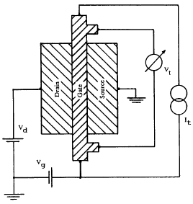
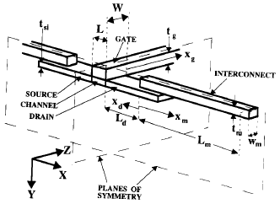
Gate Electrode Resistance Thermometry
Mautry 1990; Su-Goodson 1994-95
Gate has 4-probe configuration
Make usual I-V measurement…
Gate R calibrated vs. chuck T
Measure gate R with device power P
Correlate P vs. T and hence R_{TH}

Slide 30
Pulsed I-V Measurement
Jenkins 1995, 2002
Normal device layout
7 ns electric pulses, 10 µs period
Device can cool during long thermal time constant (50-100 ns)
High-bandwidth (10 GHz) probes
Obtain both thermal resistance and capacitance

Slide 31
AC Conductance Measurement
Lee 1995; Tenbroek 1996; Reyboz 2004; Jin 2001
No special test structure
Measure drain conductance
Frequency range must span all device thermal time constants
Obtain both R_{TH} and C_{TH}
Thermal time constant (R_{TH}C_{TH}) is bias-independent
g_{DS} = ∂I_{D} / ∂V_{DS}

Slide 32
Device Thermometry Results Summary
Single-wall nanotube
High thermal resistances:
SWNT due to small thermal conductance (very small d ~ 2 nm)
Others due to low thermal conductivity, decreasing dimensions, increased role of interfaces
Phase-change Memory (PCM)
Silicon-on-
Insulator FET
Cu Via
Power input also matters:
SWNT ~ 0.01-0.1 mW
Others ~ 0.1-1 mW
Bulk FET
Data: Mautry (1990), Bunyan (1992), Su (1994), Lee (1995), Jenkins (1995), Tenbroek (1996), Jin (2001), Reyboz (2004), Javey (2004), Seidel (2004), Pop (2004-6), Maune (2006).
Notes:
Thermal resistance R_{TH} (K/mW): ΔT increase for 1 mW power input. Typical power ~ 1 mW/μm for CMOS, ~ 0.4 mW for Phase-Change Memory, ~ 20 μW for SWNT. Explain the meaning of L here.

Slide 33
