Slide 1
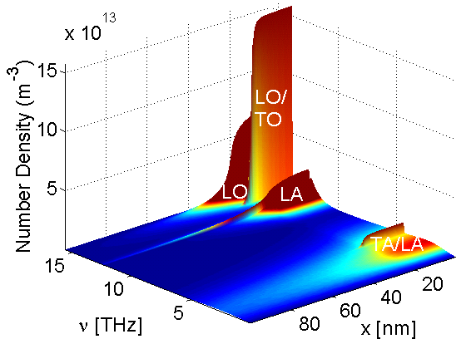
Power Dissipation in Semiconductors
Nanoelectronics:
Higher packing density → higher power density
Confined geometries
Poor thermal properties
Thermal resistance at material boundaries
Where is the heat generated?
Spatially: channel vs. contacts
Spectrally: acoustic vs. optical phonons, etc.

Slide 2
Simplest Power Dissipation Models
R
Resistor: P = IV = V²/R = I²R
Digital inverter: P = fCV²
Why?

Slide 3
Revisit Simple Landauer Resistor
Ballistic
Diffusive
I = q/t
P = qV/t = IV
?
µ₁
µ₁
E
E
µ₂
µ₂
µ₁-µ₂ = qV
Q: Where is the power dissipated and how much?

Slide 4
Continuum View of Heat Generation
Lumped model:
Finite-element model:
More complete finite-element model:
µ₁
E
(phonon emission)
(recombination)
µ₂
be careful: radiative vs. phonon-assisted
recombination/generation?!

Slide 5
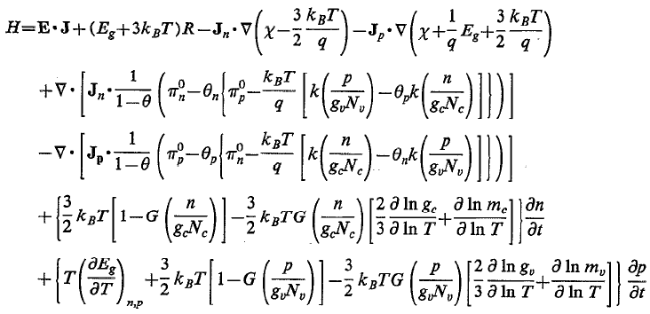
Most Complete Heat Generation Model
Lindefelt (1994): “the final formula for heat generation”
Lindefelt, J. Appl. Phys. 75, 942 (1994)

Slide 6
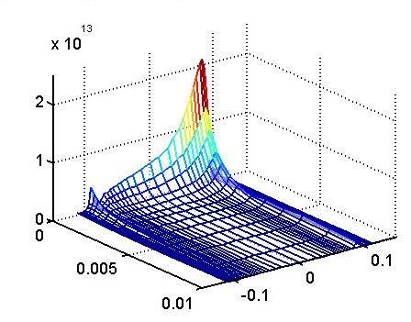
Computing Heat Generation in Devices
Drift-diffusion:
Does not capture non-local transport
Hydrodynamic:
Needs some avg. scattering time
(Both) no info about generated phonons
H (W/cm³)
y (μm)
x (μm)
Monte Carlo:
Pros: Great for non-equilibrium transport
Complete info about generated phonons:
Cons: slow (there are some short-cuts)
Notes:
Add in the simplest Q=IV ?

Slide 7
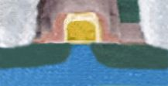
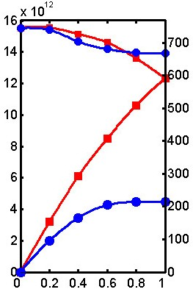
Details of Joule Heating in Silicon
High Electric
IBM
Field
Gate
Source
Drain
Hot Electrons
(Energy E)
E > 50 meV
τ ~ 0.1ps
60
E < 50 meV
(v_{op} ≤ 1000 m/s)
optical
τ ~ 0.1ps
50
Optical Phonons
40
τ ~ 10 ps
Freq (Hz)
Energy (meV)
30
Acoustic Phonons
(v_{ac} ~ 5-9000 m/s)
τ ~ 1 ms – 1 s
20
10
Heat Conduction
acoustic
to Package
Wave vector qa/2π

Slide 8
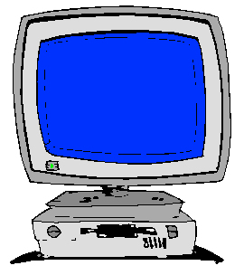
Self-Heating with the Monte Carlo Method
Electrons treated as semi-classical particles, not as “fluid”
Drift (free flight), scatter and select new state
Must run long enough to gather useful statistics
Main ingredients:
Electron energy band model
Phonon dispersion model
Device simulation:
Impurity scattering, Poisson equation, boundary conditions
Must set up proper simulation grid

Slide 9
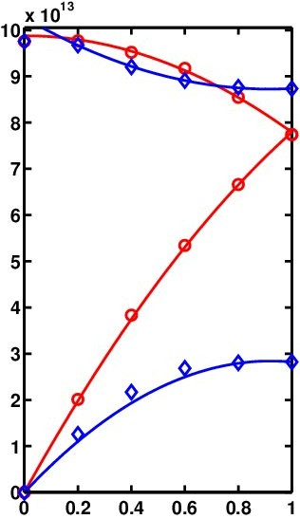
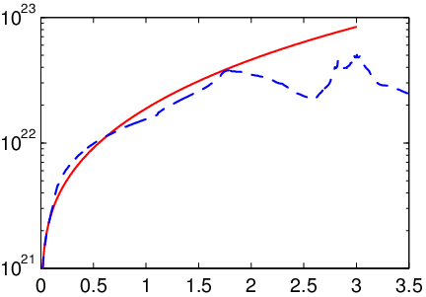
Monte Carlo Implementation: MONET
E. Pop et al., J. Appl. Phys. 96, 4998 (2004)
optical
50 meV
Typical
MC codes
Analytic band
Our analytic
approach
Phonon Freq. ω (rad/s)
Density of States (cm⁻³eV⁻¹)
Full band
OK to use
20 meV
acoustic
Energy E (eV)
Wave vector qa/2π
Analytic electron energy bands + analytic phonon dispersion
First analytic-band code to distinguish between all phonon modes
Easy to extend to other materials, strain, confinement

Slide 10
Inter-Valley Phonon Scattering in Si
Six phonons contribute
well-known: phonon energies
disputed: deformation potentials
What is their relative contribution?
Rate:
Include quadratic dispersion for all intervalley phonons ω(q) = v_{s}q-cq²
Deformation Potentials D_{p} (10⁸ eV/cm)
g
f
0.5
(TA, 10 meV)
1.5
(LA, 19 meV)
7.0
(LO, 64 meV)
0.8
(LA, 18 meV)
11.0
(LO, 63 meV)
g-type
0.3
(TA, 19 meV)
3.0
(LA/LO, 51 meV)
1.5
(TO, 57 meV)
2.0
(LA/LO, 50 meV)
2.0
(TO, 59 meV)
f-type
Pop,
2004
Jacoboni,
1983

Slide 11
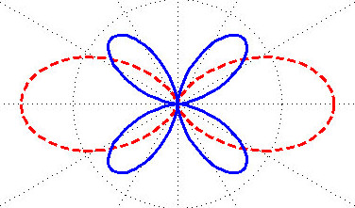
Intra-Valley Acoustic Scattering in Si
SKIP
Herring & Vogt, 1956
(Ξ_{TA}/v_{TA})²
(Ξ_{LA}/v_{LA})²
longitudinal
Yoder, 1993
Fischetti &
Laux, 1996
Pop, 2004
θ = angle between phonon k and longitudinal axis
Averaged values: D_{LA}=6.4 eV, D_{TA}=3.1 eV, v_{LA}=9000 m/s, v_{TA}=5300 m/s

Slide 12
Scattering and Deformation Potentials
SKIP
E. Pop et al., J. Appl. Phys. 96, 4998 (2004)
Intra-valley
Inter-valley
Phonon type | Energy (meV) | Old model* | This work
 |  | (x 10⁸ eV/cm)
f-TA | 19 | 0.3 | 0.5
f-LA | 51 | 2 | 3.5**
f-TO | 57 | 2 | 1.5
g-TA | 10 | 0.5 | 0.3
g-LA | 19 | 0.8 | 1.5**
g-LO | 63 | 11 | 6**
Herring
& Vogt, 1956
Yoder, 1993
Fischetti &
Laux, 1996
This work
(isotropic,
average over θ)
Average values: D_{LA} = 6.4 eV, D_{TA} = 3.1 eV
(Empirical Ξ_{u} = 6.8 eV, Ξ_{d} = 1eV)
* old model = Jacoboni 1983
** consistent with recent ab initio calculations
(Kunikiyo, Hamaguchi et al.)
Notes:
May need to skip this slide if time doesn’t allow it (too “busy”)

Slide 13
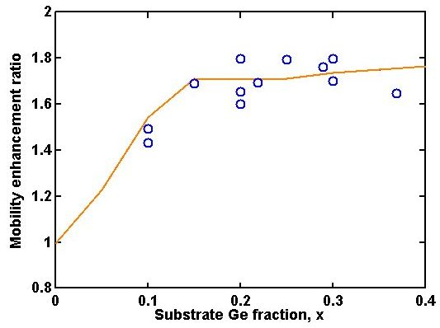
Mobility in Strained Si on Si_{1-x}Ge_{x}
Δ₂
Bulk Si
Strained Si
Strained Si on Relaxed Si_{1-x}Ge_{x}
Δ₆
Δ₄
biaxial
tension
ΔE_{s} ~ 0.67x
Δ₄
Δ₂
Conduction Band
splitting + repopulation
Less intervalley scattering
Smaller in-plane m_{t}<m_{l}
→ Larger μ=qτ/m* !!!
Various Data
(1992-2002)
Simulation

Slide 14
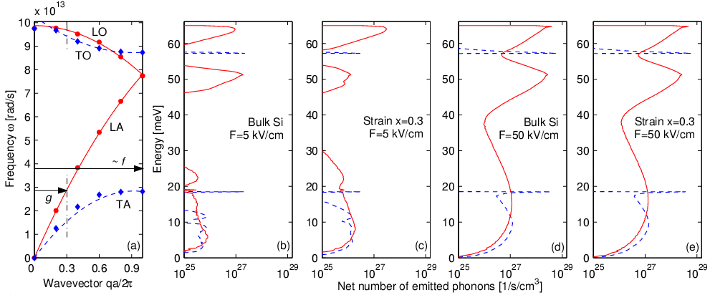
Computed Phonon Generation Spectrum
E. Pop et al., Appl. Phys. Lett. 86, 082101 (2005)
Complete spectral information on phonon generation rates
Note: effect of scattering selection rules (less f-scat in strained Si)
Note: same heat generation at high-field in Si and strained Si

Slide 15
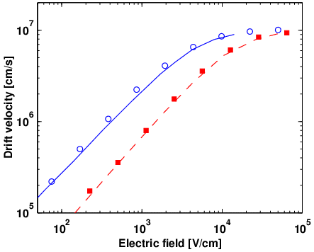
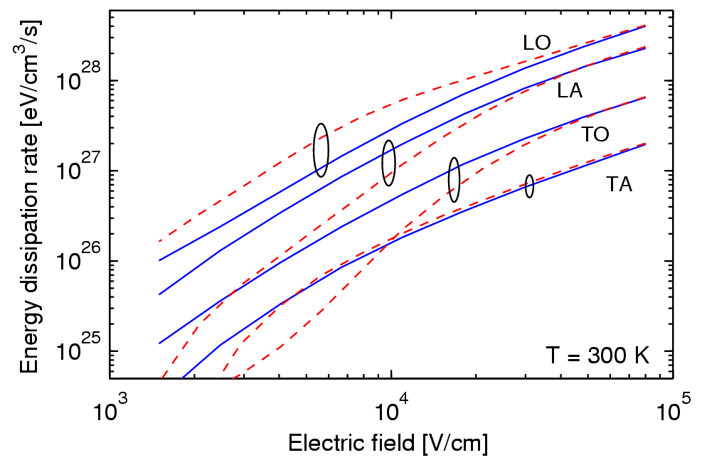
Phonon Generation in Bulk and Strained Si
E. Pop et al., Appl. Phys. Lett. 86, 082101 (2005)
bulk Si
strained Si
Strained Si
x=0.3, ΔE=0.2 eV
Doped 10¹⁷
Bulk Si
Longitudinal optical (LO) phonon emission dominates, but more so in strained silicon at low fields (90%)
Bulk silicon heat generation is about 1/3 acoustic, 2/3 optical phonons
 | Bulk (all fields) and high-field strained Si | Low-field strained Si
TA | < 0.03 | 0.02
LA | 0.32 | 0.08
TO | 0.09 | < 0.01
LO | 0.56 | 0.89

Slide 16
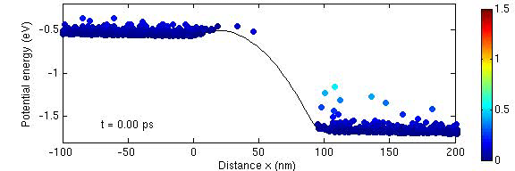
1-D Simulation: n+/n/n+ Device
(including Poisson equation and impurity scattering)
N+
N+
i-Si
V
qV

Slide 17
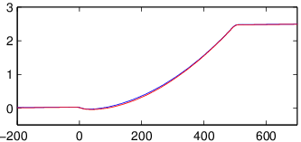
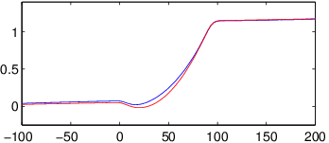
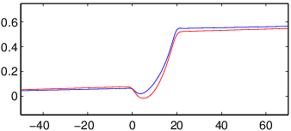
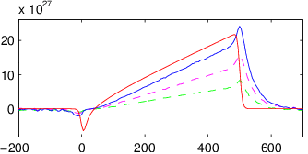
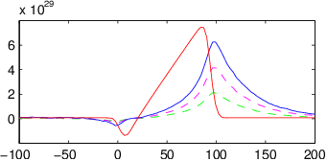
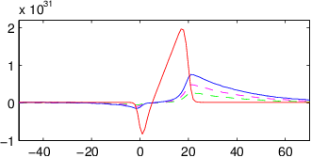
1-D Simulation Results
Potential (V)
L=500 nm
100 nm
20 nm
MONET
Medici
Heat Gen. (eV/cm³/s)
MONET
MONET
Medici
ΔL
Medici
Error: ΔL/L = 0.10
ΔL/L = 0.38
ΔL/L = 0.80
MONET vs. Medici (drift-diffusion commercial code):
“Long” (500 nm) device: same current, potential, nearly identical
Importance of non-local transport in short devices (J.E method insufficient)
MONET: heat dissipation in DRAIN (optical, acoustic) of 20 nm device

Slide 18
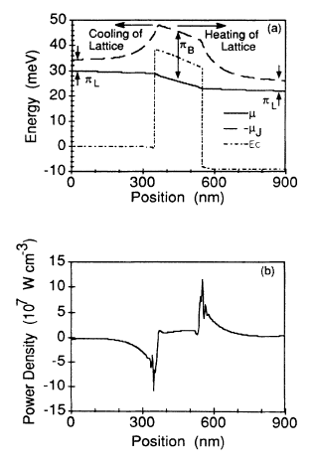
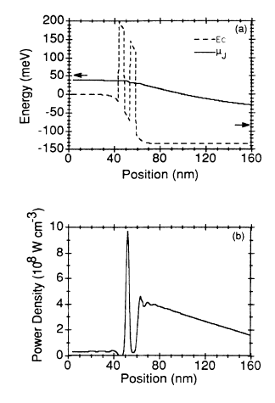
Heat Generation Near Barriers
Lake & Datta, PRB 46 4757 (1992)
Heating near a single barrier
Heating near a double-barrier
resonant tunneling structure

Slide 19
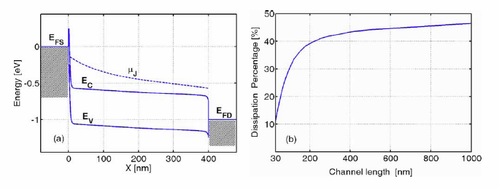
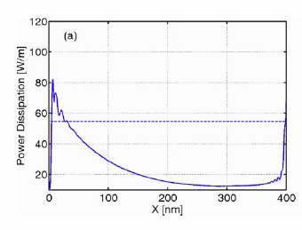
Heat Generation in Schottky-Nanotubes
Ouyang & Guo, APL 89 183122 (2006)
Semiconducting nanotubes are Schottky-FETs
Heat generation profile is strongly influenced by barriers
+Quasi-ballistic transport means less dissipation

Slide 20
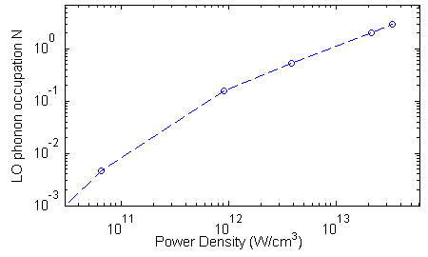
Are Hot Phonons a Possibility?!
L = 20 nm
V = 0.2, 0.4, 0.6,
0.8, 1.0 V
source
drain
where
and
Hot phonons: if occupation (N) >> thermal occupation
Why it matters: added impact on mobility, leakage, reliability
Longitudinal optical (LO) phonon “hot” for H > 10¹² W/cm³
Such power density can occur in drain of L ≤ 20 nm, V > 0.6 V device

Slide 21
Last Note on Phonon Scattering Rates
Note, the deformation potential (coupling strength) is the same between phonon emission and absorption
The differences are in the phonon occupation term and the density of final states
What if k_{B}T >> ħω (~acoustic phonons)?
What if k_{B}T << ħω (~optical phonons)?
Sketch scattering rate vs. electron energy:

Slide 22
Sketch of Scattering Rates vs. Energy
emission
Γ=1/τ
Γ=1/τ
emission ≈ absorption
absorption
E
ħω
E
k_{B}T » ħω → N_{q} « 1
Γ ~ g(E) ~ E^{1/2} in 3-D, etc.
k_{B}T « ħω → N_{q} » 1
Γ ~ N_{q}g(E± ħω) ~ (E ± ħω)^{1/2} in 3-D
Note emission threshold E > ħω

