Slide 1
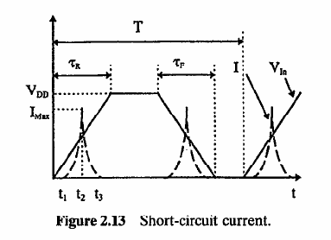

Revisit CMOS Power Dissipation
Digital inverter:
  Active (dynamic) power
  Leakage power
  Short-circuit power (ignored)
Roy & Prasad (2000)

Slide 2
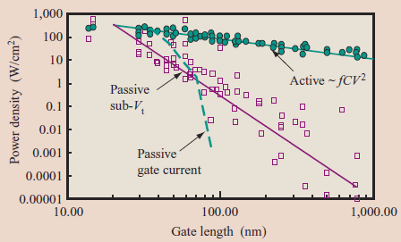
Leakage vs. Active Power Trends
W. Haensch, IBM J. Res. Dev. 50, 339 (2006)

Slide 3
Some Observations with Leakage
This is the “usual” (BSIM, Spice) leakage model
The thermal voltage V_{T} = k_{B}T/q
This model was derived for 3-dimensional carrier motion, impinging on a small energy barrier (what about 1-D or 2-D transistors?)
This model assumes some average “junction temperature” T but T itself is unsteady during digital operation! (what about hot phonons?!)

Slide 4
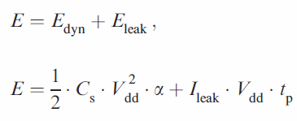
What About Energy?
Energy is a better metric when worried about battery life
So look at energy, not power minimization:
Critical difference: leakage energy depends on circuit delay, t_{p}
?

Slide 5
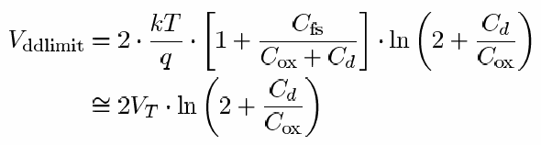
Effects of Lowering V_{DD}
B. Zhai, IEEE Trans. VLSI Sys. 13, 1239 (2005)
Easy observation: lowering V_{DD} lowers power and energy… the latter up to a point!
How low V_{DD}?
It is theoretically possible to operate circuits near V_{DD} ~ 50 mV, deep into the subthreshold regime!
So… why not do it?

Slide 6
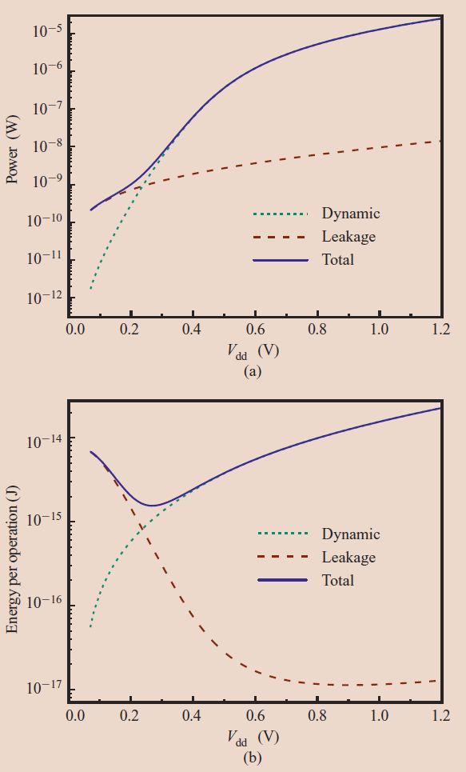
Energy-Voltage Trade-Off
B. Zhai, IEEE Trans. VLSI Sys. 13, 1239 (2005)
Remember, delay:
At high V_{DD} → I_{ON} = I_{D,sat}
At low V_{DD} delay too high, so leakage energy goes up as well
Optimum
V_{DD}!

Slide 7
Principles of Low-Power Design
Roy & Prasad (2000)
Use the lowest possible supply voltage (V_{DD})
Use the smallest geometry, highest frequency devices BUT operate them at the lowest possible frequency (f)
Use parallelism and pipelining to lower required frequency of operation
Manage power by disconnecting power source when system is idle (sleep states)
Design systems to have lowest requirements of performance for the given user functionality

Slide 8
Leakage Model: Closer Look
Strongly (exponentially!) temperature dependent!
Typically people use ΔT = PR_{TH} where
  ΔT is an average “junction temperature”
  P is a time-averaged power dissipation (active + leakage)
How do we calculate R_{TH}?
And when is it OK to use it?

Slide 9
Device Thermal Resistance Data
Single-wall nanotube
High thermal resistances:
SWNT due to small thermal conductance (very small d ~ 2 nm)
Others due to low thermal conductivity, decreasing dimensions, increased role of interfaces
Phase-change Memory (PCM)
Silicon-on-
Insulator FET
Cu Via
Power input also matters:
SWNT ~ 0.01-0.1 mW
Others ~ 0.1-1 mW
Bulk FET
Data: Mautry (1990), Bunyan (1992), Su (1994), Lee (1995), Jenkins (1995), Tenbroek (1996), Jin (2001), Reyboz (2004), Javey (2004), Seidel (2004), Pop (2004-6), Maune (2006).
Notes:
Thermal resistance R_{TH} (K/mW): ΔT increase for 1 mW power input. Typical power ~ 1 mW/μm for CMOS, ~ 0.4 mW for Phase-Change Memory, ~ 20 μW for SWNT. Explain the meaning of L here.

Slide 10
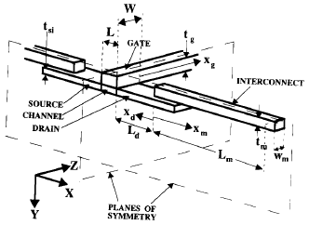
Modeling Device Thermal Response
Steady-state models
  Lumped: Mautry (1990), Goodson-Su (1994-5), Pop (2004), Darwish (2005)
  Finite-Element
SOI FET
Bulk FET
D
L
W
t_{Si}
t_{BOX}
Bulk Si FET
SOI FET

Slide 11
Modeling Device Thermal Response
Transient Models
  Lumped: Tenbroek (1997), Rinaldi (2001), Lin (2004)
  Introduce C_{TH} usually with approximate Green’s functions; heated volume is a function of time (Joy, 1970)
  Finite-Element
Instantaneous T rise
Due to very sharp heating pulse Δt ‹‹ V^{2/3}/α
More general
Simplest (~ bulk Si FET)
Temperature evolution anywhere (r,t) due to arbitrary heating function P(0<t’<t) inside volume V (dV’ ⊂ V) (Joy 1970)
Temperature evolution of a step-heated point source into silicon half-plane (Mautry 1990)

Slide 12
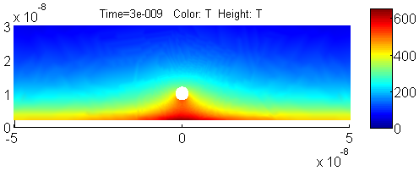
Approaches for Thermal Resistance
Time scale:
  Transient
  Steady-State
Geometric complexity:
  Lumped element (shape factors)
  Analytic
  Finite element (Fourier law)
+ Interconnect

Slide 13
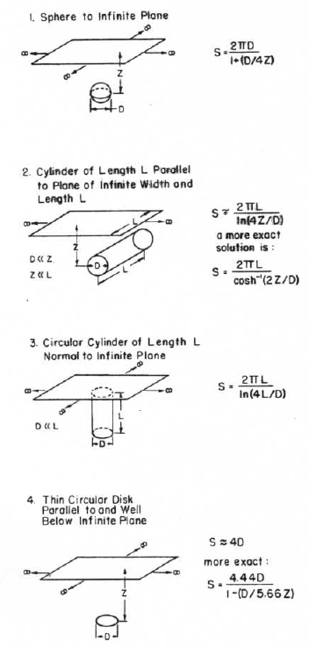
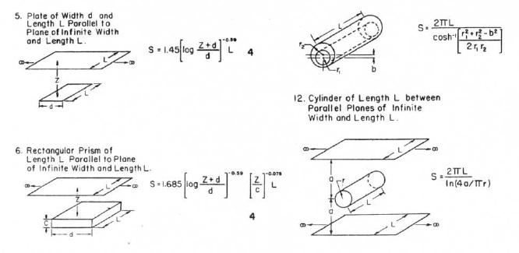
Shape Factors
Sunderland, ASHRAE (1964), many others
Heat flux: q = Sk(T₁-T₀)
Equivalent thermal resistance R_{TH} = 1/Sk

Slide 14
Ex: Heat Loss from Via + Interconnect
Chen, Li, Rosenbaum, Kang, IEEE TCAD ICS 19, 197 (2000)
Cu
Estimating heat loss (thermal resistance) “looking into” one Cu line:
Typical values
SiO₂
2r
z_{TOP}
w
d
Chen, 2000
z_{BOT}
K/mW (bot – top)
Si

Slide 15
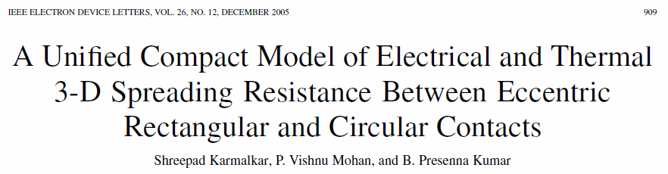
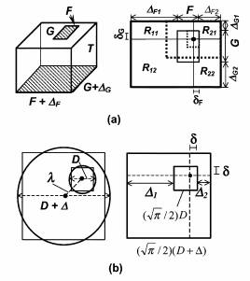

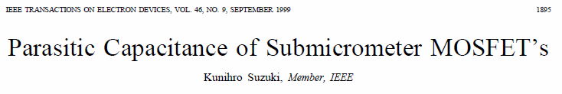
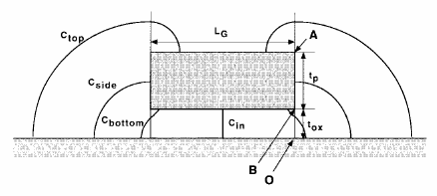
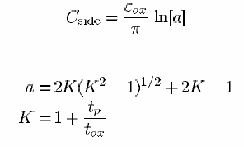
Many Shape Factors (Compact Models)

Slide 16
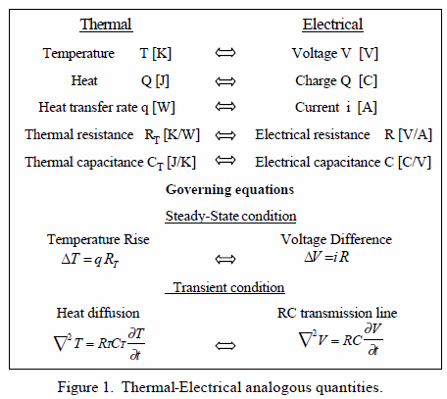
Thermal-Electrical Cheat Sheet

Slide 17
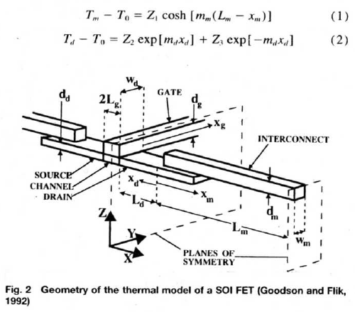
Obtaining the Temperature Distribution
Now we want temperature distribution T(x) in 1-D
Consider power in/out of a 1-D element
Simplest case: Si layer on SiO₂/Si substrate (SOI)
Or interconnect on thermally insulating SiO₂

Slide 18
1-D Interconnect with Heat Generation
L
x
x+dx
d
Heat:
W
Electrical:
SiO₂
t_{ox}
Energy balance equation for
1-D element “dx”: pick units of
J/cm³ or W/cm³ (W = J/s)
Si
T₀
Energy In (here, Joule heat) = Energy Out (left, right, bottom) + Change in Internal Energy

Slide 19
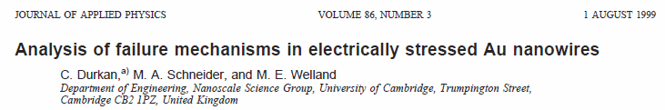
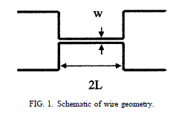
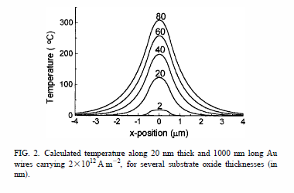
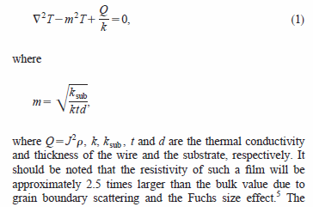
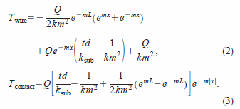
Ex: 1D Rectangular Nanowire

Slide 20
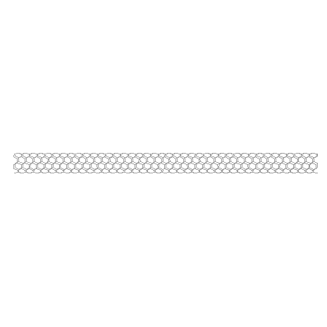
1-Dimensional Heat Equation
ΔT
unsteady (transient)
k
SiO₂
ΔT
g
steady, with convection
SiO₂

Slide 21
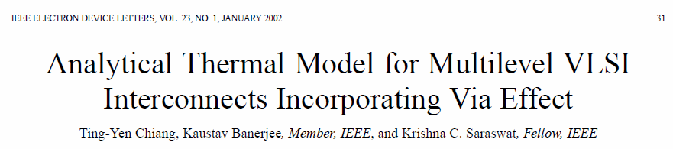
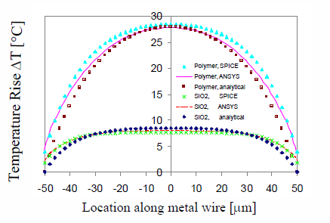
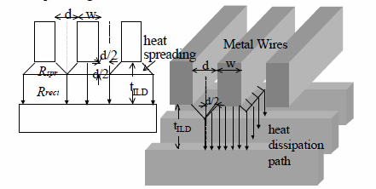
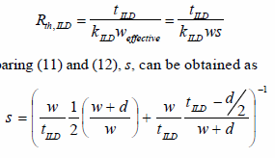

Interconnect Heat Loss and Crosstalk

Slide 22
Carbon Nanotube (Cylinder)
ΔT
Role of cylindrical heat
spreading (shape factor!)
Role of thermal
contact resistance
E. Pop et al.
J. Appl. Phys. 101, 093710 (2007)

