Slide 1
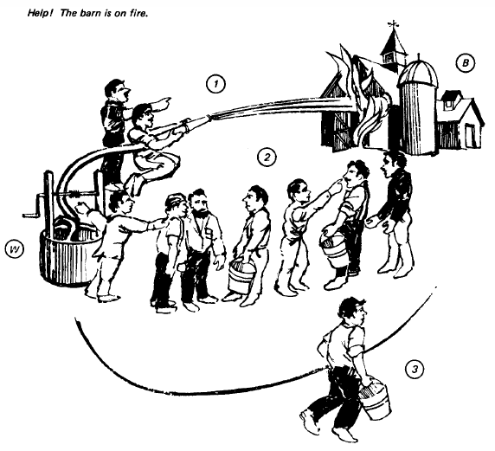
Three Modes of Heat Transfer
“radiation”
“conduction”
“convection”

Slide 2
Conduction

Slide 3
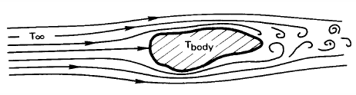
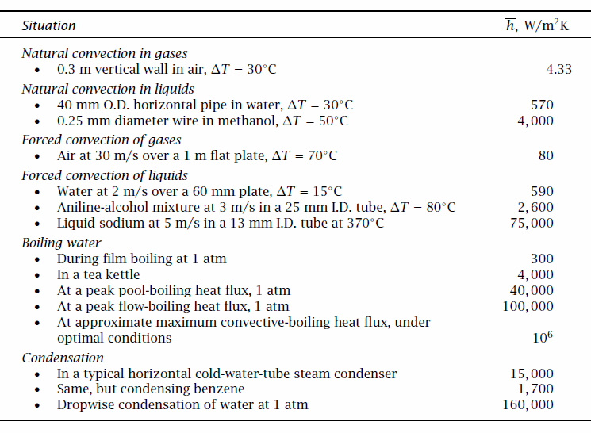
Convection
= Cooling by mass motion (diffusion + advection) in a fluid

Slide 4
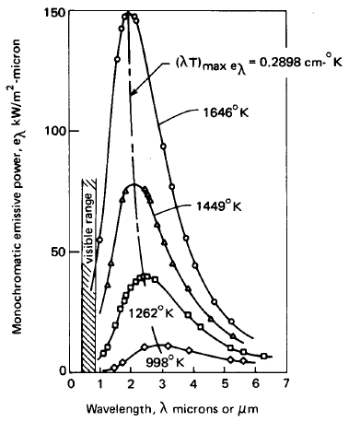
Radiation
Linearize (when and why?):
For black body (Ɛ=1) at 300 K:
Note: Usually nothing is a perfect “black body” and parts of the emissive spectrum may be missing (ex: photonic band gap crystals).

Slide 5
Boundaries and Lumped Elements
All problems have boundaries!
Heat diffusion equation needs boundary conditions
Dirichlet (fixed T):
Neumann (fixed flux ~ dT/dx):
When is it OK to “lump” a body as a single R or C?
Biot number:

Slide 6
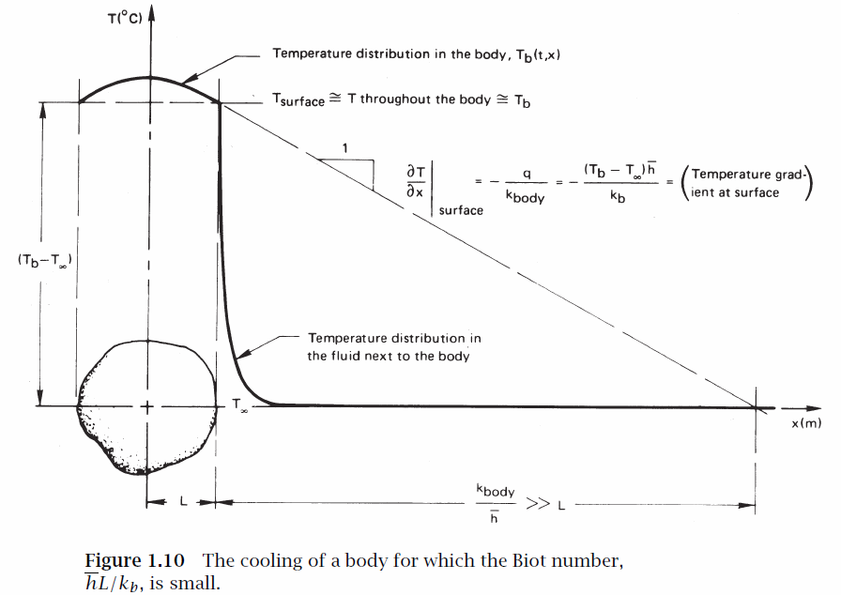
Transient Cooling of Lumped Body
Source: Lienhard book, http://web.mit.edu/lienhard/www/ahtt.html (2008)

Slide 7
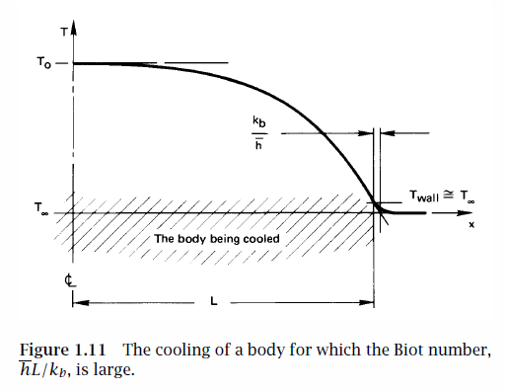
What if Biot Number is Large
Bi = hL/k_{b} << 1 implies T_{b}(x) ~ T_{surf} (lumped OK)
Bi = hL/k_{b} >> 1 implies significant internal T_{b}(x) gradient

Slide 8
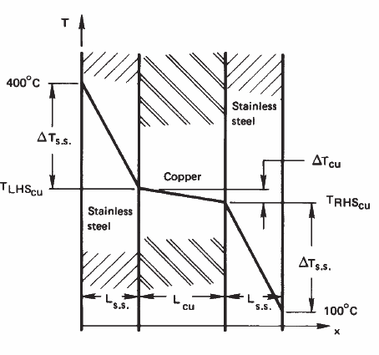
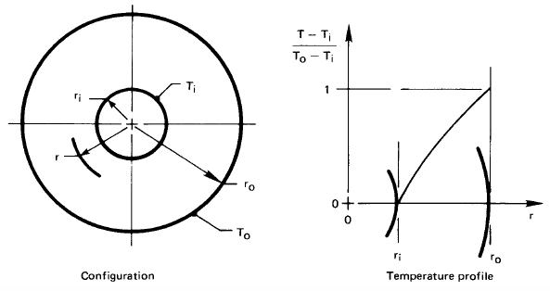
Lumped Body Examples (Steady State)
Boundary conditions:
T_{L} = 400 ºC, T_{R} = 100 ºC
Assume NO internal heat generation
(how does the temperature slope dT/dx
scale qualitatively within each layer?)
2) Assume UNIFORM internal heat generation

Slide 9
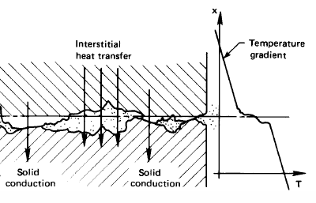
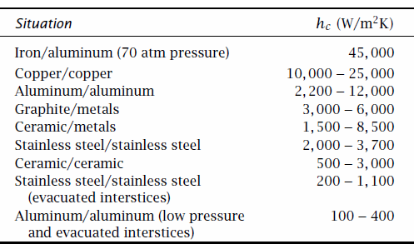
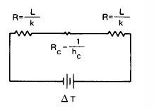
Contact Resistance
R_{C} = 1/h_{C}A
BUT, also remember the fundamental solid-solid contact resistance given by density of states, acoustic/diffuse phonon mismatch ~Cv/4! (prof. Cahill’s lecture)

Slide 10
Notes on Finite-Element Heat Diffusion
T_{i-1}
T_{i}
T_{i+1}
T₁
Δx
T_{N}
R_{C}
L
T₀
T₀
Boundary conditions:
(heat flux conservation)
M₁₁ M₁₂ 0 …
T₁
b₁
M₂₁ M₂₂ M₂₃ 0 …
…
…
…
=
…
Matlab:
T = M\b
…
M_{NN}
T_{N}
b_{N}
M
T
b

Slide 11
More Comments on “Fin Equation”
Same as Poisson equation with various BC’s
BC’s can be given flux (dT/dx) or given temperature (T₀)
Very useful to know:
  Thermal healing length L_{H} (Poisson: screening length)
  General, qualitative shape or solution
general
solution
sinh, cosh, tanh … etc.

Slide 12
Fin Efficiency (how long is too long?)
L
exp
W
d
cosh
T=T_{B}
tanh
dT/dx ≈ 0
sinh
Fin efficiency η = actual heat loss by fin / heat loss if entire fin was at base temperature TB
Actual heat loss:
Here
Not worth making cooling fins much >> L_{H} !

Slide 13
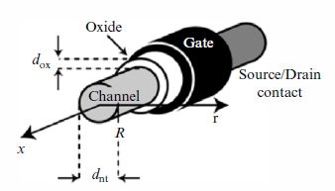


Poisson Equation Analogy
with solution
Liu (1993)
Knoch (2006)
and electrostatic screening length
Thermal fin is ~ mathematically same problem as 1-D transistor electrostatics, e.g. nanowire or SOI transistor
L < λ → short fin, or “short channel” FET
L >> λ → long fin (too long?!), or “long channel” FET

