Slide 1

Hot Chips: Atoms to Heat Sinks
ECE 598EP
Prof. Eric Pop
Dept. of Electrical and Computer Engineering
Univ. Illinois Urbana-Champaign
http://poplab.ece.illinois.edu

Slide 2
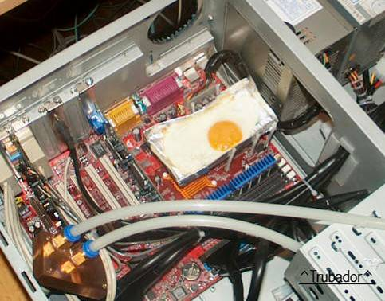

The Big Picture
XP1500+ CPU
http://phys.ncku.edu.tw/~htsu/humor/fry_egg.html

Slide 3
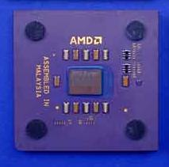
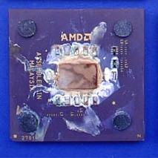
Another CPU without a Heat Sink
Source: Tom’s Hardware Guide
http://www6.tomshardware.com/cpu/01q3/010917/heatvideo-01.html

Slide 4
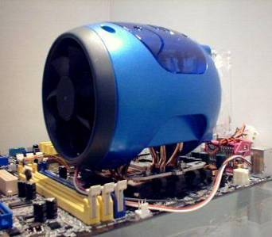
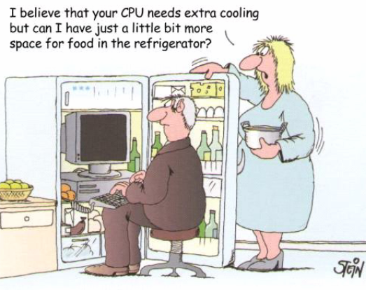
Thermal Management Methods
ASUSTeK cooling solution (!)

Slide 5
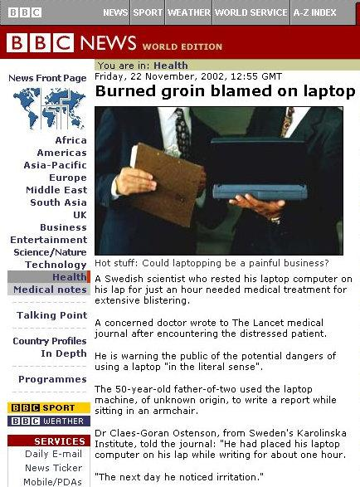
Impact on People & Environment
Fast computers run HOT
COOL computers are slow…
Huge data centers need significant power generation and cooling investment
Impact on environment?!
The industry often calls them
“portables” or “notebooks” not “laptops”

Slide 6
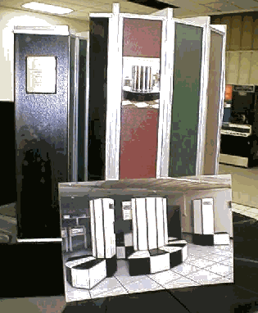
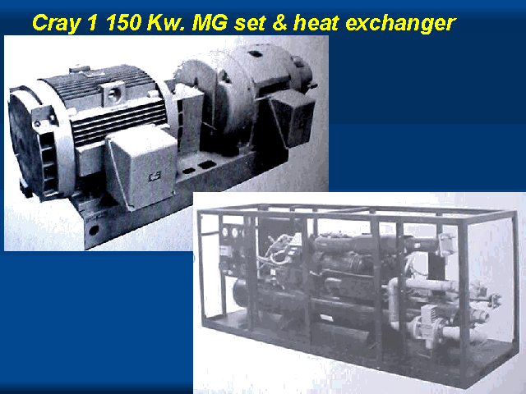
Packaging cost
From Cray (local power generator and refrigeration)…
http://www.research.microsoft.com/users/gbell/craytalk/

Slide 7
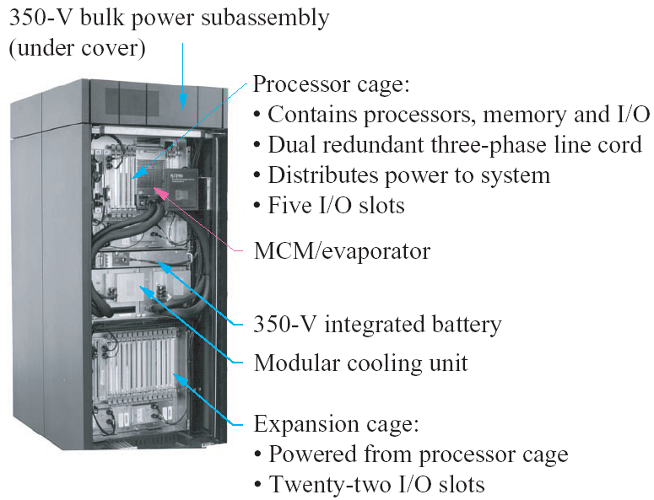
Packaging cost
To today…
Grid computing: power plants co-located near computer farms
IBM S/390:
refrigeration
Source: R. R. Schmidt, B. D. Notohardjono “High-end server low temperature cooling”
IBM Journal of R&D

Slide 8
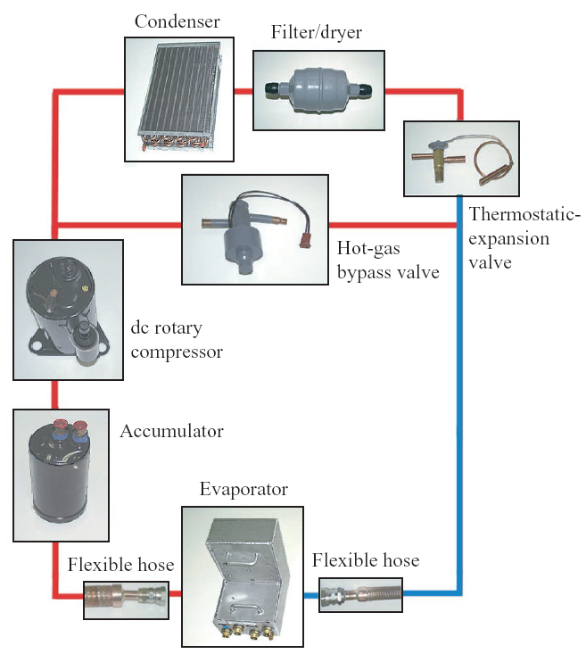
IBM S/390 refrigeration
Complex and expensive
Source: R. R. Schmidt, B. D. Notohardjono “High-end server low temperature cooling” IBM Journal of R&D

Slide 9
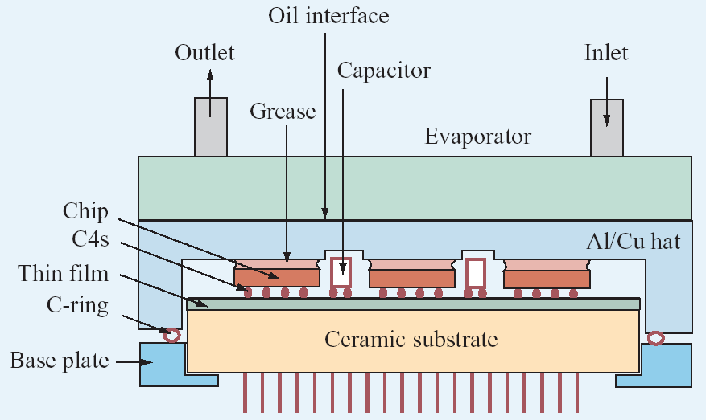
IBM S/390 processor packaging
Processor sub-assembly: complex!
C4: Controlled Collapse Chip Connection (flip-chip)
Source: R. R. Schmidt, B. D. Notohardjono “High-end server low temperature cooling”
IBM Journal of R&D

Slide 10
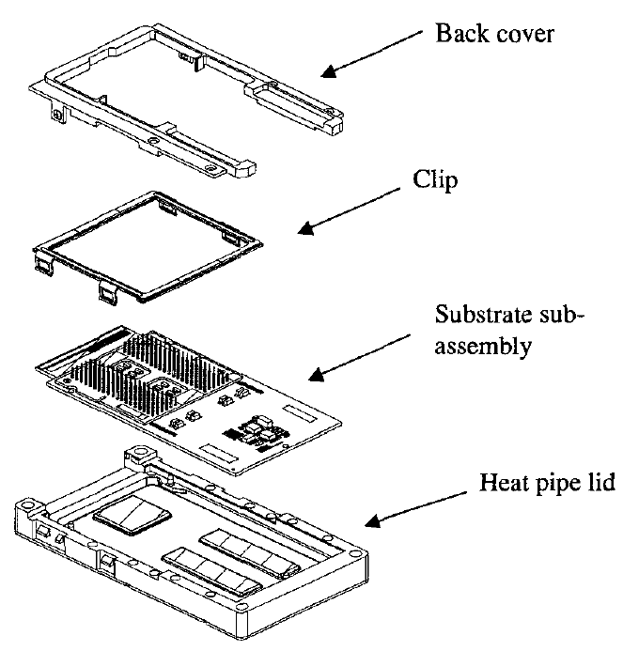
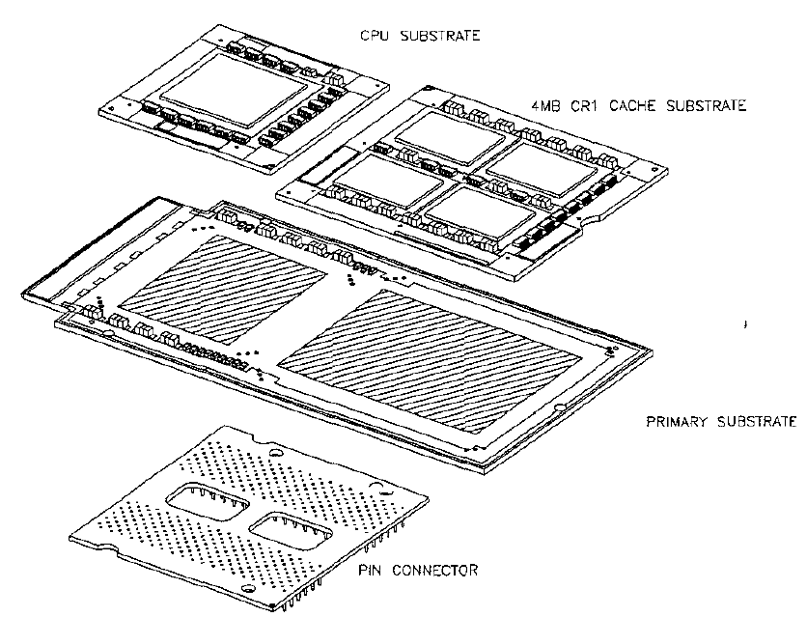
Intel Itanium packaging
Complex and expensive (note heatpipe)
Source: H. Xie et al. “Packaging the Itanium Microprocessor”
Electronic Components and Technology Conference 2002

Slide 11
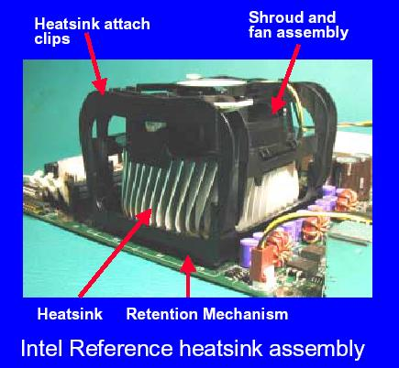
Intel Pentium 4 packaging
Simpler, but still…
Source: Intel web site

Slide 12
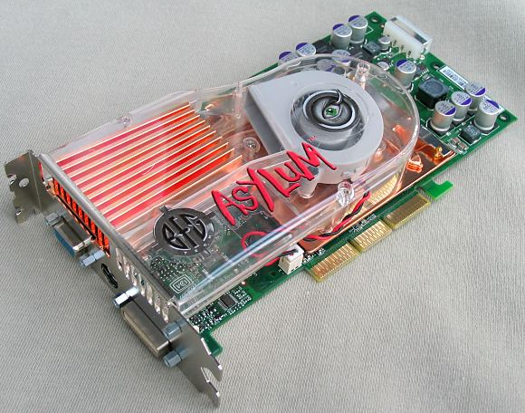
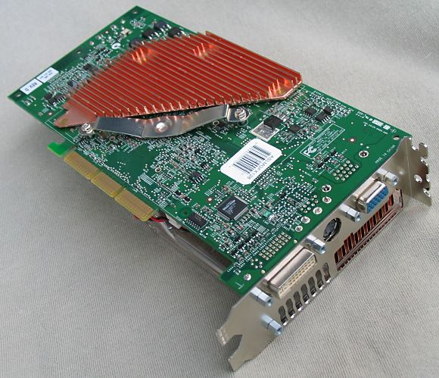
Graphics Cards
Nvidia GeForce 5900 card
Source: Tech-Report.com

Slide 13
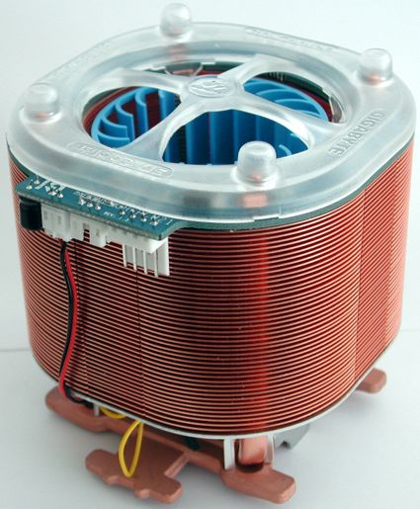
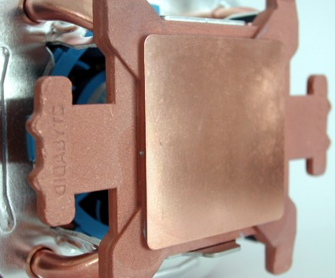
Under/Overclocking
Some chips need to be under-clocked
  Especially true in constrained form factors
Try fitting this in a laptop or Gameboy!
Ultra model of Gigabyte's 3D Cooler Series
Source: Tom’s Hardware Guide

Slide 14
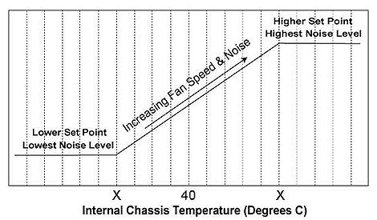
Environment
Environment Protection Agency (EPA): computers consume 10% of commercial electricity consumption
  This incl. peripherals, possibly also manufacturing
  A DOE report suggested this percentage is much lower
  No consensus, but it’s probably significant
Equivalent power (with only 30% efficiency) for AC
CFCs used for refrigeration
Lap burn
Fan noise

Slide 15
A More Detailed Look
Data centers + 100 million PCs + displays + cooling = 5 % of nation-wide power budget in 2007
PCs alone generate pollution equivalent to 5 million cars (state of Maryland!), which would require nearly 2 billion trees to offset
If current trends continue, computer-related energy use could be 1/3 of US power by 2025
http://www.climatesaverscomputing.org
http://www.energystar.gov/index.cfm?c=prod_development.server_efficiency_study

Slide 16
Power Dissipation: Transistor → CPU
Single Transistor?
Single CPU?
x 1,000,000,000 Transistors?
Sun surface? 6000 W/cm²
E. Pop, Nano Research 3, 147 (2010)
W. Haensch, IBM J. Res. Dev. 50, 339 (2006)
R. Cavin, J. Nanoparticle Res. 8, 841 (2006)

Slide 17
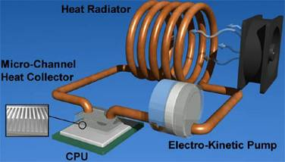
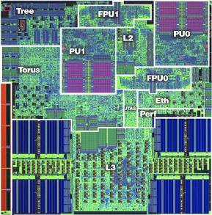

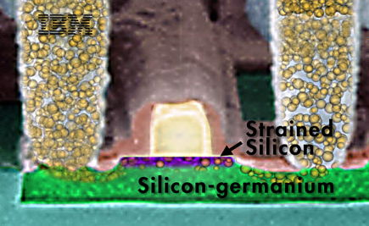
Thermal Management Methods
System Level
→ Active Microchannel Cooling (Cooligy)
IBM
Circuit + Software Level
active power management
(turn parts of circuit on/off)
Transistor Level
→ electro-thermal device design
Notes:
circuit: dynamic (threshold) voltage adjustment + power-saving algorithms

Slide 18
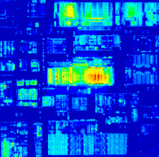
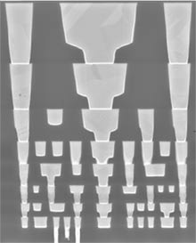
Where Does the Heat Come From?
Intel Itanium
C_{interconnect}
T_{interconnect}
Top view
Hottest spots > 300 W/cm²
R_{dielectric}
C_{transistor}
T_{transistors}
Cross-section
8 metal levels + ILD
R_{spreading}
C_{chip}
Intel 65 nm
T_{chip}
R_{chip}
C_{heat sink}
T_{heat sink}
R_{convection}
T_{coolant}
Transistor < 100 nm

Slide 19
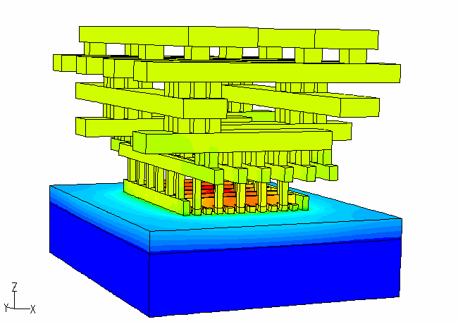
More on Chip-Level Complexity
Power dissipation
in interconnects
Power dissipation
in transistors
Thermal conductivity
of substrate, heat sink
3-D integrated circuits = the ultimate density limit
How do we get the power in?
How do we take the heat out?

Slide 20
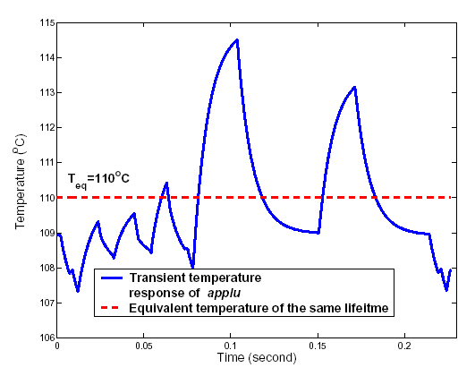
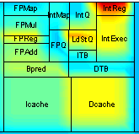
Temporal, Spatial Variations
Temperature variation
of SPEC applu over time
Hot spots increase
cooling costs
⇨ must cool for
hot spot

Slide 21
Variations Depending on Application
Wide variation across applications
Architectural and technology trends are making it worse, e.g. simultaneous multithreading (SMT)
  Leakage is an especially severe problem: exponentially dependent on temperature!

Slide 22
Temperature Affects (Effects?):
Circuit performance
Circuit power (leakage exponential)
IC reliability (exponential)
IC and system packaging cost
Environment

Slide 23
Thermal Interconnect Failure
Open Circuit Interconnect Failure
Banerjee, Kim, Amerasekera, Hu, Wong, and Goodson, IRPS 2000
~ 12 μm
~ 12 μm
Metal 4
Metal 1
Passivation fracture due to the expansion of critical volume of molten AlCu. (@ 1000 ⁰C)

Slide 24
Chip-Level Thermal Challenges
Device Level:
Confined Geometries, Novel Materials
Rocket Nozzle
Nuclear Reactor
Hot Plate
Material
k (W/m/K)
Cu
400
Si
150
Ge
60
Silicides
40
Si (10 nm)
13
SiO₂
1.4
Source: E. Pop (Proc IEEE 2006)
Notes:
High-k dielectrics ZrO2 and Al2O3 (alumina) have kth around 2 and 18-35 W/mK (depends on purity), respectively

Slide 25
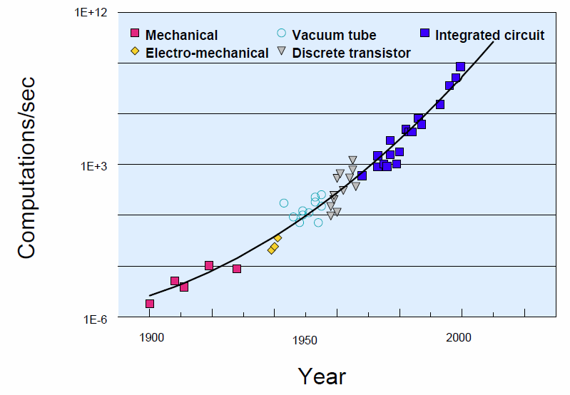
Why (down)Scaling?
To increase speed & complexity!
$1000 buys:
Source: J. Welser, IBM

Slide 26
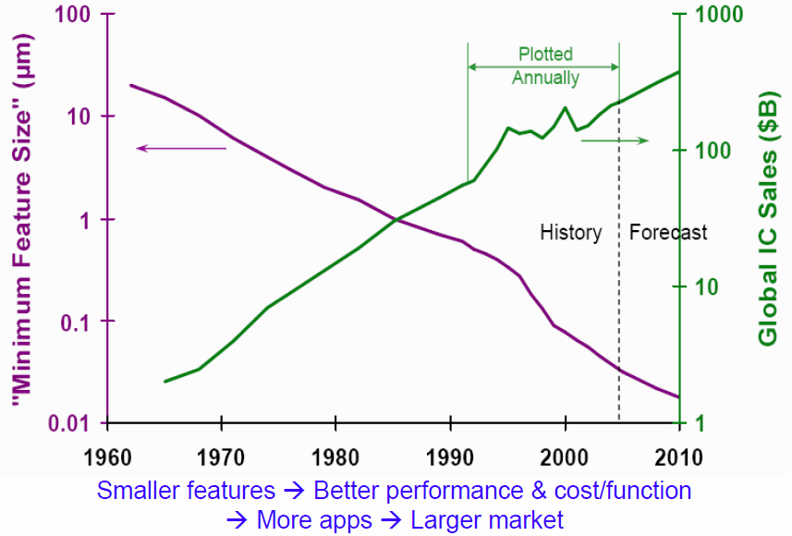
Scaling = Progress in Electronics
Source: J. Welser, IBM

Slide 27
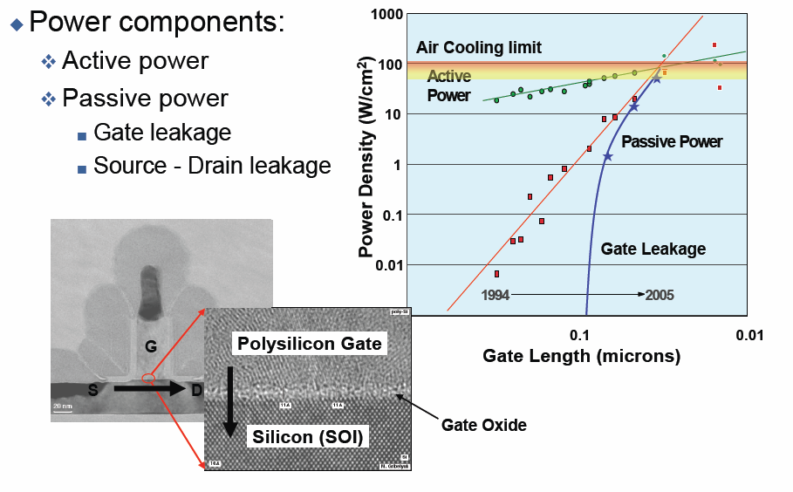
CMOS Power Issue: Active vs. Passive

Slide 28
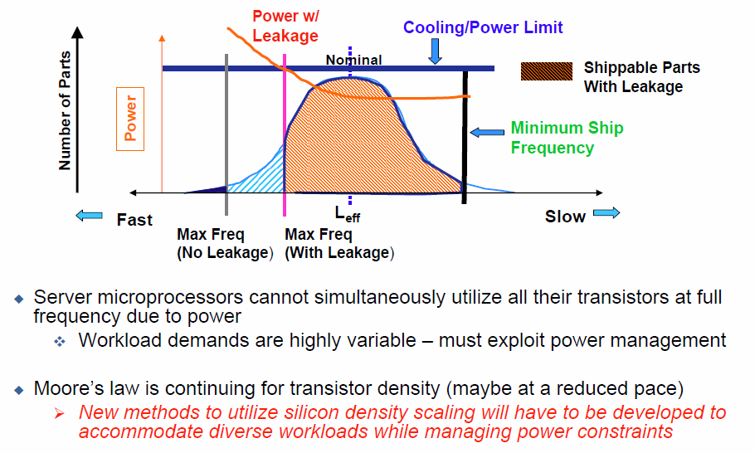
Power & Heat Limit Frequency Scaling

Slide 29
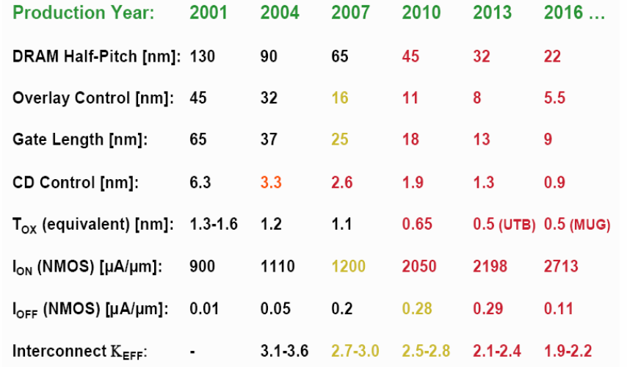
Industry Developed ITRS Guide
(Intl. Technology Roadmap for Semic.) http://www.itrs.net

Slide 30
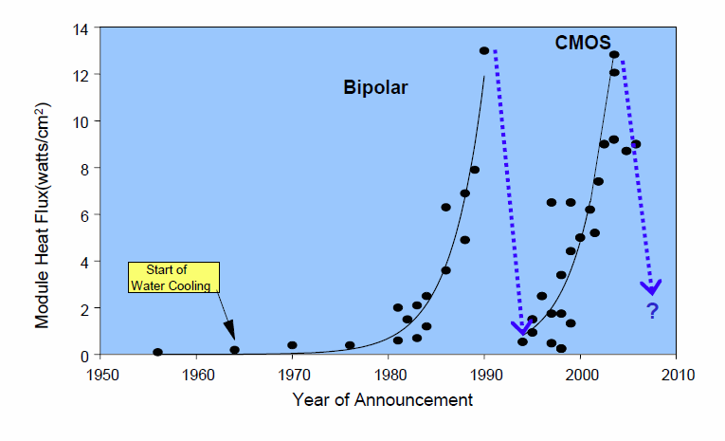
Has This Ever Happened Before?
Source: J. Welser, IBM

Slide 31
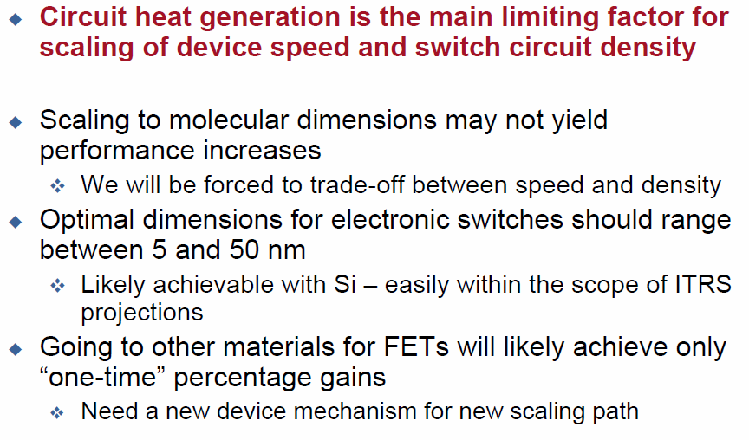
Implications for Nanoscale Circuits

Slide 32
Transistor-Level Thermal Challenges
Device Level:
Confined Geometries, Novel Materials
Small geometry
  High power density (device-level hot spot)
  Higher surface area -to- volume ratio, i.e. higher role of thermal interfaces between materials
Lower thermal conductivity
Lowering power (but can it ever be low enough?!)
Device-level thermal design (phonon engineering)
Material
k (W/m/K)
Cu
400
Si
150
Ge
60
Silicides
40
Si (10 nm)
13
SiO₂
1.4
Source: E. Pop (Proc IEEE 2006)
Notes:
High-k dielectrics ZrO2 and Al2O3 (alumina) have kth around 2 and 18-35 W/mK (depends on purity), respectively

Slide 33
The Tiny Picture
Suspended
On substrate
Carbon nanotubes burn at high enough applied voltage

Slide 34
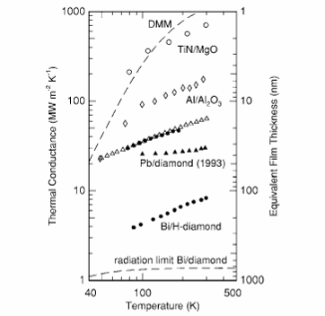


K of Nano{wires;layers}, R_{B} of Interfaces
Bulk Si ~ 150, Ge ~ 60 W/m/K
Al/SiO₂/Si
GST/ZnS/SiO₂
Thermal conductivity (K) of thin films and nanowires:
  Decrease due to phonon confinement and boundary scattering
  Up to an order of magnitude decrease from bulk values
Al
SiO₂
R_{B}
Thermal interface resistance ~ 10 nm SiO₂
Data: Li (2003), Liu (2005); Model: Pop (2004)
Lyeo (2006)

Slide 35
Thermal Resistance at Device Level
Single-wall nanotube
High thermal resistances:
SWNT due to small thermal conductance (very small d ~ 2 nm)
Others due to low thermal conductivity, decreasing dimensions, increased role of interfaces
Phase-change Memory (PCM)
Silicon-on-
Insulator FET
Cu Via
Power input also matters:
SWNT ~ 0.01-0.1 mW
Others ~ 0.1-1 mW
Bulk FET
Data: Mautry (1990), Bunyan (1992), Su (1994), Lee (1995), Jenkins (1995), Tenbroek (1996), Jin (2001), Reyboz (2004), Javey (2004), Seidel (2004), Pop (2004-6), Maune (2006).
Notes:
Thermal resistance R_{TH} (K/mW): ΔT increase for 1 mW power input. Typical power ~ 1 mW/μm for CMOS, ~ 0.4 mW for Phase-Change Memory, ~ 20 μW for SWNT. Explain the meaning of L here.

Slide 36


Thermal Resistance, Electrical Resistance
P = I² × R
∆T = P × R_{TH}
∆ V = I × R
R = f(∆T)
Fourier’s Law (1822)
Ohm’s Law (1827)

Slide 37
This Heating Business is Not All Bad…
IF we can control it!

Slide 38
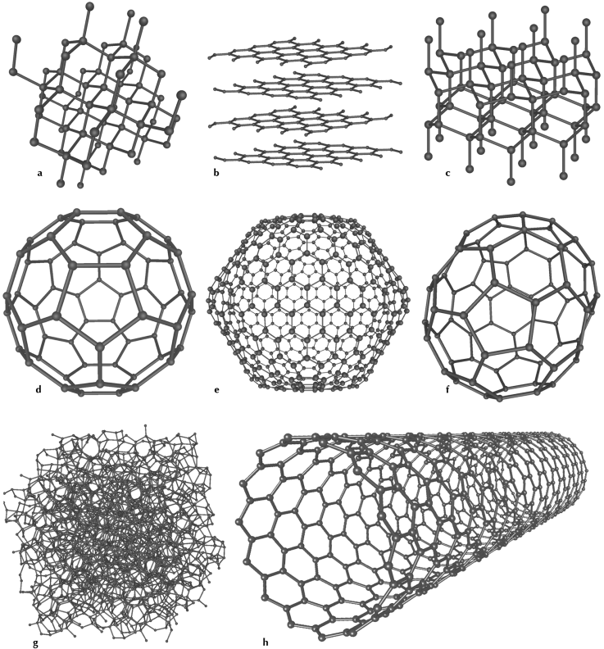
Nanotubes in the Carbon World
Allotropes of Carbon:
Graphite (pencil lead)
Diamond
Buckyball
(C60)
Amorphous
(soot)
Single-Walled Nanotube

Slide 39


Why Carbon Nanotubes & Graphene?
Carbon nanotube = rolled up graphene sheet
Great electrical properties
  Semiconducting → Transistors
  Metallic → Interconnects
  Electrical Conductivity σ ≈ 100 x σ_{Cu}
  Thermal Conductivity k ≈ k_{diamond} ≈ 5 x k_{Cu}
d ~ 1-3 nm
Nanotube challenges:
  Reproducible growth
  Control of electrical and thermal properties
  Going “from one to a billion”
HfO₂
top gate (Al)
CNT
S (Pd)
D (Pd)
SiO₂
back gate
(p++ Si)

Slide 40
Light Emission from Metallic SWNTs
D. Mann et al., Nature Nano 2, 33 (2007)
Joule-heated tubes emit light:
  Comes from center, highly polarized
  Emitted photons at higher energy than applied bias (high energy tail)
  World’s smallest light bulb?
~ σT⁴
Polarization
Notes:
[Dave Mann]: Luminescence has been reported. NOT attributed to heating, attributed to impact excitation of the electrons, and supposedly primarily in semiconductors.

Slide 41
Extracting SWNT Thermal Conductivity
E. Pop et al., Nano Letters 6, 96 (2006)
Yu et al. (NL’05)
This work
Numerical extraction of k from the high bias (V > 0.3 V) tail
Comparison to data from 100-300 K of UT Austin group (C. Yu, NL Sep’05)
Result: first “complete” picture of SWNT thermal conductivity from 100 – 800 K

Slide 42
What Is Phase-Change Memory?
Flash
PCM
Bit (1/0) is stored as
resistance change with
material phase
Bit (1/0) is ~100
electrons stored on
Floating Gate
SiO₂
GST
Bottom electrode
heater (e.g. TiN)
Si
PCM: Like Flash memory (non-volatile)
PCM: Unlike Flash memory (resistance change, not charge storage)
Faster than Flash (100 ns vs. 0.1–1 ms), smaller than Flash (which is limited by ~100 electrons stored/bit)
For: iPod nano, mobile phones, PDAs, solid-state hard drives…
Notes:
Compare it to Flash (left column, right column)
Mention it’s for iPod nano, Cell phones, and ultimately hard drive replacement for solid-state laptops

Slide 43
How Phase-Change Materials Work
Current (mA)
Based on Ge₂Sb₂Te₅ reversible phase change
Amorphous to Crystalline resistivity change > 100x
Control phase transitions with pulsed Joule heating (~100 ns / 0.1 mA)

Slide 44
How Phase-Change Memory Works
RESET
Pulse
PCM
Melting Temperature
~ 600 ºC
Polycrystalline
GST
Amorphous
Temperature
Glass Temperature
~ 150 ºC
Bottom electrode
heater (e.g. TiN)
SET
Pulse
Time
Short (10 ns), high pulse (0.5 mA) melts, amorphizes GST
Longer (100 ns), lower pulse (0.1 mA) crystallizes GST
Small cell area (sits on top of heater), challenge is reliability and lowering programming current
Scaling helps: smaller = faster = less switching energy (volume ↓)

Slide 45
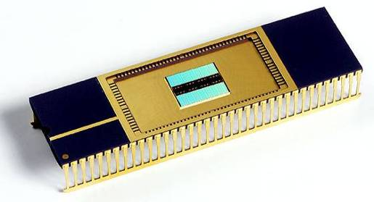
Samsung 512 Mb PCM Prototype
Sep 11, 2006
Put in perspective:
NAND Flash chips of
8-16 Gb in production
“Samsung completed the first working prototype of what is expected to be the main memory device to replace high density Flash in the next decade – a Phase-change Random Access Memory (PRAM). The company unveiled the 512 Mb device at its sixth annual press conference in Seoul today.” Source: http://samsung.com/PressCenter/PressRelease/PressRelease.asp?seq=20060911_0000286481

Slide 46
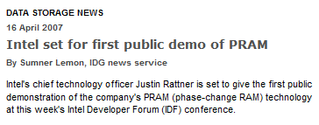
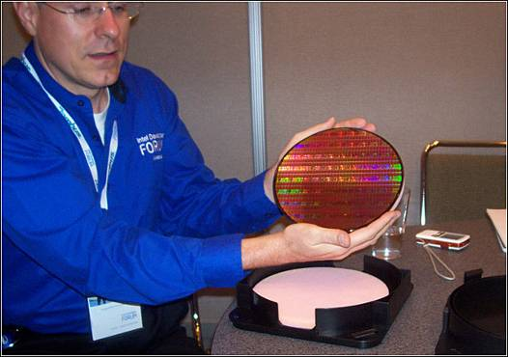
Intel/ST Phase-Change Memory Wafer
Sep 28, 2006
Put in perspective:
NAND Flash chips of
8-16 Gb in production
“Intel CTO of Flash Memory Ed Doller holds the first wafer of 128 Mbit phase change memory (PCM) chips, which has just been overnighted to him from semiconductor maker STMicroelectronics in Agrate, Italy. Intel believes that PCM will be the next phase in the non-volatile memory market.” Source: http://www.eweek.com/article2/0,1895,2021841,00.asp

