Slide 1
Classical Theory Expectations
Equipartition: 1/2k_{B}T per degree of freedom
In 3-D electron gas this means 3/2k_{B}T per electron
In 3-D atomic lattice this means 3k_{B}T per atom (why?)
So one would expect: C_{V} = du/dT = 3/2n_{e}k_{B} + 3n_{a}k_{B}
Dulong & Petit (1819!) had found the heat capacity per mole for most solids approaches 3N_{A}k_{B} at high T
Molar heat capacity @ high T → 25 J/mol/K
Notes:
na = rho*Na/M

Slide 2
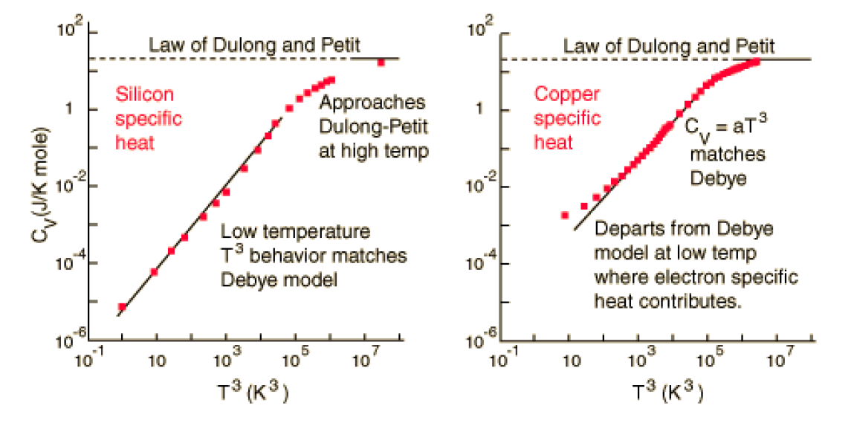
Heat Capacity: Real Metals
due to
electron gas
due to
atomic lattice
C_{v} = bT
So far we’ve learned about heat capacity of electron gas
But evidence of linear ~T dependence only at very low T
Otherwise C_{V} = constant (very high T), or ~T³ (intermediate)
Why?
Notes:
heat capacity certainly NOT independent of T!!!

Slide 3
Heat Capacity: Dielectrics vs. Metals
C_{v} = bT
Very high T: C_{V} = 3nk_{B} (constant) both dielectrics & metals
Intermediate T: C_{V} ~ aT³ both dielectrics & metals
Very low T: C_{V} ~ bT metals only (electron contribution)

Slide 4

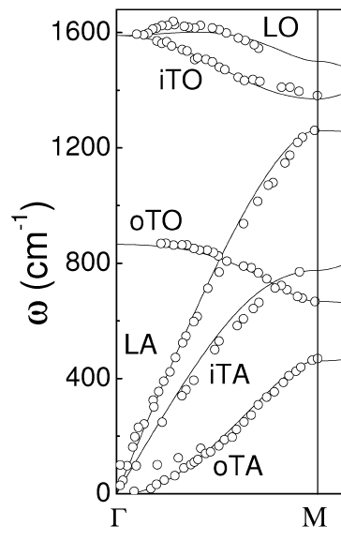


Phonons: Atomic Lattice Vibrations
Graphene Phonons [100]
CO₂ molecule
vibrations
200 meV
160 meV
transverse
small k
Frequency ω (cm⁻¹)
100 meV
transverse
max k=2π/a
~63 meV
Si optical
phonons
26 meV =
300 K
k
Phonons = quantized atomic lattice vibrations ~ elastic waves
Transverse (u ⊥ k) vs. longitudinal modes (u || k), acoustic vs. optical
“Hot phonons” = highly occupied modes above room temperature

Slide 5
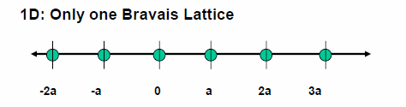
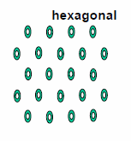
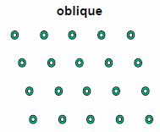
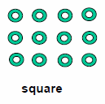


A Few Lattice Types
Point lattice (Bravais)
  1D
  2D
  3D

Slide 6
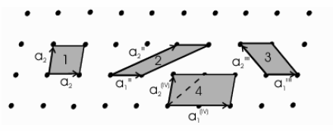

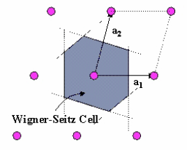
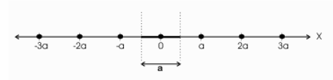
Primitive Cell and Lattice Vectors
Lattice = regular array of points {R_{l}} in space repeatable by translation through primitive lattice vectors
The vectors a_{i} are all primitive lattice vectors
Primitive cell: Wigner-Seitz

Slide 7
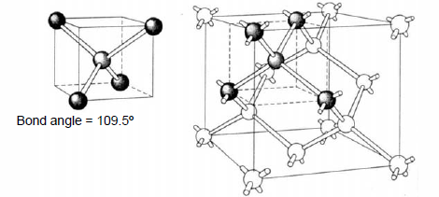
Silicon (Diamond) Lattice
Tetrahedral bond arrangement
2-atom basis
Each atom has 4 nearest neighbors and 12 next-nearest neighbors
What about in (Fourier-transformed) k-space?

Slide 8
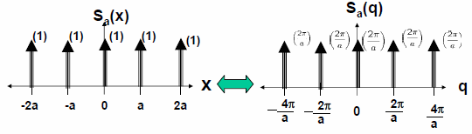
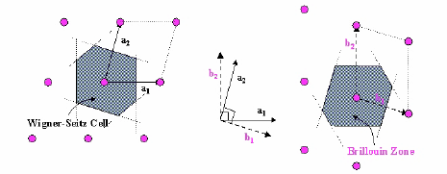
Position → Momentum (k-) Space
S_{a}(k)
k
The Fourier transform in k-space is also a lattice
This reciprocal lattice has a lattice constant 2π/a

Slide 9
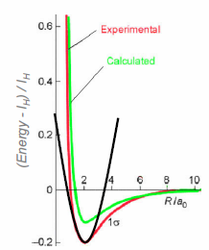


Atomic Potentials and Vibrations
Within small perturbations from their equilibrium positions, atomic potentials are nearly quadratic
Can think of them (simplistically) as masses connected by springs!

Slide 10
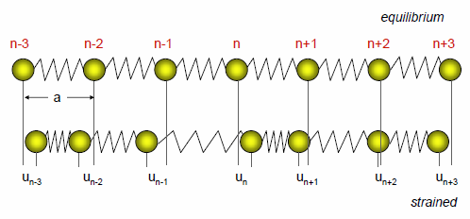
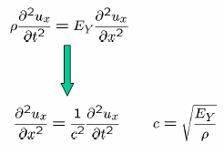
Vibrations in a Discrete 1D Lattice
Can write down wave equation
Velocity of sound (vibration propagation) is proportional to stiffness and inversely to mass (inertia)
See C. Kittel, Ch. 4
or G. Chen Ch. 3

Slide 11
Two Atoms per Unit Cell
Lattice Constant, a
Optical
Vibrational
Modes
y_{n-1}
x_{n}
y_{n}
x_{n+1}
LO
TO
Frequency, ω
LA
TA
0
Wave vector, K
π/a

Slide 12
Energy Stored in These Vibrations
Heat capacity of an atomic lattice
C = du/dT =
Classically, recall C = 3Nk, but only at high temperature
At low temperature, experimentally C → 0
Einstein model (1907)
  All oscillators at same, identical frequency (ω = ω_{E})
Debye model (1912)
  Oscillators have linear frequency distribution (ω = v_{s}k)

Slide 13
The Einstein Model
All N oscillators same frequency
Density of states in ω (energy/freq) is a delta function
Einstein specific heat
Frequency, ω
0
Wave vector, k
2π/a

Slide 14
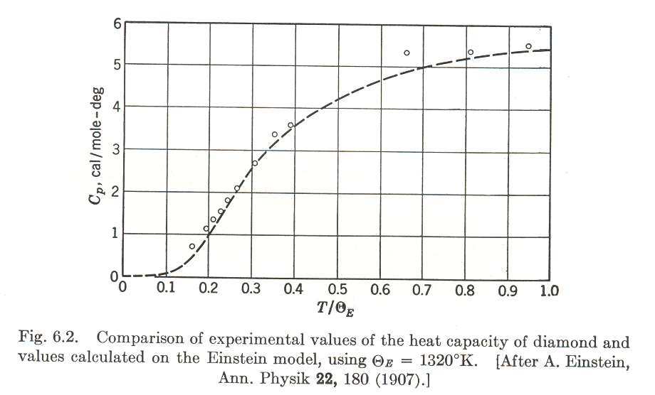
Einstein Low-T and High-T Behavior
High-T (correct, recover Dulong-Petit):
Low-T (incorrect, drops too fast)
Einstein model
OK for optical phonon
heat capacity

Slide 15
The Debye Model
Linear (no) dispersion
with frequency cutoff
Density of states in 3D:
(for one polarization, e.g. LA)
(also assumed isotropic solid, same v_{s} in 3D)
N acoustic phonon modes up to ω_{D}
Or, in terms of Debye temperature
Frequency, ω
0
Wave vector, k
2π/a
k_{D} roughly corresponds to
max lattice wave vector (2π/a)
ω_{D} roughly corresponds to
max acoustic phonon frequency

Slide 16
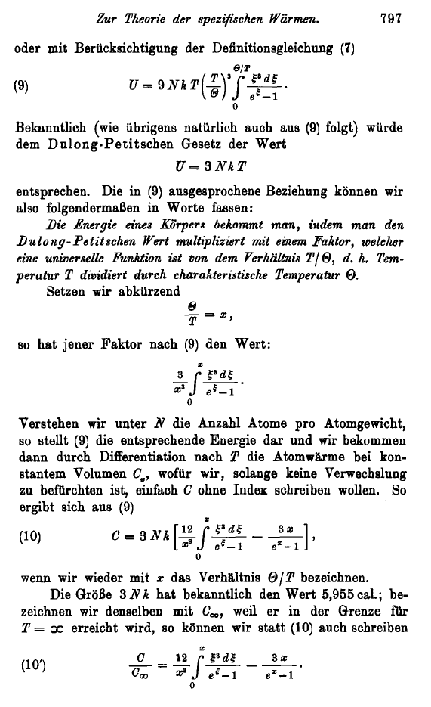
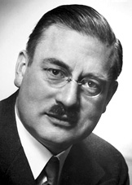
Annalen der Physik 39(4)
p. 789 (1912)
Peter Debye (1884-1966)

Slide 17
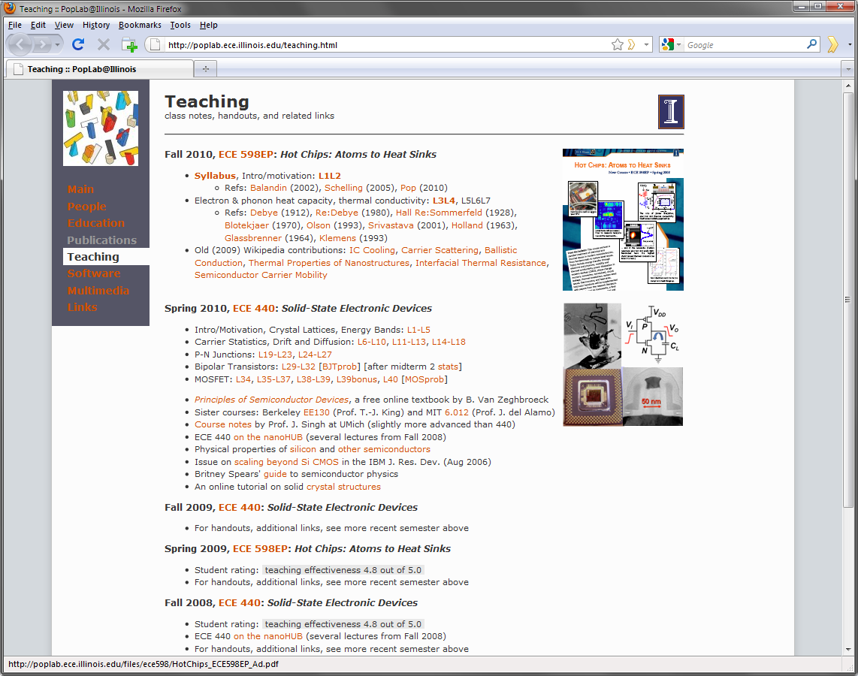
Website Reminder

Slide 18
The Debye Integral
Total energy
Multiply by 3 if assuming all polarizations identical (one LA, and 2 TA)
Or treat each one separately with its own (v_{s},ω_{D}) and add them all up
C = du/dT
Frequency, ω
0
Wave vector, k
2π/a
people like to write:
(note, includes 3x)

Slide 19
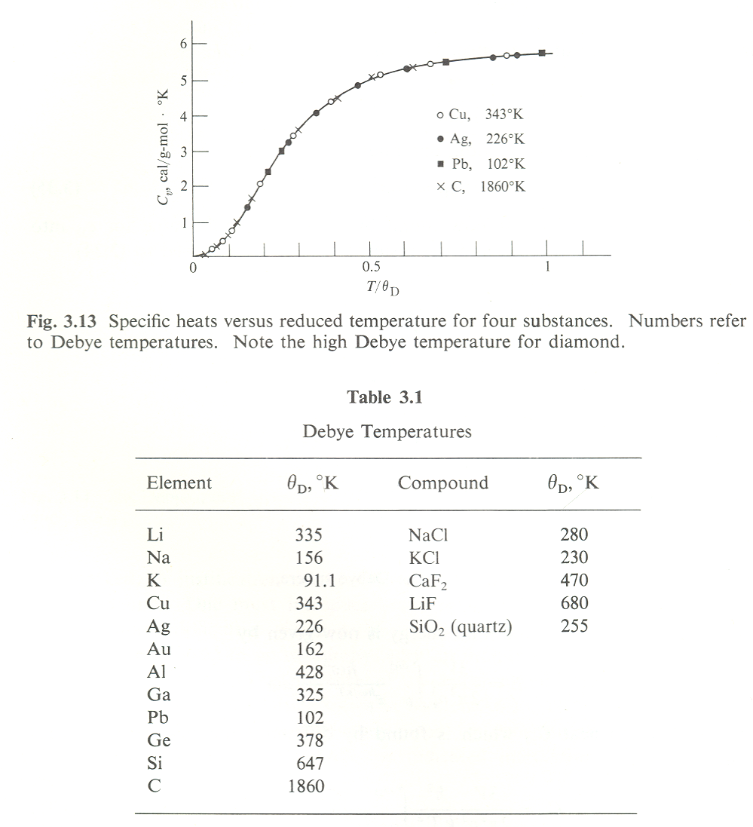
Debye Model at Low- and High-T
At low-T (< θ_{D}/10):
At high-T: (> 0.8 θ_{D})
“Universal” behavior for all solids
In practice: θ_{D} ~ fitting parameter to heat capacity data
θ_{D} is related to “stiffness” of solid as expected

Slide 20
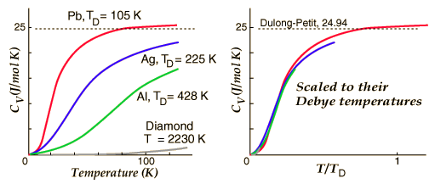
Experimental Specific Heat
3Νk_{B}T
Diamond
Each atom has
a thermal energy
of 3K_{B}T
Specific Heat (J/m³-K)
C ∝ T³
Classical
Regime
Temperature (K)
In general, when T << θ_{D}

Slide 21
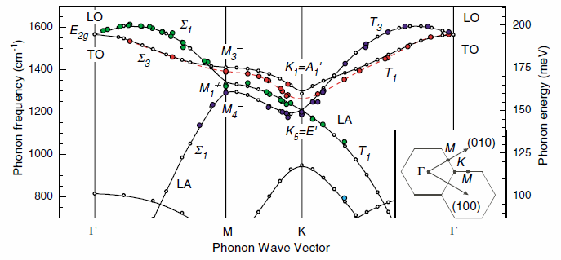
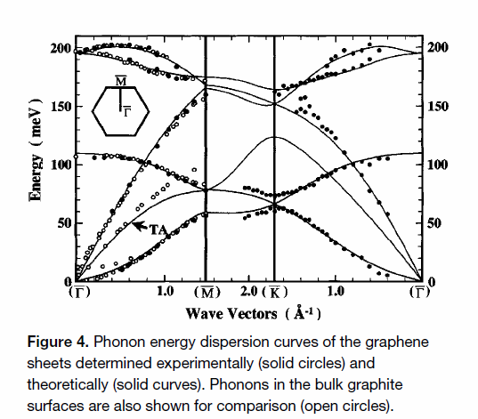
Phonon Dispersion in Graphene
Maultzsch et al., Phys. Rev. Lett. 92, 075501 (2004)
Optical
Phonons
Yanagisawa et al.,
Surf. Interf. Analysis
37, 133 (2005)

Slide 22
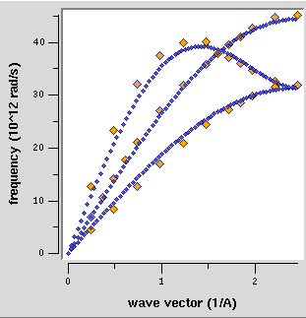
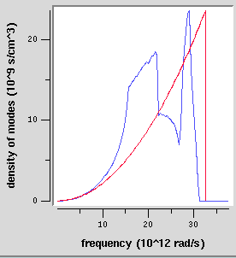
Heat Capacity and Phonon Dispersion
Debye model is just a simple, elastic, isotropic approximation; be careful when you apply it
To be “right” one has to integrate over phonon dispersion ω(k), along all crystal directions
See, e.g. http://www.physics.cornell.edu/sss/debye/debye.html

Slide 23
Thermal Conductivity of Solids
thermal conductivity spans ~10⁵x
(electrical conductivity spans >10²⁰x)
how do we explain the variation?

Slide 24
Kinetic Theory of Energy Transport
u(z+_{z})
Net Energy Flux / # of Molecules
z + _{z}
q_{z}
θ
λ
z
through Taylor expansion of u
u(z-_{z})
z - _{z}
Integration over all the solid angles → total energy flux
Thermal conductivity:

Slide 25
Simple Kinetic Theory Assumptions
Valid for particles (“beans” or “mosquitoes”)
  Cannot handle wave effects (interference, diffraction, tunneling)
Based on BTE and RTA
Assumes local thermodynamic equilibrium: u = u(T)
Breaks down when L ~ _______ and t ~ _________
Assumes single particle velocity and mean free path
  But we can write it a bit more carefully:

Slide 26
Phonon MFP and Scattering Time
Group velocity only depends on dispersion ω(k)
Phonon scattering mechanisms
  Boundary scattering
  Defect and dislocation scattering
  Phonon-phonon scattering

Slide 27
Temperature Dependence of Phonon K_{TH}
 | C | λ | κ
low T | ∝ T^{d} | n_{ph} → 0, so λ → ∞, but then λ → D (size) | ∝ T^{d}
high T | 3Nk_{B} | ∝ 1/T | ∝ 1/T

Slide 28
Ex: Silicon Film Thermal Conductivity

Slide 29
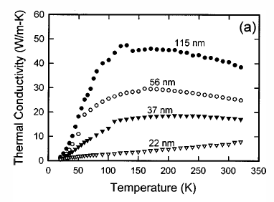
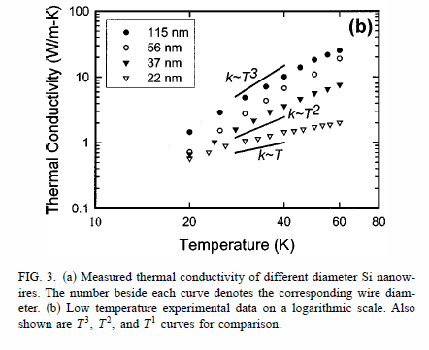
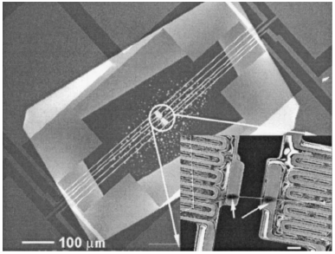
Ex: Silicon Nanowire Thermal Conductivity
Nanowire diameter
Recall, undoped bulk crystalline silicon k ~ 150 W/m/K (previous slide)
Li, Appl. Phys. Lett. 83, 2934 (2003)

Slide 30
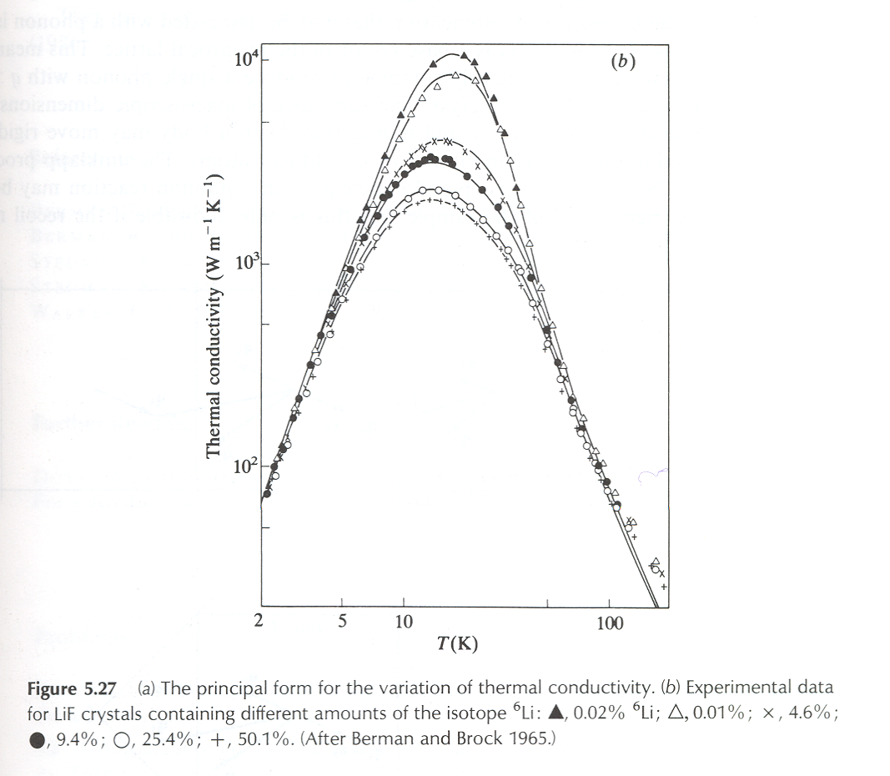
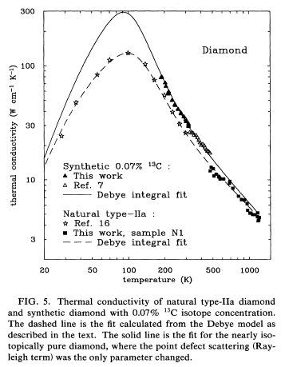
Ex: Isotope Scattering
isotope
~impurity
~T³
~1/T

Slide 31
Why the Variation in K_{th}?
A: Phonon λ(ω) and dimensionality (D.O.S.)
Do C and v change in nanostructures? (1D or 2D)
Several mechanisms contribute to scattering
  Impurity mass-difference scattering
  Boundary & grain boundary scattering
  Phonon-phonon scattering

Slide 32
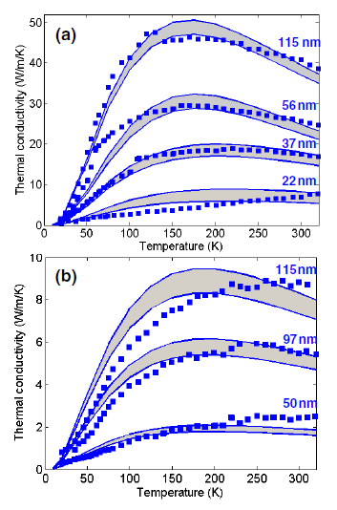
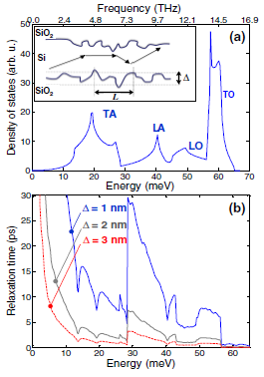
Surface Roughness Scattering in NWs
What if you have really rough nanowires?
Surface roughness Δ ~ several nm!
Thermal conductivity scales as ~ (D/Δ)2
Can be as low as that of a-SiO₂ (!) for very rough Si nanowires
smooth Δ=1-3 Å
rough Δ=3-3.25 nm

Slide 33
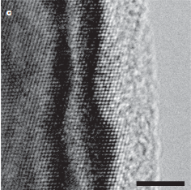
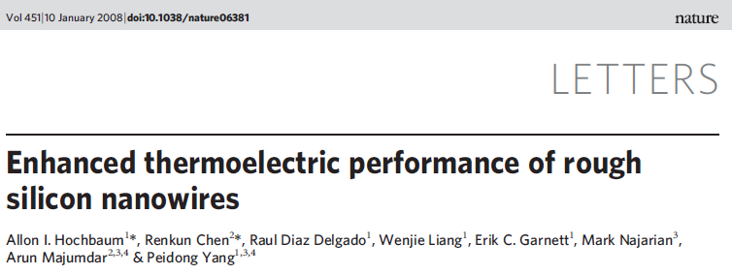
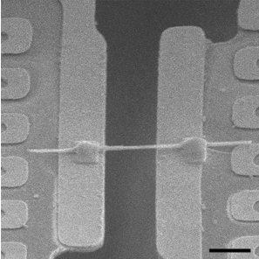
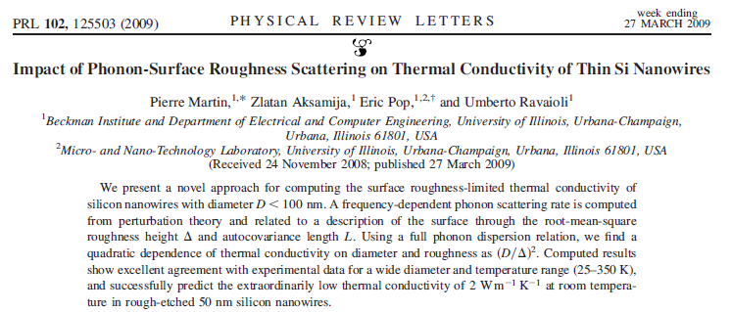
Data and Model From…
Data…
Model…
(Hot Chips
class project)

Slide 34
What About Electron Thermal Conductivity?
Recall electron heat capacity
Electron thermal conductivity
at most T
in 3D
Mean scattering time:
τ_{e} = _______
Electron Scattering Mechanisms
Defect or impurity scattering
Phonon scattering
Boundary scattering (film thickness, grain boundary)

Slide 35
Ex: Thermal Conductivity of Cu and Al
Electrons dominate k in metals
Matthiessen Rule:

Slide 36
Wiedemann-Franz Law
where
recall electrical
conductivity
taking the ratio
Wiedemann & Franz (1853) empirically saw k_{e}/σ = const(T)
Lorenz (1872) noted k_{e}/σ proportional to T

Slide 37
Lorenz Number
Experimentally
 | L = κ/σT 10⁻⁸ WΩ/K²
Metal | 0 ° C | 100 °C
Cu | 2.23 | 2.33
Ag | 2.31 | 2.37
Au | 2.35 | 2.40
Zn | 2.31 | 2.33
Cd | 2.42 | 2.43
Mo | 2.61 | 2.79
Pb | 2.47 | 2.56
This is remarkable!
It is independent of n, m, and even τ !
Agreement with experiment is quite good, although L ~ 10x lower when T ~ 10 K… why?!

Slide 38
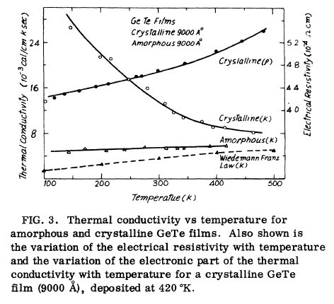
Amorphous Material Thermal Conductivity
a-SiO₂
GeTe
a-Si
Amorphous (semi)metals: both
electrons & phonons contribute
Amorphous dielectrics:
K saturates at high T (why?)

Slide 39
Summary
Phonons dominate heat conduction in dielectrics
Electrons dominate heat conduction in metals
(but not always! when not?!)
Generally, C = C_{e} + C_{p} and k = k_{e} + k_{p}
For C: remember T dependence in “d” dimensions
For k: remember system size, carrier λ’s (Matthiessen)
In metals, use WFL as rule of thumb

