Slide 1
Recap (so far)
Ohm’s & Fourier’s Laws
Mobility & Thermal Conductivity
Heat Capacity
Wiedemann-Franz Relationship
Size Effects and Breakdown of Classical Laws

Slide 2
Low-Dimensional & Boundary Effects
Energy Transport in Thin Films, Nanowires, Nanotubes
Landauer Transport
  Quantum of Electrical and Thermal Conductance
Electrical and Thermal Contacts
Materials Thermometry
Guest Lecture: Prof. David Cahill (MSE)

Slide 3


“Sub-Continuum” Energy Transport
Macroscale (D >> Λ)
Nanoscale (D < Λ)
Ox
Me
t_{si}
D
Size and Non-Equilibrium Effects
    optical-acoustic
    small heat source
    impurity scattering
    boundary scattering
    boundary resistance
Ox
Λ ~ 200 nm
Si
Si

Slide 4

Thermal Simulation Hierarchy
MFP ~ 200 nm at 300 K in Si
Continuum
Fourier’s Law, FE
D ~ Λ
lattice wave
D
Phonon Transport
BTE & Monte Carlo
defect
phonon
D ~ λ
Waves & Atoms
Wavelength
Waves & Atoms
MD & QMD

Slide 5
Thermal and Electrical Simulation
Atomistic
BTE with
Wave models
electrons
phonons
MFP
~5 nm
~100 nm
Sverdrup, Ju,
Goodson (2000)
BTE or
Monte Carlo
λ
~5 nm
~1 nm
Phonons
Lai, Majumdar
(1995)
much work
Wachutka
(1994)
Diffusion
Shur (1990)
Apanovich (1995)
Bloetekjaer (1970)
Baccarani (1985)
Rudan (1986)
Jacoboni (1983)
Fischetti (1988)
Winstead (2003)
Lundstrom
Datta (1995)
Stratton (1962)
Isothermal
Drift Diffusion
BTE
Moments
Monte Carlo
& BTE
Monte Carlo
with Quantum
Models
Full Quantum
Electrons

Slide 6
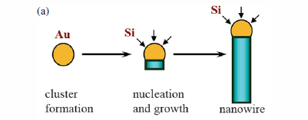
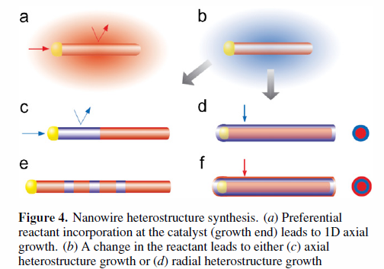
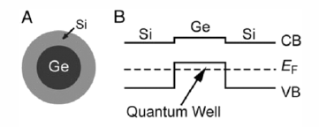
Nanowire Formation: “Bottom-Up”
Vapor-Liquid-Solid (VLS) growth
Need gas reactant as Si source (e.g. silane, SiH₄)
Generated through
  Chemical vapor deposition (CVD)
  Laser ablation or MBE (solid target)
Lu & Lieber, J. Phys. D (2006)

Slide 7
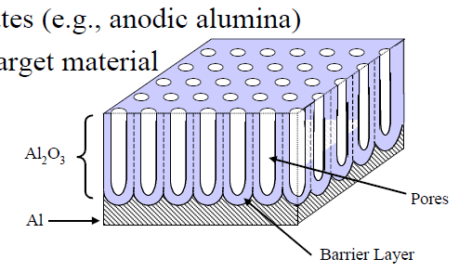
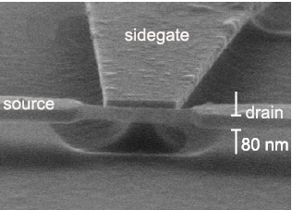
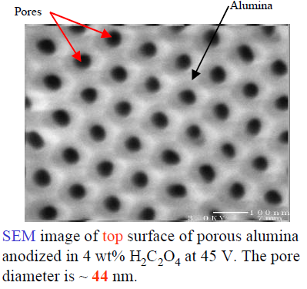
“Top-Down” and Templated Nanowires
Suspended nanowire (Tilke ‘03)
“Top-down” = through conventional lithography
“Guided” growth = through porous templates (anodic Al₂O₃)
  Vapor or electrochemical deposition

Slide 8
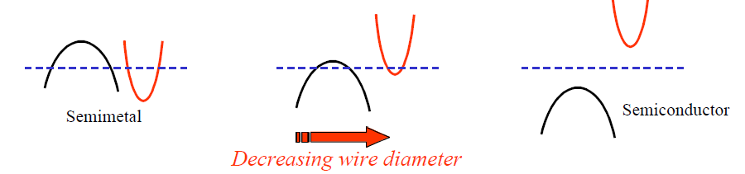
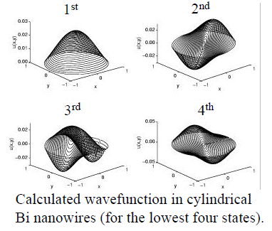
Semimetal-Semiconductor Transition
Bi (bismuth) has semimetal-semiconductor transition at wire D ~ 50 nm due to quantum confinement effects
Source: M. Dresselhaus (MIT)

Slide 9
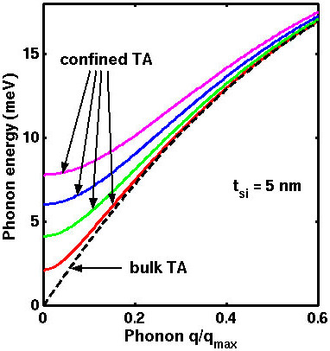
When to Worry About Confinement
2-D Electrons
2-D Phonons
d
d

Slide 10
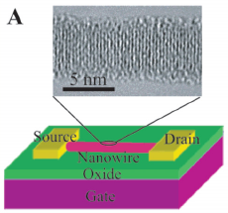
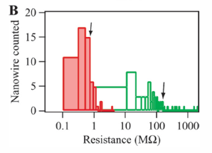
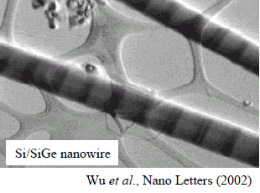
Nanowire Applications
Transistors
Interconnects
Thermoelectrics
Heterostructures
Single-electron devices

Slide 11
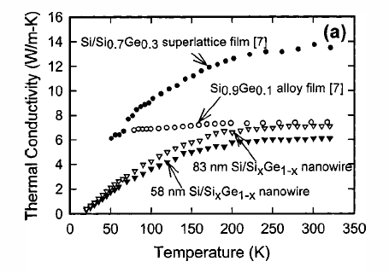
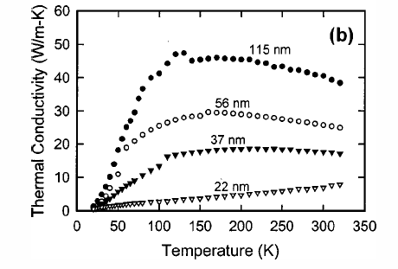
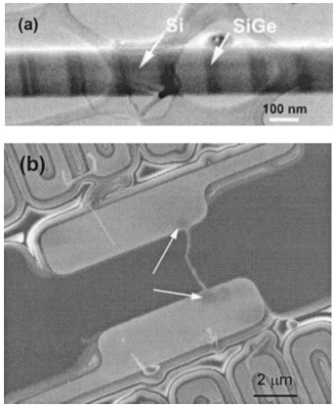
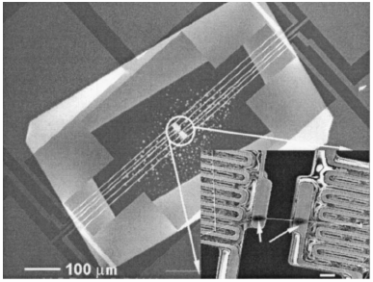
Nanowire Thermal Conductivity
Nanowire diameter
Li, Appl. Phys. Lett. 83, 3187 (2003)

Slide 12
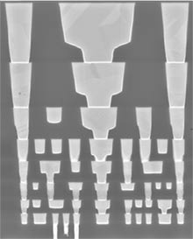
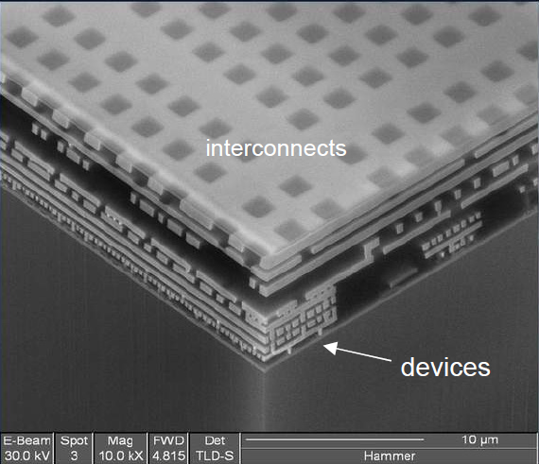
Interconnects = Top-Down Nanowires
Intel 65 nm
SEM of AMD’s “Hammer” microprocessor in 130 nm CMOS with 9 copper layers
Cross-section
8 metal levels + ILD
M1 pitch
Transistor

Slide 13
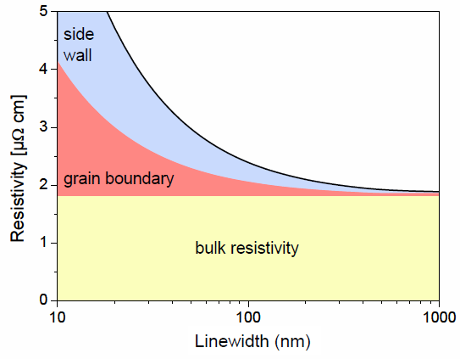
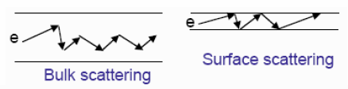
Cu Resistivity Increase <100 nm Lines
Size Matters
Why?
Remember Matthiessen’s Rule

Slide 14
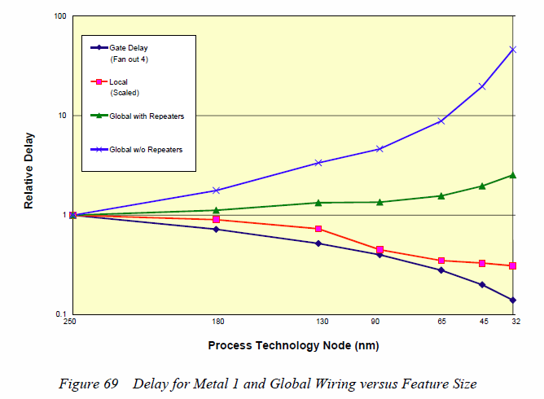
Cu Interconnect Delays Increase Too
Source: ITRS http://www.itrs.net

Slide 15
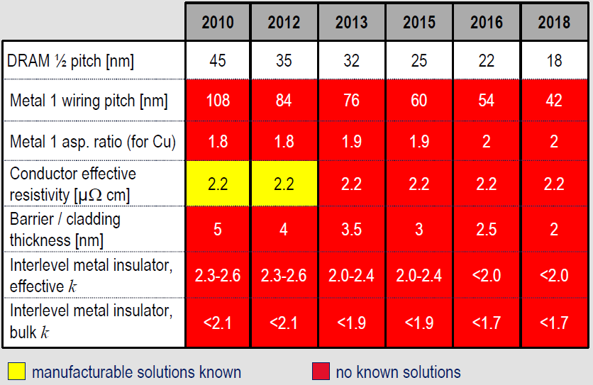
Industry Acknowledged Challenges
Source: ITRS http://www.itrs.net

Slide 16
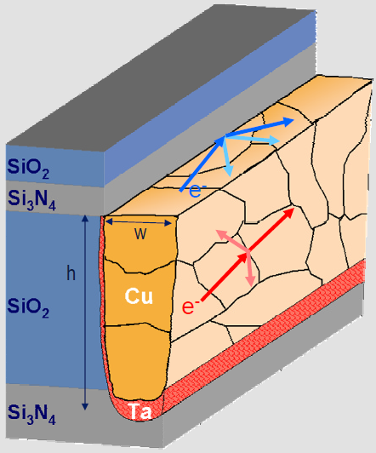
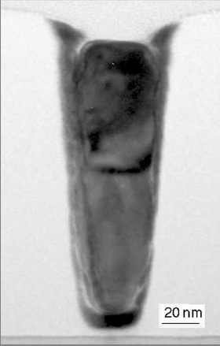
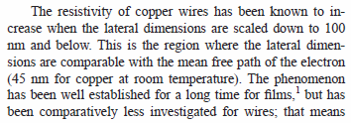
Cu Resistivity and Line Width
Steinhögl et al., Phys. Rev. B66 (2002)

Slide 17
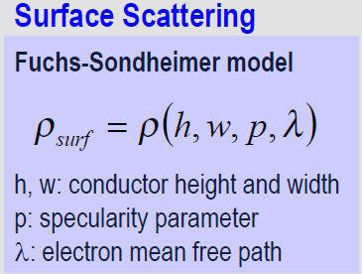
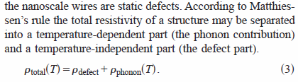
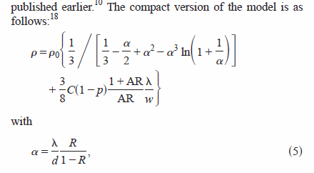
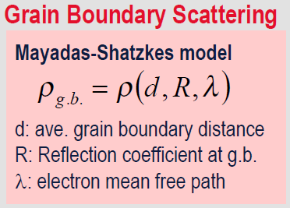
Modeling Cu Line Resistivity
Steinhögl et al., Phys. Rev. B66 (2002)

Slide 18
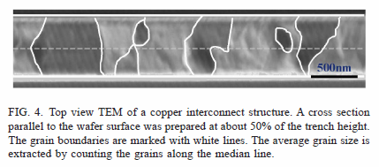
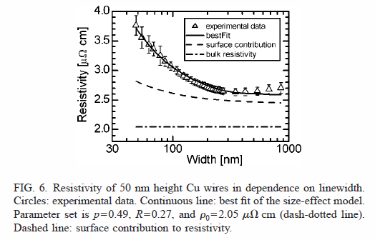
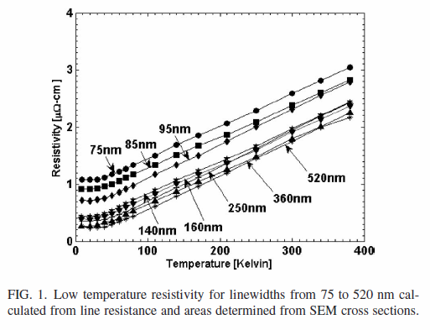
Model Applications
Steinhögl et al., Phys. Rev. B66 (2002)
Plombon et al., Appl. Phys. Lett 89 (2006)

Slide 19
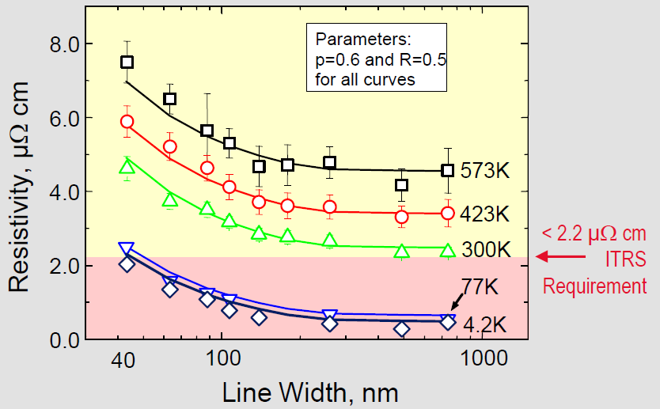
Resistivity Temperature Dependence

Slide 20
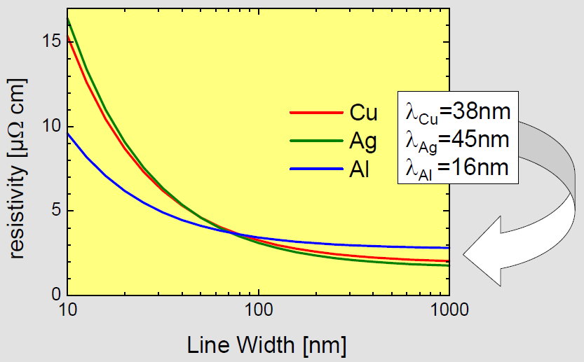
Other Material Resistivity and MFP
Greater MFP (λ) means greater impact of “size effects”
Will Aluminum get a second chance?!

Slide 21
Same Effect for Thermal Conductivity!
Recall:
bulk Si k_{th} ~ 150 W/m/K
bulk Ge k_{th} ~ 60 W/m/K
Approximate bulk MFP’s:
λ_{Si} ~ 100 nm
λ_{Ge} ~ 60 nm
(at room temperature)
Material with longer (bulk, phonon-limited) MFP λ → suffers a stronger % decrease in conductivity in thin films or nanowires (when d ≤ λ)
Nanowire (NW) data by Li (2003), model Pop (2004)

Slide 22
Back-of-Envelope Estimates
 | C (MJm⁻³K⁻¹) | λ_{b} (nm) | v_{L} (m/s) | v_{T} (m/s) | k_{b} (Wm⁻¹K⁻¹)
Si | 1.66 | ~100 | 9000 | 5330 | 150
Ge | 1.73 | ~60 | 5000 | 3550 | 60
(at room temperature)

Slide 23

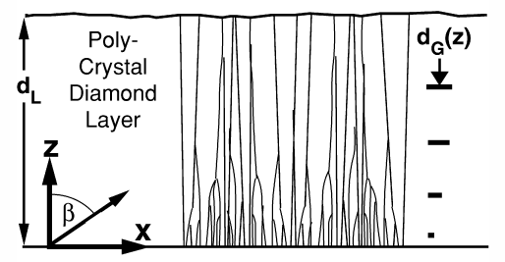
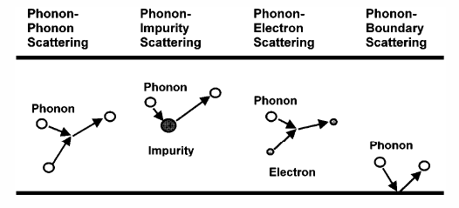

More Sophisticated Analytic Models
δ = d/λ < 1
S = (1 – δ²)^{1/2}
Flik and Tien, J. Heat Transfer (1990)
Goodson, Annu. Rev. Mater. Sci. (1999)

Slide 24
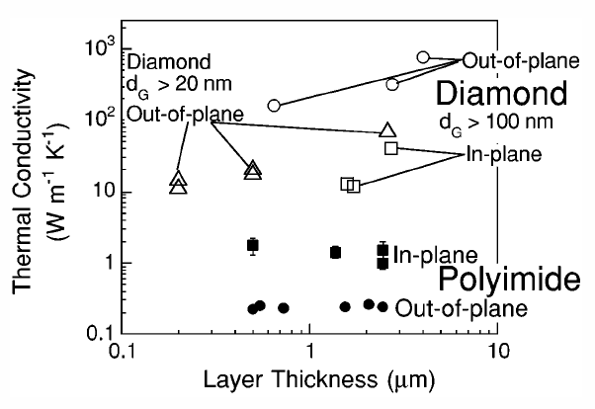
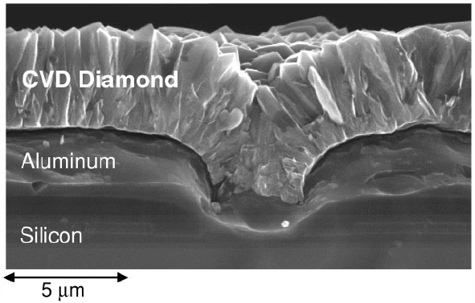
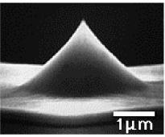
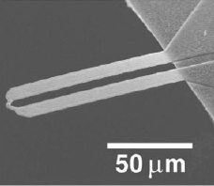
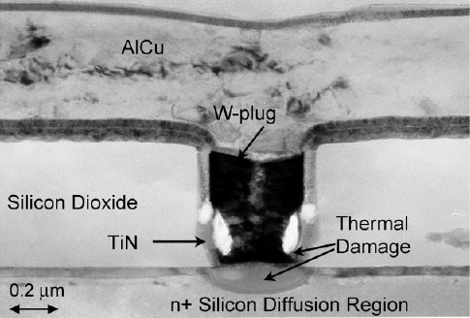
A Few Other Scenarios
anisotropy
Goodson, Annu. Rev. Mater. Sci. (1999)

Slide 25
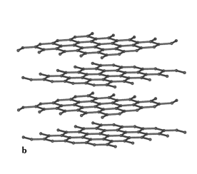
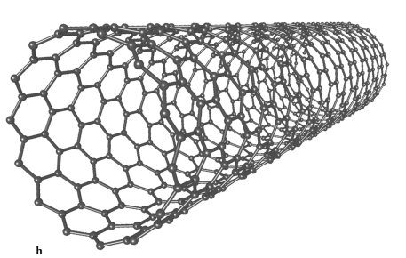
Onto Nanotubes…
Nanowires:
  “Shrunk-down” 3D cylinders of a larger solid (large surface area to volume ratio)
  Diameter d typically < {electron, phonon} bulk MFP Λ: surface roughness and grain boundary scattering important
  Quantum confinement does not play a role unless d < {electron, phonon} wavelength λ ~ 1-5 nm (rarely!)
Nanotubes:
  “Rolled-up” sheets of a 2D atomic plane
  There is “no” volume, everything is a surface*
  Diameter 1-3 nm (single-wall) comparable to wavelength λ so nanotubes do have 1D characteristics
b
* people usually define “thickness” b ~ 0.34 nm

Slide 26


Single-Wall Carbon Nanotubes
Carbon nanotube = rolled up graphene sheet
Great electrical properties
  Semiconducting → Transistors
  Metallic → Interconnects
  Electrical Conductivity σ ≈ 100 x σ_{Cu}
  Thermal Conductivity k ≈ k_{diamond} ≈ 5 x k_{Cu}
d ~ 1-3 nm
Nanotube challenges:
  Reproducible growth
  Control of electrical and thermal properties
  Going “from one to a billion”
HfO₂
top gate (Al)
CNT
S (Pd)
D (Pd)
SiO₂

Slide 27
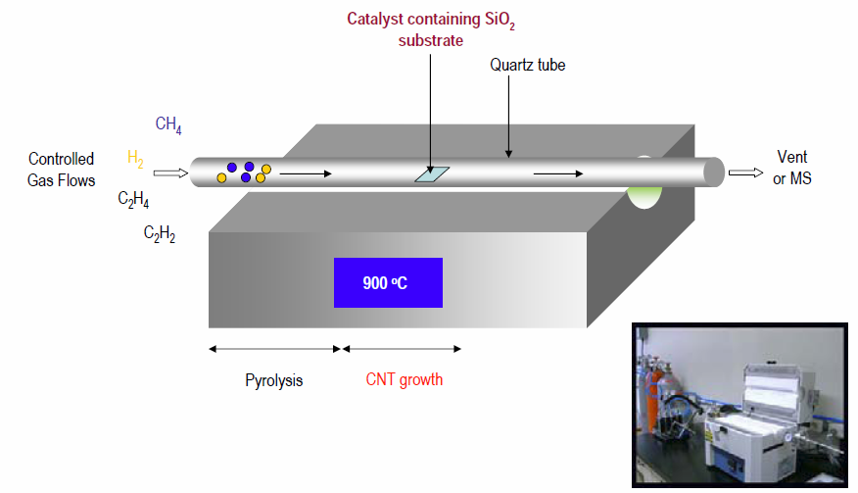
CVD Growth at ~900 ºC

Slide 28
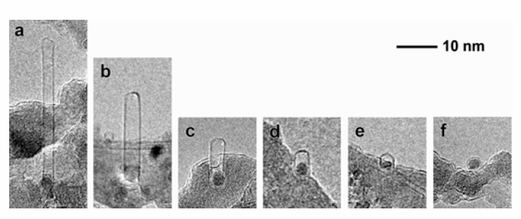

Fe Nanoparticle-Assisted Nanotube Growth
Particle size corresponds to nanotube diameter
Catalytic particles (“active end”) remain stuck to substrate
The other end is dome-closed
Base growth

Slide 29
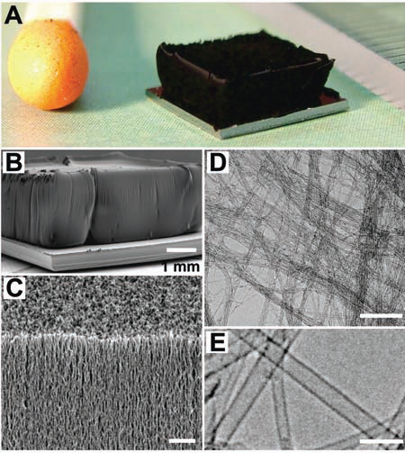
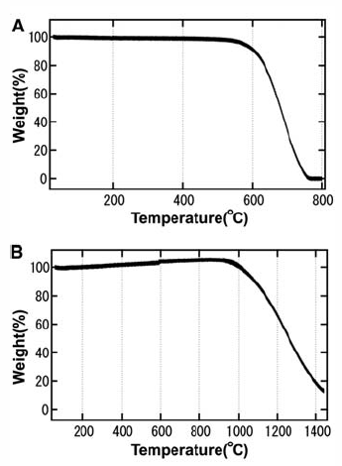
Water-Assisted CVD and Breakdown
People can also grow “macroscopic” nanotube-based structures
Nanotubes break down at ~600 ºC in O₂, 1000 ºC in N₂
in O₂
in N₂
Hata et al., Science (2004)

Slide 30
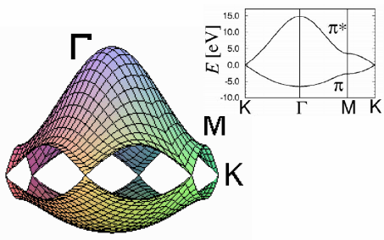
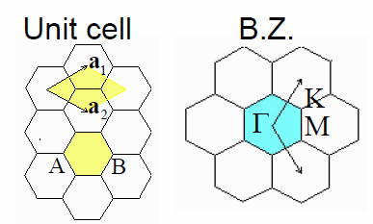
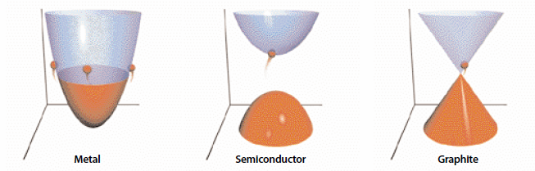
Graphite Electronic Structure
b ~ 3.4 Å
a_{cc} ~ 1.42 Å
|a₁| = |a₂| = √3a_{cc}
http://www.photon.t.u-tokyo.ac.jp/~maruyama/kataura/discussions.html

Slide 31


Nanotube Electronic Structure
E_{G} = 0
E_{G} > 0
Collins and Avouris, Scientific American (2000)
E_{G} = 0
E_{G} > 0

Slide 32


Band Gap Variation with Diameter
Red: metallic
Black: semiconducting
Charlier, Rev. Mod. Phys. (2007)
E_{11,M}
E_{22,M}
E_{22,S}
E_{11,M}
E_{11,S} = E_{G}
≈ 0.8/d
“Kataura plot”
http://www.photon.t.u-tokyo.ac.jp/~maruyama/kataura/kataura.html

Slide 33


Nanotube Current Density ~ 10⁹ A/cm²
Nanotubes are nearly ballistic conductors up to room temperature
Electron mean free path ~ 100-1000 nm
CNT
S (Pd)
D (Pd)
L = 60 nm
V_{DS} = 1 mV
SiO₂
G (Si)
Javey et al., Phys. Rev. Lett. (2004)

Slide 34

Transport in Suspended Nanotubes
E. Pop et al., Phys. Rev. Lett. 95, 155505 (2005)
nanotube on substrate
2 μm
suspended over trench
nanotube
Pt
Pt gate
Si₃N₄
SiO₂
Observation: significant current degradation and negative differential conductance at high bias in suspended tubes
Question: Why? Answer: Tube gets HOT (how?)

Slide 35
Transport Model Including Hot Phonons
I²(R-R_{c})
E. Pop et al., Phys. Rev. Lett. 95, 155505 (2005)
T_{OP}
Non-equilibrium OP:
R_{OP}
T_{AC} = T_{L}
Heat transfer via AC:
R_{TH}
T₀
I²(R-R_{C})
oxidation T
T_{OP}
Landauer electrical resistance
T_{AC} = T_{L}
Optical T_{OP}
Include OP absorption:
Acoustic T_{AC}

Slide 36
Extracting SWNT Thermal Conductivity
E. Pop et al., Nano Letters 6, 96 (2006)
Yu et al. (NL’05)
This work
~1/T
~T
Ask the “inverse” question: Can I extract thermal properties from electrical data?
Numerical extraction of k from the high bias (V > 0.3 V) tail of I-V data
Compare to data from 100-300 K of UT Austin group (C. Yu, NL Sep’05)
Result: first “complete” picture of SWNT thermal conductivity from 100 – 800 K

